Slide 1
Exploring changes in routine Rheumatology practice from COVID-19
Professor Philip Conaghan
Director, Leeds Institute of Rheumatic and Musculoskeletal Medicine, University of Leeds
Dr Chris Holroyd
Consultant Rheumatologist, University Hospital Southampton Foundation Trust
This was a non-promotional industry educational session organised and funded by Bristol-Myers Squibb
This presentation is intended for Healthcare Professionals only
This was presented at the British Society for Rheumatology annual congress in 2022
IMM-GB-2300263 Date of Prep June 2023

Slide 2
Professor Philip Conaghan has done consultancies or speakers bureaus for AbbVie, Amgen, BMS, Eli-Lilly, Galapagos, GSK, Merck, Novartis, Pfizer, Regeneron and UCB Dr Chris Holroyd has received honorariums or sat on advisory boards for Abbvie, BMS, Celltrion, Chugai, Galapagos/Gilead, Lilly, Napp, Novartis, Pfizer and UCB
Speaker Disclosures

Slide 3
Agenda
Professor Philip Conaghan: Introduction: Exploring lessons from COVID-19
Professor Philip Conaghan: The necessary shift of care
Pros and cons of remote care
The future of care delivery
Dr Chris Holroyd: Medication considerations
Patient risk factors for infection
Understanding the impact of immunosuppressants
Reducing the risk of infection
Dr Chris Holroyd: Summary and Close

Slide 4
The impact of COVID on clinical practice
Increase in telemedicine & remote tools¹
Medication which can be used, administered and monitored outside hospital favoured¹
Large reduction in patient interactions¹
Half of physicians worry that patients will not receive timely care¹
Re-prioritization of treatment guidelines – towards out of hospital administration ²
Changes dosing, route of administration and mode of action needed for some patients²
Cohen O, Fox B. et.al. McKinsey & company. COVID-19 and commercial pharma: Navigating an uneven recovery. 2020
National Institute for Health and Care Excellence. COVID-19 rapid guideline: rheumatological autoimmune, inflammatory and metabolic bone disorders (NG167). 2020.

Slide 5
Professor Philip Conaghan Director, Leeds Institute of Rheumatic and Musculoskeletal Medicine, University of Leeds
The Necessary Shift of Care

Slide 6
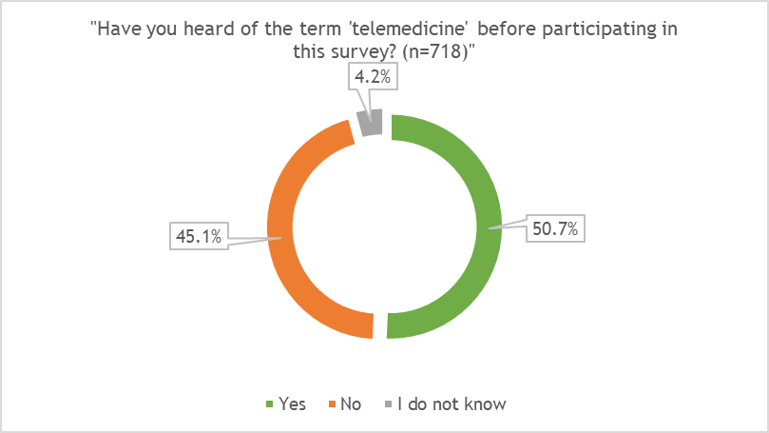
What is telemedicine?
The outbreak of COVID-19 forced an urgent and necessary shift towards telemedicine, which is defined as:
“The practice of medicine over a distance, in which interventions, diagnoses, therapeutic decisions, and subsequent treatment recommendations are based on patient data, documents and other information transmitted through telecommunication systems”³
Opportunities and Barriers of Telemedicine in Rheumatology: A Participatory, Mixed-Methods Study 2021
From November 2017 to December 2019, a participatory, mixed-methods study was conducted, consisting of (1) expert interviews (n = 27) with RMD patients and professional stakeholders, (2) a national paper-based patient survey (n = 766), and (3) focus groups (n = 2) with patient representatives and rheumatologists.⁴
Figures adapted from:⁴ Muehlensiepen F, et al. Int J Environ Res Public Health. 2021 Dec 13;18(24):13127

Slide 7
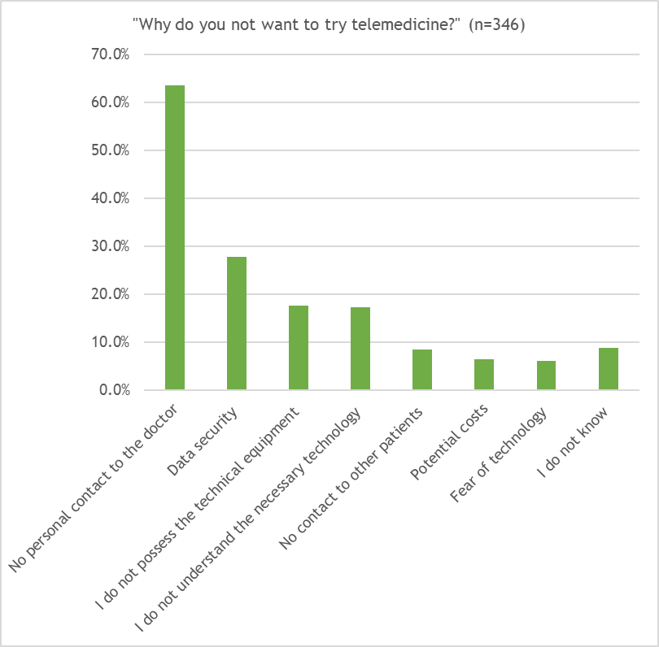
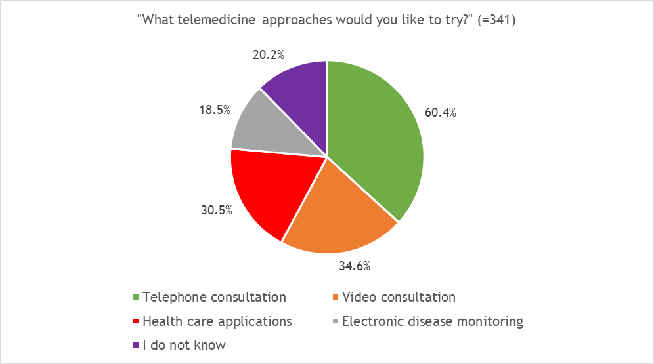
Opportunities and Barriers of Telemedicine in Rheumatology: Pre-COVID view
From November 2017 to December 2019, a participatory, mixed-methods study was conducted, consisting of (1) expert interviews (n = 27) with RMD patients and professional stakeholders, (2) a national paper-based patient survey (n = 766), and (3) focus groups (n = 2) with patient representatives and rheumatologists.⁴
Figures adapted from:⁴ Muehlensiepen F, et al. Int J Environ Res Public Health. 2021 Dec 13;18(24):13127
Notes:
From November 2017 to December 2019, a participatory, mixed-methods study was conducted, consisting of (1) expert interviews (n = 27) with RMD patients and professional stakeholders, (2) a national paper-based patient survey (n = 766), and (3) focus groups (n = 2) with patient representatives and rheumatologists.³
Patients equate personal contact with physical face-to-face contact, which could be reduced by implementing telemedicine, thus negatively influencing the patient–doctor relationship ³
The main barriers reported by stakeholders were the scarcity of time resources in RMD care, the absence of physical examinations, and organizational challenges associated with the implementation of telemedicine in RMD care ³

Slide 8
Patient view
Opportunities
Challenges
Patients supported telemedicine as an addition to physical consultations if the physician and patient are already acquainted with each other ⁴
Many patients found telemedicine to be as effective or more effective as in person visits ^{5,6}
Reduced waiting times with personalised and constant follow up ^{7,8,9}
Patients expected telemedicine to contribute to quick medical assessment in case of symptom changes ⁴
More convenient for patients & reduction of health costs, especially transport ^{9,10,11}
Quicker communication and better access to clinicians ¹²
There is a patient preference for in-person services for for more complex examinations such as joint counts ⁶
Patients perceived the loss of personal physical contact to physicians as the main barrier of telemedicine ⁴
Patients also reported data security, lack of technical equipment and knowledge as barriers of telemedicine implementation ⁴
Non-verbal communication is lost ⁹
Listening can be worse with telemedicine, appointments can feel rushed, and ‘tick list’ mentality ⁹
Patients expected deterioration of the patient-doctor relationship due to telemedicine ⁴
Lack of access to the digital network and internet ⁷
Notes:
All refs except 3 are post covid

Slide 9
Patients’ satisfaction with telemedicine
Adapted from:¹³ Piga M, et al. Rheumatology. 2021 Aug 5:keab632. Epub ahead of print.

Slide 10
Healthcare professional view
Opportunities
Challenges
Good for established patients ^{7,11,14}
Patients with greater need (more comorbidities and higher disease activity) are more likely to use telemedicine or consultations ¹¹
More than half of virtual consultations were resolved without face-to-face assessment, with a diagnosis being established in almost 90% in one study ¹⁵
Good if adjunct to treatment rather than replacement or if alternating with face-to-face visits ^{5,16}
Patients and staff are protected from infection risk ¹²
Rheumatologists perceived telemedicine as additional safety and support for close monitoring and to provide patients with the best possible care ⁴
Increased sense of clinician well being ¹⁶
The absence of physical examination is the main disadvantage of telemedicine in rheumatology care ^{4,7}
Data security, legal problems and reimbursement method are additional limitations which remain to be solved ⁸
Not appropriate for some patient groups such as the elderly, those with learning difficulties and where English is not the first language ^{10,16}
Telemedicine is more difficult for new patients as well as complex cases and those requiring emergency care ^{9,10}
Limited distribution of technology ^{7,10,17}

Slide 11
Reliability of remote consultations
Adapted from:¹³ Piga M, et al. Rheumatology. 2021 Aug 5:keab632. Epub ahead of print.
106 Tightly followed-up adult patients with RA, PsA, AS or SLE took part in a video consultation during COVID19 lockdown and repeated the same rheumatology evaluations through a face-to-face visit within 2 weeks ¹³
Face-to-face visits confirmed the remotely delivered treatment decisions in 89 out of the 106
patients ¹³
Notes:
Face-to-face visits confirmed the remotely delivered
treatment decisions in 89 out of the 106 patients
(84.0%) (Fig. 1). Virtual consultations showed 94.1%
(95% CI: 71.3%, 99.9%) sensitivity and 96.7% specificity
(95% CI: 90.8%, 99.3%) in detecting the need for
adjusting treatment due to inadequate disease activity
control, using face-to-face visits as the gold standard

Slide 12
Patients vs. clinician's view
MD= Mean difference
Adapted from: Sloan, M., et al,. Rheumatology 2021;00:1–13.

Slide 13
Accessing the system
Opportunities
Challenges
Quicker communication with doctor/better access ^{4,10}
Reduced waiting times ⁷
Telemedicine could contribute to effective allocation of resources in rheumatology care (e.g., by replacing routine appointments) ⁴
Most patients have access to telemedicine. One study of rheumatologists (n = 2406) showed less than 20% of patients had no telemedicine access ¹⁸
Telemedicine could increase treatment continuity by enabling effective disease monitoring & tight control ⁴
McKinsey’s report predicted one in four people visiting outpatient clinics could be seen online, with a third of home visits carried out digitally ¹⁶
Where there is a clinical need for emergency appointments to be face-to-face (including medico-legal concerns) ⁹
Concerns that telemedicine would be overused as cost and time saving measure ⁹
Sometimes lack of appointment times which can be inconvenient ⁹
Rheumatologists believe telemedicine could tie up additional time resources that are already scarce in rheumatology ^{4,9}
Difficult for people who are socially or educationally disadvantaged and with no access to the internet ^{7,9,10}
Patients reported data security, lack of technical equipment and knowledge as barriers of telemedicine implementation ^{4,8}

Slide 14
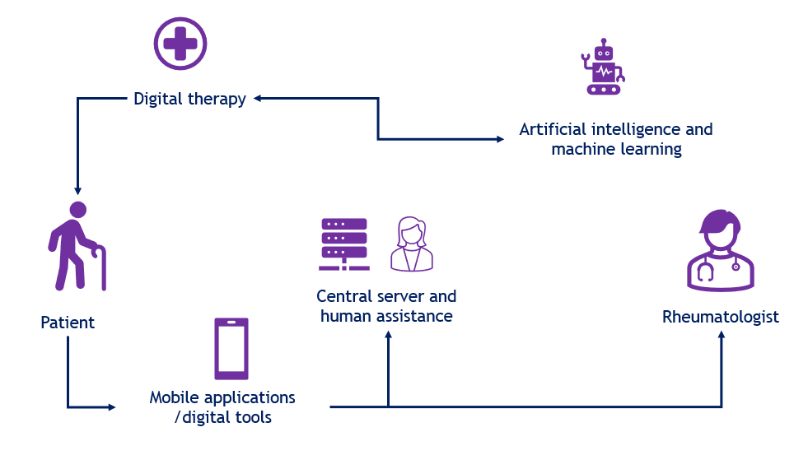
The shift towards hybrid care
Adapted from:⁸ Song Y, et al. Front Med. 2021 Oct 13;8:746219.

Slide 15
References
Cohen O, Fox B. et.al. McKinsey & company. COVID-19 and commercial pharma: Navigating an uneven recovery. 2020
National Institute for Health and Care Excellence. COVID-19 rapid guideline: rheumatological autoimmune, inflammatory and metabolic bone disorders (NG167). 2020.
World Medical Association. WMA Statement on the Ethics of Telemedicine. 2018. [Online]. Available from: https://www.wma.net/policiespost/wma-statement-on-the-ethics-of-telemedicine/ (accessed on 8 March 2022).
Muehlensiepen F, et al. Opportunities and Barriers of Telemedicine in Rheumatology: A Participatory, Mixed-Methods Study. Int J Environ Res Public Health. 2021 Dec 13;18(24):13127
Maheswaranathan M. et.al. ACR 2021 ABSTRACT NUMBER: 1913 Patient Perceptions of Telemedicine Use in Rheumatology Clinics During the COVID-19 Pandemic: An Analysis from the COVID-19 Global Rheumatology Alliance
Joshi M. et.al. ACR 2021 ABSTRACT NUMBER: 1597 Arthritis Patient Perspectives on Virtual Care for People Living with Arthritis During the COVID-19 Pandemic and for the Future
Bonfa E, et al. How COVID-19 is changing rheumatology clinical practice. Nature Reviews Rheumatology 17, 11–15 (2021).https://doi.org/10.1038/s41584-020-00527-5
Song Y, et al. The Challenges of Telemedicine in Rheumatology. Front Med. 2021 Oct 13;8:746219. doi: 10.3389/fmed.2021.746219
Sloan M, et al. Telemedicine in rheumatology: a mixed methods study exploring acceptability, preferences and experiences among patients and clinicians. Rheumatology. 2021 Oct 26:keab796. Epub ahead of print.
The Lancet Rheumatology. Telemedicine: is the new normal fit for purpose. Lancet Rheumatol. 2022 Jan;4(1):e1
Wipfler K et.al. ACR 2021 ABSTRACT NUMBER: 1962 Utilization of Telehealth Among Patients with Rheumatic Diseases in the Early Months of the COVID-19 Pandemic
Monaghesh E, Hajizadeh A. The role of telehealth during COVID-19 outbreak: a systematic review based on current evidence. BMC Public Health. 2020 Aug 1;20(1):1193. https://doi.org/10.1186/s12889-020-09301-4
Piga M, et al. Telemedicine in rheumatology: high specificity and sensitivity of follow-up virtual video consultations during COVID-19 pandemic. Rheumatology. 2021 Aug 5:keab632. Epub ahead of print.
Singh JA, et al. Management of Rheumatic Diseases During the COVID-19 Pandemic: A National Veterans Affairs Survey of Rheumatologists. Arthritis Care Res. 2021 Jul;73(7):998-1003
Garcia Hernandez I et.al. EULAR POS1480-HPR (2021) Implementation of telemedicine in Rheumatology: Virtual consultation as a too or direct communication with Primary Care.
Stokel-Walker C. Why Telemedicine is here to stay. British Medical Journal. 2020;371:m3603
Jhaveri D et.al. ACR 2021 ABSTRACT NUMBER: 1063 Use of Telemedicine for Rheumatology Practice in Queensland, Australia: Experiences Before and During the COVID-19 Pandemic
Bacalao M et.al. ACR 2021 ABSTRACT NUMBER: 0607 The Evolution of Rheumatologist’s Practice in Response to the COVID19 Pandemic

Slide 16
Dr Chris Holroyd Consultant Rheumatologist, University Hospital Southampton Foundation Trust
Medication Considerations

Slide 17
Introduction
Infections are a major concern in patients with RA and other inflammatory conditions and contribute to overall mortality
Advanced therapies are associated with a higher risk of infection
In recent years, due to the pandemic, the balance between drug efficacy and infection has become even more relevant
It is important to consider how to optimise patients care to minimise infection risks

Slide 18
RA and infection
Disturbance in innate and adaptive immune system
RA is a chronic disorder with immunological dysfunction
Higher risk of infection and associated mortality with RA found in observational studies since 1950s ¹
Prospective data from UK of 2108 unselected patients with inflammatory polyarthritis found a 2.5 increased risk of infection compared to the general population ²
Pneumococcal infection was found at 2.47 rate of hospitalised patients with RA compared to patients with non-immune mediated diseases ³
Neutrophil dysfunction:⁴
Neutropenia is more common in RA
Increased pathological immune complexes
Direct anti-neutrophil antibodies
Increased margination
T cell dysfunction:⁵
Reduced TCR repertoire
Reduced expansion of T cells to unknown antigens
Reduction of naïve T cells from thymus
Specific gene polymorphisms (TRAF1/C5 locus) ⁶
Notes:
1. Cobb S, Anderson F, Bauer W. Length of life and cause of death in rheumatoid arthritis. N Engl J Med. 1953 Oct 1;249(14):553-6
2. Franklin J, Lunt M, Bunn D, Symmons D, Silman A. Risk and predictors of infection leading to hospitalisation in a large primary-care-derived cohort of patients with inflammatory polyarthritis. Ann Rheum Dis. 2007 Mar;66(3):308-12
3. Wotton CJ, Goldacre MJ. Risk of invasive pneumococcal disease in people admitted to hospital with selected immune-mediated diseases: record linkage cohort analyses. J Epidemiol Community Health. 2012 Dec;66(12):1177-81
4. Starkebaum G. Chronic neutropenia associated with autoimmune disease. Semin Hematol. 2002 Apr;39(2):121-7
5. Koetz K, Bryl E, Spickschen K, O'Fallon WM, Goronzy JJ, Weyand CM. T cell homeostasis in patients with rheumatoid arthritis. Proc Natl Acad Sci U S A. 2000 Aug 1;97(16):9203-8
6. Plenge RM, Seielstad M, Padyukov L, et al. TRAF1-C5 as a risk locus for rheumatoid arthritis--a genome wide study. N Engl J Med. 2007;357(12):1199-1209. doi:10.1056/NEJMoa073491

Slide 19
Comorbidity, clinical status and lifestyle
Associated chronic lung diseases may include bronchiectasis and fibrotic lung disease ⁷
Smoking – pathogenesis as well as predictor for infection ^{8,9}
Cigarette smoke impairs innate defence mechanisms that are mediated by macrophages, epithelial cells, dendritic cells (DCs) and natural killer (NK) cells, thereby increasing the risk, severity and duration of infection ¹⁰
CORONNA database: Of 6246 patients, 2282 infections were reported followed over 7290 pt. years
Per 0.6 unit increase in DAS28 = 4% increase in risk of outpatient infections and 25% risk of requiring hospitalization ¹²
Risk of infection - confirmed in several studies including BSRBR-RA ¹³ and CORONNA ¹⁴
Risk of Serious Infection According to Age
DMARD | Anti-TNF
Age band, years | Follow up, pyrs | Infections (n) | Events / 100pyrs (95% CI) | Follow up, pyrs | Infections (n) | Events / 100pyrs (95% CI) | AdjHR ^{a,b} (95% CI)
< 55 | 2951 | 52 | 18 (13, 23) | 17 100 | 477 | 28 (25, 31) | 1.2 (0.8, 1.6)
55 - 64 | 2964 | 76 | 26 (20, 32) | 11 608 | 533 | 46 (42, 50) | 1.4 (1.1, 1.9)
65 – 74 | 2414 | 125 | 52 (43, 62) | 6325 | 395 | 62 (56, 69) | 0.9 (0.7, 1.2)
> 75 | 931 | 43 | 46 (33, 62) | 1198 | 99 | 83 (67, 101) | 1.5 (0.9, 2.6)
ª Adjusted for age, gender, COPD, diabetes, smoking, disease duration, DAS, HAQ, entry year, steroid use and MTX use
^{b} Wald test for significance between groups confirms non-significance (P=0.210). pyrs: patient years
Figure adapted from:¹⁵ Galloway JB, Hyrich KL, Mercer LK, Dixon WG, et al. Rheumatology (Oxford). 2011 Jan;50(1):124-31
Notes:
7. Yunt ZX, Solomon JJ. Lung disease in rheumatoid arthritis. Rheum Dis Clin North Am. 2015;41(2):225-236. doi:10.1016/j.rdc.2014.12.004
8. Ishikawa Y, Terao C. The Impact of Cigarette Smoking on Risk of Rheumatoid Arthritis: A Narrative Review. Cells. 2020;9(2):475. Published 2020 Feb 19. doi:10.3390/cells9020475
9. Joseph RM, Movahedi M, Dixon WG, Symmons DP. Risks of smoking and benefits of smoking cessation on hospitalisations for cardiovascular events and respiratory infection in patients with rheumatoid arthritis: a retrospective cohort study using the Clinical Practice Research Datalink. RMD Open. 2017 Sep 26;3(2):e000506.
10. Stämpfli MR, Anderson GP. How cigarette smoke skews immune responses to promote infection, lung disease and cancer. Nat Rev Immunol. 2009 May;9(5):377-84
11. Edwards CJ, Kiely P, Arthanari S, Kiri S, Mount J, Barry J, Mitchell CR, Field P, Conaghan PG. Predicting disease progression and poor outcomes in patients with moderately active rheumatoid arthritis: a systematic review. Rheumatol Adv Pract. 2019 Feb 15;3(1):rkz002.
12. Au K, Reed G, Curtis JR, Kremer JM, Greenberg JD, Strand V, Furst DE; CORRONA Investigators. High disease activity is associated with an increased risk of infection in patients with rheumatoid arthritis. Ann Rheum Dis. 2011 May;70(5):785-91
13. Dixon WG, Watson K, Lunt M, Hyrich KL, Silman AJ, Symmons DP; British Society for Rheumatology Biologics Register. Rates of serious infection, including site-specific and bacterial intracellular infection, in rheumatoid arthritis patients receiving anti-tumor necrosis factor therapy: results from the British Society for Rheumatology Biologics Register. Arthritis Rheum. 2006 Aug;54(8):2368-76
14. Greenberg JD, Reed G, Kremer JM, Tindall E, Kavanaugh A, Zheng C, Bishai W, Hochberg MC; CORRONA Investigators. Association of methotrexate and tumour necrosis factor antagonists with risk of infectious outcomes including opportunistic infections in the CORRONA registry. Ann Rheum Dis. 2010 Feb;69(2):380-6
15. Galloway JB, Hyrich KL, Mercer LK, Dixon WG, Fu B, Ustianowski AP, Watson KD, Lunt M, Symmons DP; BSRBR Control Centre Consortium; British Society for Rheumatology Biologics Register. Anti-TNF therapy is associated with an increased risk of serious infections in patients with rheumatoid arthritis especially in the first 6 months of treatment: updated results from the British Society for Rheumatology Biologics Register with special emphasis on risks in the elderly. Rheumatology (Oxford). 2011 Jan;50(1):124-31

Slide 20
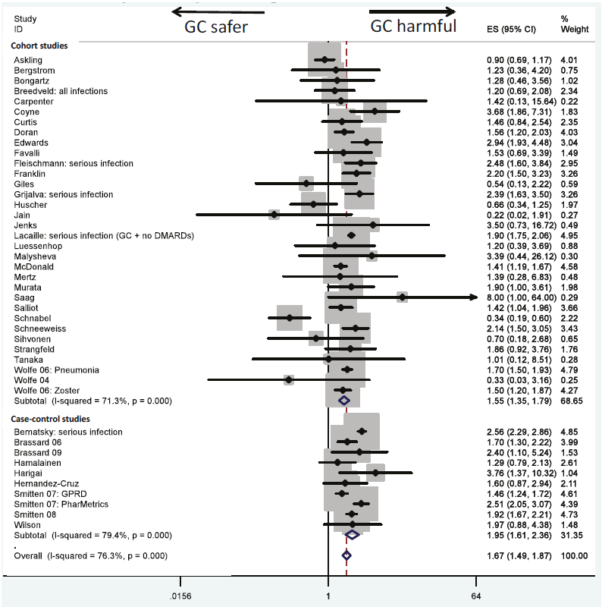
Corticosteroids
Observational studies have demonstrated that corticosteroids are associated with higher risks of infections in RA in a dose dependent manner¹⁶
Meta-analysis of RCTs and observational studies (Dixon WG et al 2011)¹⁶
Table shows the dose response effect seen in observational studies only.
Daily prednisolone equivalent dose (mg/day) | RR for SE | 95% CI
< 5 | 1.37 | 1.18-1.58
5 – 10 | 1.93 | 1.67-2.23
10 – 20 | 2.97 | 1.89-4.67
*
*This data is from 1 observational study only
Table created from data:¹⁶ Dixon WG, Suissa S, Hudson M. Arthritis Res Ther. 2011;13(4):R139.
Figure reproduced from:¹⁶ Dixon WG, Suissa S, Hudson M. Arthritis Res Ther. 2011;13(4):R139.
Notes:
16. Dixon WG, Suissa S, Hudson M. The association between systemic glucocorticoid therapy and the risk of infection in patients with rheumatoid arthritis: systematic review and meta-analyses. Arthritis Res Ther. 2011;13(4):R139.

Slide 21
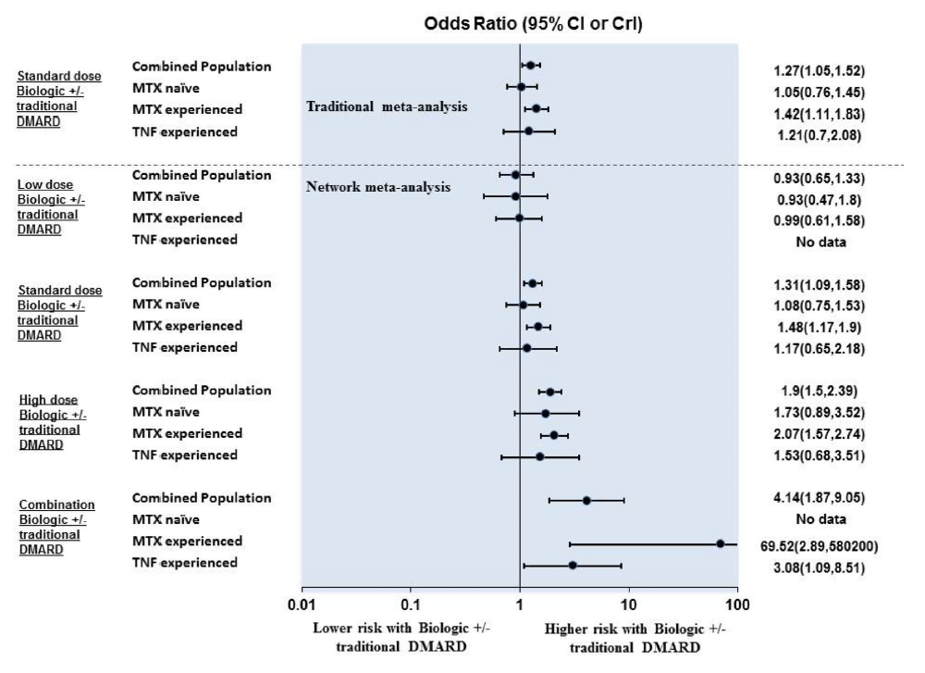
Advanced therapies
Serious infection incidence rates vary across RCTs; generally, around 2.5 100PY ^{17,18}
A systematic review and meta-analyses of 106 controlled trials including 42,330 patients with RA, found that patients receiving standard dose biological therapies were at a 31% higher odds of serious infection compared to DMARDs (OR 1.31 95% CI 1.09-1.58) ¹⁹
Meta analysis have shown a similar risk with an approximate 1.4-fold increased risk of infection in RA patients treated with anti-TNF agents compared to csDMARD or no biologic ²⁰
Figure reproduced from:¹⁹ Singh JA, Cameron C, Noorbaloochi S, et al. Lancet. 2015 Jul 18;386(9990):258-65
Notes:
17. Yamanaka H, Askling J, Berglind N, et al. Infection rates in patients from five rheumatoid arthritis (RA) registries: contextualising an RA clinical trial programme
RMD Open 2017;3:e000498
18. Komano Y, Tanaka M, Nanki T, Koike R, et al. Incidence and risk factors for serious infection in patients with rheumatoid arthritis treated with tumor necrosis factor inhibitors: a report from the Registry of Japanese Rheumatoid Arthritis Patients for Longterm Safety. J Rheumatol. 2011 Jul;38(7):1258-64.
19. Singh JA, Cameron C, Noorbaloochi S, Cullis T, Tucker M, Christensen R, Ghogomu ET, Coyle D, Clifford T, Tugwell P, Wells GA. Risk of serious infection in biological treatment of patients with rheumatoid arthritis: a systematic review and meta-analysis. Lancet. 2015 Jul 18;386(9990):258-65
20. Bernatsky S, Habel Y, Rahme E. Observational studies of infections in rheumatoid arthritis: a meta analysis of tumor necrosis factor antagonists. Journal of Rheumatology. 2010;37(5):928-31.

Slide 22
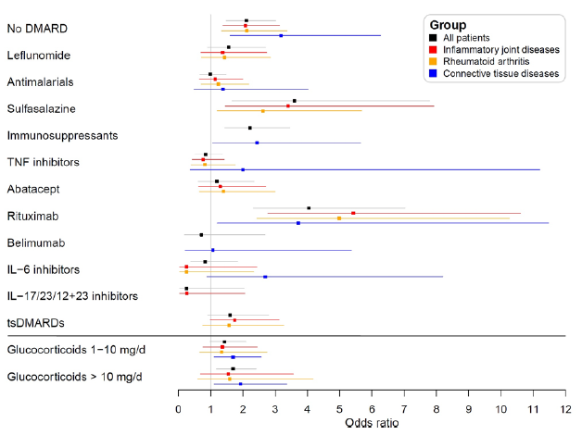
COVID-19 Global Rheumatology Alliance – The Community’s response to the Worldwide pandemic
Results of the main logistic regression analysis: multivariable-adjusted ORs for the outcome COVID-19-related death with 95 CIs, assessing the association with the general patient characteristics
Results of the main logistic regression analysis: multivariable-adjusted ORs for the outcome COVID-19-related death with 95 CIs, assessing the association with the Rheumatic Disease Medications
Figures reproduced from:²¹ Strangfeld A, Schäfer M, Gianfrancesco MA, Lawson-Tovey S, et al. Ann Rheum Dis. 2021 Jul;80(7):930-942
Notes:
21. Strangfeld A, Schäfer M, Gianfrancesco MA, Lawson-Tovey S, et al. Factors associated with COVID-19-related death in people with rheumatic diseases: results from the COVID-19 Global Rheumatology Alliance physician-reported registry. Ann Rheum Dis. 2021 Jul;80(7):930-942

Slide 23
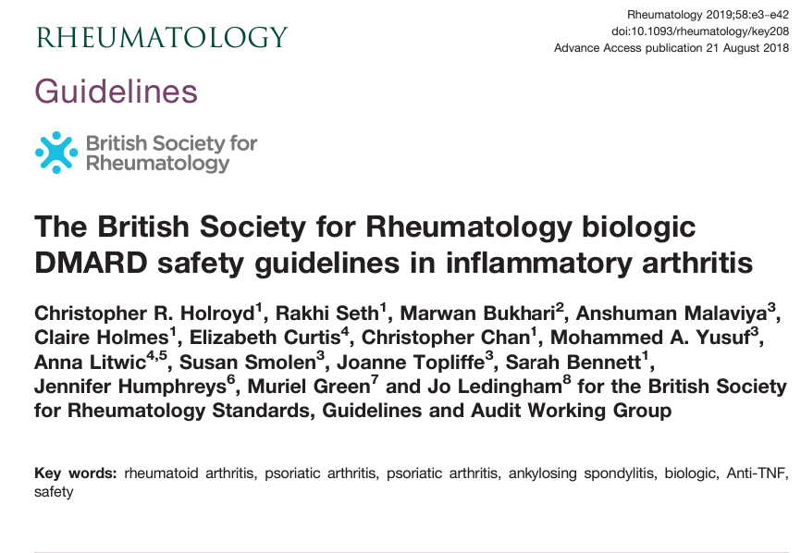
BSR Biologics safety guideline recommendations
These guidelines make specific recommendations for medications if a patient is at higher risk of infection
Notes:
22. Jo Ledingham, Nicola Gullick, Katherine Irving, et al. BSR and BHPR guideline for the prescription and monitoring of non-biologic disease-modifying anti-rheumatic drugs. Rheumatology, Volume 56, Issue 6, June 2017.
23. Holroyd CR, Seth R, Bukhari M, Malaviya A, et al. The British Society for Rheumatology biologic DMARD safety guidelines in inflammatory arthritis-Executive summary. Rheumatology (Oxford). 2019 Feb 1;58(2):220-226.

Slide 24
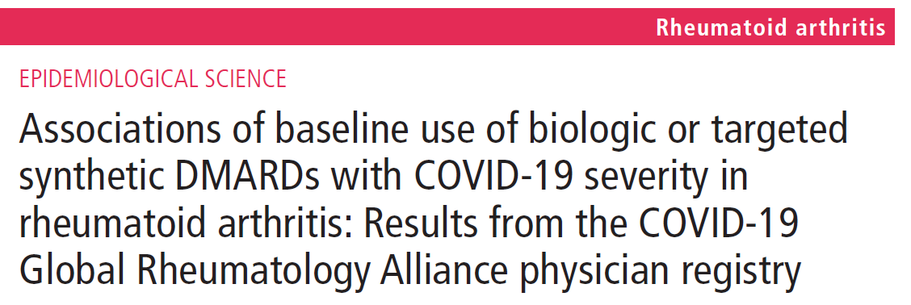
Figure reproduced from:²⁴ Sparks JA, Wallace ZS, Seet AM COVID-19 Global Rheumatology Alliance, et al. Annals of the Rheumatic Diseases 2021;80:1137-1146
Notes:
24. Sparks JA, Wallace ZS, Seet AM COVID-19 Global Rheumatology Alliance, et al. Associations of baseline use of biologic or targeted synthetic DMARDs with COVID-19 severity in rheumatoid arthritis: Results from the COVID-19 Global Rheumatology Alliance physician registry. Annals of the Rheumatic Diseases 2021;80:1137-1146
25. Felten R, Duret PM, Bauer E on behalf of BIOCOV Study Group, et al. OP0282 Rituximab associated with severe COVID-19 among patients with inflammatory arthritides: A 1-year multicenter study in 1166 successive patients receiving biologic agents. Annals of the Rheumatic Diseases 2021;80:170-171

Slide 25
Discontinuing and Dose Reduction
Temporary discontinuation at time of serious infection recommended in BSR guidance²³
Complete cessation is more likely to cause flare ²⁶
In one particular study looking at time to flare between patients stopping therapy and continuing therapy, significantly more patients in the stop group experienced a flare within 6 months (213 out of 531 [40.1%] vs 34 out of 286 [11.9%] patients, p<0.001) or within 12 months (272 out of 531 [51.2%] vs 52 out of 286 [18.2%] patients, P<0.001) compared with the continuation group ²⁶
Fewer infections in the dose-reduced group 104 vs 172 per 1000py ²⁷
Incidence rate of severe infection: 2.3 vs 6.7 per 1000 patient years (not significant) ²⁷
Notes:
26. Ghiti Moghadam M, Vonkeman HE, Ten Klooster PM, Tekstra J, et al. Stopping Tumor Necrosis Factor Inhibitor Treatment in Patients With Established Rheumatoid Arthritis in Remission or With Stable Low Disease Activity: A Pragmatic Multicenter, Open-Label Randomized Controlled Trial. Arthritis Rheumatol. 2016 Aug;68(8):1810-7
27. Raffeiner B, Botsios C, Ometto F, Bernardi L, Stramare R, Todesco S, Sfriso P, Punzi L. Effects of half dose etanercept (25 mg once a week) on clinical remission and radiographic progression in patients with rheumatoid arthritis in clinical remission achieved with standard dose. Clin Exp Rheumatol. 2015 Jan-Feb;33(1):63-8. Epub 2014 Dec 22. PMID: 25535985.

Slide 26
Vaccinations
JCVI recommendations³²:
Influenza – yearly
Pneumococcal vaccine - 2 doses then one more 65+
HZ – not “routinely” below 70. Shingrix (non-live) now available
Meta-analysis of 12 studies ²⁸
MTX decreases humoral response to pneumococcal vaccination and may impair response to influenza vaccination ²⁸
The immune response to both vaccines is reduced with RTX but not with anti-TNFα therapy in RA patients ²⁸
Notes:
28. Hua C, Barnetche T, Combe B, Morel J. Effect of methotrexate, anti-tumor necrosis factor α, and rituximab on the immune response to influenza and pneumococcal vaccines in patients with rheumatoid arthritis: a systematic review and meta-analysis. Arthritis Care Res (Hoboken). 2014 Jul;66(7):1016-26

Slide 27
International registry of patients with I-RMDs and vaccinated against SARS-CoV-2 showed the overwhelming majority of patients tolerated their vaccination well³⁰
Rare reports: I-RMD flare (4.4%, 0.6% severe, 1.5% requiring medication changes)
Very rare reports of serious adverse events (AEs) (0.4%) and breakthrough infections in fully vaccinated patients (0.7%)
The AE profile was similar to the one observed in patients with non-inflammatory RMDs ³⁰
They were mainly non-serious transient local and systemic reactions ³⁰
How might this impact on clinical practice or future decisions?
Data from first 600 patients recruited found that 40% of immunocompromised patients mounted a low serological immune response after 2 SARS-CoV-2 vaccines compared to healthy subjects ²⁹
11% failed to generate any antibodies 4 weeks after 2nd vaccine ²⁹
The proportion of patients with lower levels of antibody reactivity was dependant on the disease cohort, with 87% of those with rituximab treated ANCA-Associated Vasculitis, 51% of those with inflammatory arthritis ²⁹
Notes:
29. Kearns P, Siebert S, Willicombe M, et al. Examining the Immunological Effects of COVID-19 Vaccination in Patients with Conditions Potentially Leading to Diminished Immune Response Capacity – The OCTAVE Trial. Available at SSRN: https://ssrn.com/abstract=3910058 or http://dx.doi.org/10.2139/ssrn.3910058
30. Machado PM, Lawson-Tovey S, Strangfeld A, et al. Safety of vaccination against SARS-CoV-2 in people with rheumatic and musculoskeletal diseases: results from the EULAR Coronavirus Vaccine (COVAX) physician-reported registry. Annals of the Rheumatic Diseases Published Online First: 31 December 2021. doi: 10.1136/annrheumdis-2021-221490

Slide 28
Notes:
31. RECOVERY Collaborative Group. Tocilizumab in patients admitted to hospital with COVID-19 (RECOVERY): a randomised, controlled, open-label, platform trial. Lancet. 2021 May 1;397(10285):1637-1645.

Slide 29
Summary and Conclusion
In recent years, due to the pandemic, we have needed to shift the delivery of care to maintain the safety of both patients and healthcare workers.
This need saw the rapid increase in telemedicine and remote consultations
The balance between drug efficacy and infection has become even more relevant
It is important to consider how to optimise patients care to minimise infection risks
A lot has been asked of healthcare workers during the pandemic and we have expected a lot of our patients too
As we move towards a more hybrid approach to care, we must ensure that supportive self care is evident and the therapeutic relationship between healthcare profession and our patients is not lost

Slide 31
References
1. Cobb S, Anderson F, Bauer W. Length of life and cause of death in rheumatoid arthritis. N Engl J Med. 1953 Oct 1;249(14):553-6
2. Franklin J, Lunt M, Bunn D, Symmons D, Silman A. Risk and predictors of infection leading to hospitalisation in a large primary-care-derived cohort of patients with inflammatory polyarthritis. Ann Rheum Dis. 2007 Mar;66(3):308-12
3. Wotton CJ, Goldacre MJ. Risk of invasive pneumococcal disease in people admitted to hospital with selected immune-mediated diseases: record linkage cohort analyses. J Epidemiol Community Health. 2012 Dec;66(12):1177-81
4. Starkebaum G. Chronic neutropenia associated with autoimmune disease. Semin Hematol. 2002 Apr;39(2):121-7
5. Koetz K, Bryl E, Spickschen K, O'Fallon WM, Goronzy JJ, Weyand CM. T cell homeostasis in patients with rheumatoid arthritis. Proc Natl Acad Sci U S A. 2000 Aug 1;97(16):9203-8
6. Plenge RM, Seielstad M, Padyukov L, et al. TRAF1-C5 as a risk locus for rheumatoid arthritis--a genomewide study. N Engl J Med. 2007;357(12):1199-1209. doi:10.1056/NEJMoa073491
7. Yunt ZX, Solomon JJ. Lung disease in rheumatoid arthritis. Rheum Dis Clin North Am. 2015;41(2):225-236. doi:10.1016/j.rdc.2014.12.004
8. Ishikawa Y, Terao C. The Impact of Cigarette Smoking on Risk of Rheumatoid Arthritis: A Narrative Review. Cells. 2020;9(2):475. Published 2020 Feb 19. doi:10.3390/cells9020475
9. Joseph RM, Movahedi M, Dixon WG, Symmons DP. Risks of smoking and benefits of smoking cessation on hospitalisations for cardiovascular events and respiratory infection in patients with rheumatoid arthritis: a retrospective cohort study using the Clinical Practice Research Datalink. RMD Open. 2017 (2):e000506.
10. Stämpfli MR, Anderson GP. How cigarette smoke skews immune responses to promote infection, lung disease and cancer. Nat Rev Immunol. 2009 May;9(5):377-84
11. Edwards CJ, Kiely P, Arthanari S, Kiri S, Mount J, Barry J, Mitchell CR, Field P, Conaghan PG. Predicting disease progression and poor outcomes in patients with moderately active rheumatoid arthritis: a systematic review. Rheumatol Adv Pract. 2019 Feb 15;3(1):rkz002.
12. Au K, Reed G, Curtis JR, Kremer JM, Greenberg JD, Strand V, Furst DE; CORRONA Investigators. High disease activity is associated with an increased risk of infection in patients with rheumatoid arthritis. Ann Rheum Dis. 2011 May;70(5):785-91
13. Dixon WG, Watson K, Lunt M, Hyrich KL, Silman AJ, Symmons DP; British Society for Rheumatology Biologics Register. Rates of serious infection, including site-specific and bacterial intracellular infection, in rheumatoid arthritis patients receiving anti-tumor necrosis factor therapy: results from the British Society for Rheumatology Biologics Register. Arthritis Rheum. 2006 Aug;54(8):2368-76
14. Greenberg JD, Reed G, Kremer JM, Tindall E, Kavanaugh A, Zheng C, Bishai W, Hochberg MC; CORRONA Investigators. Association of methotrexate and tumour necrosis factor antagonists with risk of infectious outcomes including opportunistic infections in the CORRONA registry. Ann Rheum Dis. 2010 Feb;69(2):380-6
15. Galloway JB, Hyrich KL, Mercer LK, Dixon WG, Fu B, Ustianowski AP, Watson KD, Lunt M, Symmons DP; BSRBR Control Centre Consortium; British Society for Rheumatology Biologics Register. Anti-TNF therapy is associated with an increased risk of serious infections in patients with rheumatoid arthritis especially in the first 6 months of treatment: updated results from the British Society for Rheumatology Biologics Register with special emphasis on risks in the elderly. Rheumatology (Oxford). 2011 Jan;50(1):124-31
16. Dixon WG, Suissa S, Hudson M. The association between systemic glucocorticoid therapy and the risk of infection in patients with rheumatoid arthritis: systematic review and meta-analyses. Arthritis Res Ther. 2011;13(4):R139.
17. Yamanaka H, Askling J, Berglind N, et al. Infection rates in patients from five rheumatoid arthritis (RA) registries: contextualising an RA clinical trial programme
RMD Open 2017;3:e000498
18. Komano Y, Tanaka M, Nanki T, Koike R, et al. Incidence and risk factors for serious infection in patients with rheumatoid arthritis treated with tumor necrosis factor inhibitors: a report from the Registry of Japanese Rheumatoid Arthritis Patients for Longterm Safety. J Rheumatol. 2011 Jul;38(7):1258-64.
19. Singh JA, Cameron C, Noorbaloochi S, Cullis T, Tucker M, Christensen R, Ghogomu ET, Coyle D, Clifford T, Tugwell P, Wells GA. Risk of serious infection in biological treatment of patients with rheumatoid arthritis: a systematic review and meta-analysis. Lancet. 2015 Jul 18;386(9990):258-65
20. Bernatsky S, Habel Y, Rahme E. Observational studies of infections in rheumatoid arthritis: a meta-analysis of tumor necrosis factor antagonists. Journal of Rheumatology. 2010;37(5):928-31.
21. Strangfeld A, Schäfer M, Gianfrancesco MA, Lawson-Tovey S, et al. Factors associated with COVID-19-related death in people with rheumatic diseases: results from the COVID-19 Global Rheumatology Alliance physician-reported registry. Ann Rheum Dis. 2021 Jul;80(7):930-942
22. Jo Ledingham, Nicola Gullick, Katherine Irving, et al. BSR and BHPR guideline for the prescription and monitoring of non-biologic disease-modifying anti-rheumatic drugs. Rheumatology, Volume 56, Issue 6, 865-868 June 2017.
23. Holroyd CR, Seth R, Bukhari M, Malaviya A, et al. The British Society for Rheumatology biologic DMARD safety guidelines in inflammatory arthritis. Rheumatology (Oxford). 2019;58:e3-e42
24. Sparks JA, Wallace ZS, Seet AM COVID-19 Global Rheumatology Alliance, et al. Associations of baseline use of biologic or targeted synthetic DMARDs with COVID-19 severity in rheumatoid arthritis: Results from the COVID-19 Global Rheumatology Alliance physician registryAnnals of the Rheumatic Diseases 2021;80:1137-1146
25. Felten R, Duret PM, Bauer E on behalf of BIOCOV Study Group, et al. OP0282 Rituximab associated with severe COVID-19 among patients with inflammatory arthritides: A 1-year multicenter study in 1166 successive patients receiving biologic agents. Annals of the Rheumatic Diseases 2021;80:170-171
26. Ghiti Moghadam M, Vonkeman HE, Ten Klooster PM, Tekstra J, et al. Stopping Tumor Necrosis Factor Inhibitor Treatment in Patients With Established Rheumatoid Arthritis in Remission or With Stable Low Disease Activity: A Pragmatic Multicenter, Open-Label Randomized Controlled Trial. Arthritis Rheumatol. 2016 Aug;68(8):1810-7
27. Raffeiner B, Botsios C, Ometto F, Bernardi L, Stramare R, Todesco S, Sfriso P, Punzi L. Effects of half dose etanercept (25 mg once a week) on clinical remission and radiographic progression in patients with rheumatoid arthritis in clinical remission achieved with standard dose. Clin Exp Rheumatol. 2015 Jan-Feb;33(1):63-8. Epub 2014 Dec 22. PMID: 25535985.
28. Hua C, Barnetche T, Combe B, Morel J. Effect of methotrexate, anti-tumor necrosis factor α, and rituximab on the immune response to influenza and pneumococcal vaccines in patients with rheumatoid arthritis: a systematic review and meta-analysis. Arthritis Care Res (Hoboken). 2014 Jul;66(7):1016-26
29. Kearns P, Siebert S, Willicombe M, et al. Examining the Immunological Effects of COVID-19 Vaccination in Patients with Conditions Potentially Leading to Diminished Immune Response Capacity – The OCTAVE Trial. Available at SSRN:https://papers.ssrn.com/sol3/papers.cfm?abstract_id=3910058
30. Machado PM, Lawson-Tovey S, Strangfeld A, et al. Safety of vaccination against SARS-CoV-2 in people with rheumatic and musculoskeletal diseases: results from the EULAR Coronavirus Vaccine (COVAX) physician-reported registry. Annals of the Rheumatic Diseases Published Online First: 31 December 2021. doi: 10.1136/annrheumdis-2021-221490
31. RECOVERY Collaborative Group. Tocilizumab in patients admitted to hospital with COVID-19 (RECOVERY): a randomised, controlled, open-label, platform trial. Lancet. 2021 May 1;397(10285):1637-1645.
32. Joint Committee on Vaccination and Immunisation. Green book. The UK Immunisation schedule- Chapters 19,25, 28a. Available at: https://www.gov.uk/government/collections/immunisation-against-infectious-disease-the-green-book#the-green-book
33. Recovery trial shows Baricitinib reduces death in patients hospitalised with COVID-19 Available at: https://www.ox.ac.uk/news/2022-03-03-recovery-trial-shows-baricitinib-reduces-deaths-patients-hospitalised-covid-19

