Slide 1
Nuevos paradigmas en cáncer colorectal
metastásico (CCRm):
¿Nos estamos acercando a la cura?
Juan M OConnor
Instituto A Fleming
1506LA2004015-01

Slide 2

AGENDA
1- CCR actualmente
2- Racional
3- evidencia clinica

Slide 3
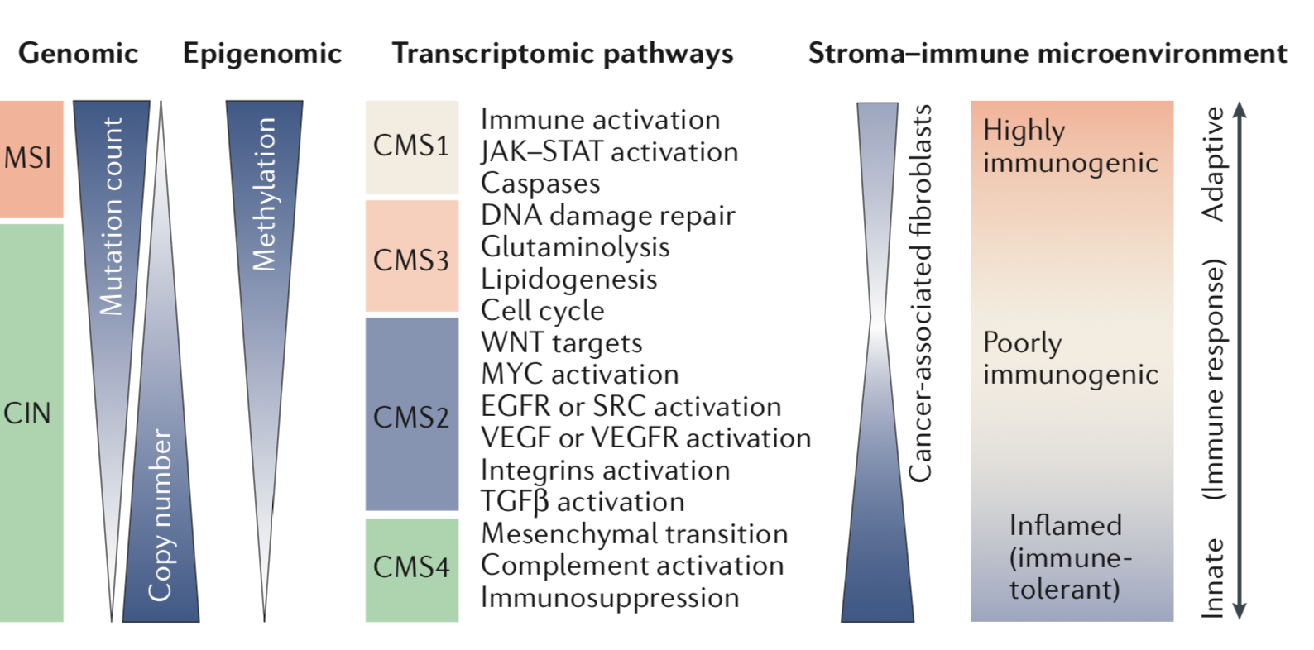
MultiOMICS en CRC
Dienstmann R, et al. Nat Rev Cancer. 2017;17(2):79-92.

Slide 4
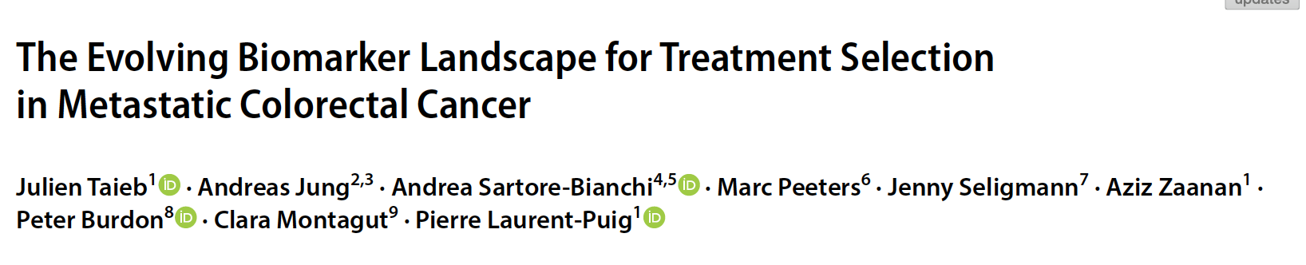
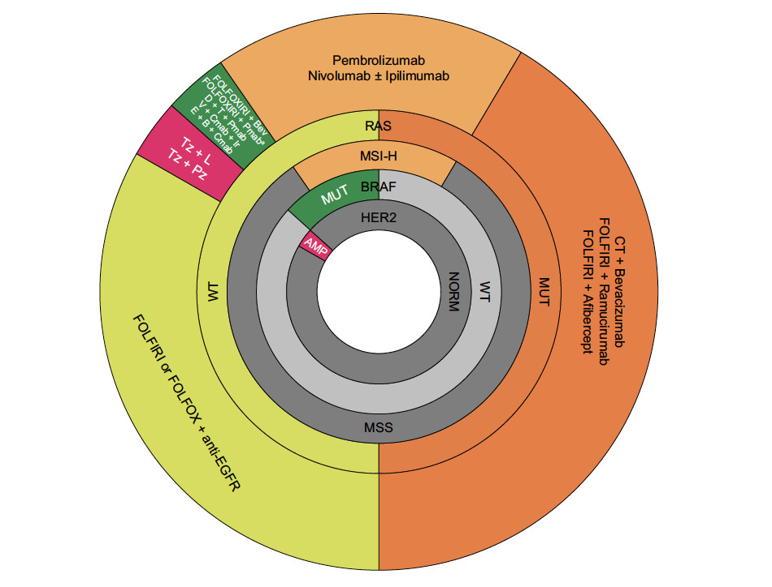
Rol de Inhibidores de CHP (5% MSI)

Slide 5
AGENDA
1- CCR actualmente
2- Racional
3- evidencia clinica

Slide 6
Alteraciones funcionales en la replicación del ADN y mutaciones
Errores generados durante la replicacion del ADN¹
Genes claves en la via de reparación²:
Approved symbol | Approved name
EXO1 | exonuclease 1
HMGB1 | high mobility group box 1
LIG1 | DNA ligase 1
MLH1 | mutL homolog 1
MLH3 | mutL homolog 3
MSH2 | mutS homolog 2
MSH3 | mutS homolog 3
MSH6 | mutS homolog 6
PCNA | proliferating cell nuclear antigen
PMS1 | PMS1 homolog 1, mismatch repair system component
PMS2 | PMS1 homolog 2, mismatch repair system component
POLd | DNA polymerase delta
RFC | replication facto C
RPA | replication protein A
MLH1
PMS2
Proficient mismatch repair (pMMR): Eficiencia de los genes reparadores del ADN
MSH2
MSH6
MLH1
PMS2
Deficient mismatch repair (dMMR):
Deficit en los genes reparadores del ADN Errores no detectados y acumulados
MSH2
MSH6
Deficiente reparación de errores
Genes involucrados en la vía de dMMR
DNA, deoxyribonucleic acid; LOH, loss of heterozygosity; MMR, mismatch repair; PMS, post-meiotic segregation.
1. Lee V et al. Oncologist. 2016;21(10):1200-1211. 2. Jalal S et al. Clin Cancer Res. 2011;17(22):6973-6984.
Notes:
As discussed in the previous two slides, during DNA replication there is a heightened likelihood of introducing erros into the genome¹
When the MMR machinery is proficient, erros can be promptly detected and fixed¹
However, when it is deficient, erros are left to accumulate¹
The four key proteins that make up the heterodimer complexes MutS and MutL are called MLH1, MSH2, MSH6, and PMS2^{1,2}
There are two common causes of MMR pathway alterations: one is hereditary and the other is spoadic^{1,3}
Hereditary, o germline, mutations in an MMR protein can be passed on from parent to offspring, making the offspring predisposed³
There will be a loss of heterozygosity when the second allele is “hit” by either somatic mutation o epigenetic silencing¹
In spoadic cases, both alleles are mutated o silenced somatically¹
As elucidated in the table on the right, it is impotant to note that some of the same proteins involved in DNA replication also function in DNA repair, such as DNA polymerase, PCNA, and RPA³
Jalal, 2011, p6975, Fig 1
Lee, 2016, p2, c1, ¶2, ¶5
Jalal, 2011, p6974, c1, ¶1
Lee, 2016, p2, c1, ¶2, ¶5
Li, 2008, p87, c1, ¶2
Jalal, 2011, p6974, c1, ¶1
Jalal, 2011, p6797, c1, ¶1
Lee, 2016, p2, c1, ¶4
Jalal, 2011, p6795, Fig 1
Lee V, Murphy A, Le DT, Diaz LA. Mismatch repair deficiency and response to immune checkpoint blockade. Oncologist. 2016;21(10):1200-1211.
Li GM. Mechanisms and functions of DNA mismatch repair. Cell Res. 2008;18(1):85-98.
Jalal S, Earley JN, Turchi JJ. DNA repair: From genome maintenance to biomarker and therapeutic target. Clin Cancer Res. 2011;17(22):6973-6984.

Slide 7
dMMR/MSI-H
~15% de CRCs tempranos dMMR/MSI-H¹
~4–5% de CRCs metastásicos dMMR/MSI-H¹
dMMR/MSI-H in CRC
dMMR/MSI-H en CRC esporádico²
10–15% de cancer de colon esporádicos
Raro en cancer rectal
Mutación BRAF (V600E) asociada
dMMR/MSI-H en CRC hereditario
(Síndrome de Lynch ) ²
3% de todos los CRCs¹
Mutación de genes²:
Sme Lynch asociado con alto riesgo CRC²
  MLH1 (42%)
  MSH2 (33%)
  MSH6 (18%)
  PMS2 (7%)
CRC=colorectal cancer; dMMR=deficient mismatch repair; MSI-H=microsatellite instability high; MLH1=mutL homolog 1; MSH2=mutS protein homolog 2
1. Sinicrope FA, Sargent DJ. Clin Cancer Res. 2012; 18(6):1506-12. 2. Richman SD. Int J Oncol. 2015; 47(4):1189-1202.
7

Slide 8
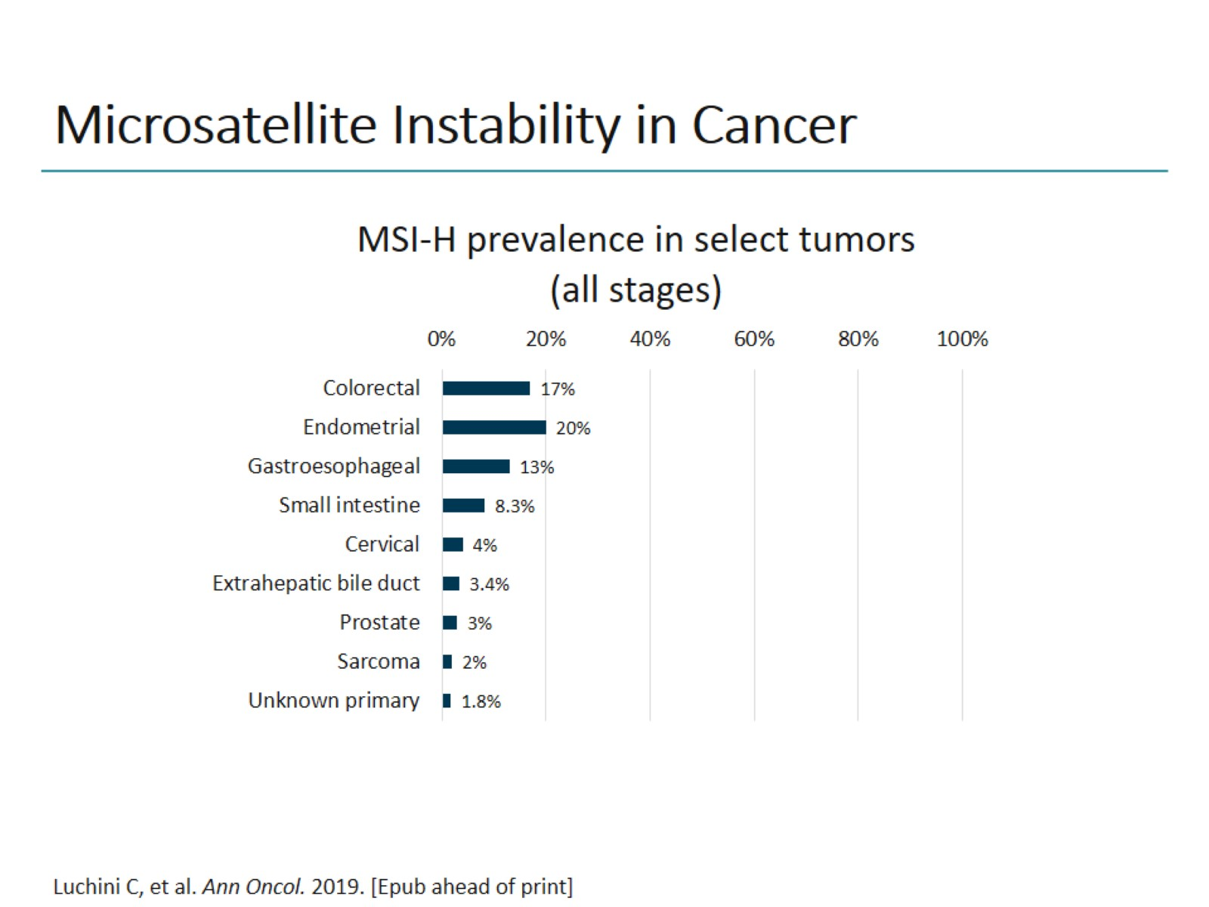
Microsatellite Instability in Cancer

Slide 9
Metodos: IHC vs PCR^{1,2}
IHC y PCR tienen la misma especificidad y sensibilidad para detectar MSI tumoral
Ambos tienen un 5%–10% de falsos negativos
Heterogeneidad en el Mercado de cómo se combinan
 | MMR Genes reparadores del ADN^{1,2,5} | MSI Inestabilidad microsatelital 1,3,4
Metodo | IHC | PCR
Hallazgo | Presencia o ausencia de proteinas de reparación | Presencia o ausencia de mutaciones del ADN
Ventajas | Bajo costo Baja tecnología Rápido resultado | Test único Kit disponible (Promega)
Desventajas | Depende de la interpretación del patólogo (tinción/interpretación) Muchos anticuerpos disponibles para cada proteína | Más caro Tarda más el resultado Requiere un tejido de control normal (tejido o sangre)
dMMR, deficient mismatch repair; DNA, deoxyribonucleic acid; MSI-H, high microsatellite instability.
1. Richman R. Int J Oncol. 2015;47:1189-1202. 2. Van Cutsem E. Ann Oncol. 2016;27:1386-1422. 3. Promega. Accessed December 14, 2016.
4. Quest Diagnostic. Accessed December 14, 2016. 5. ARUP. Accessed December 14, 2016.

Slide 10
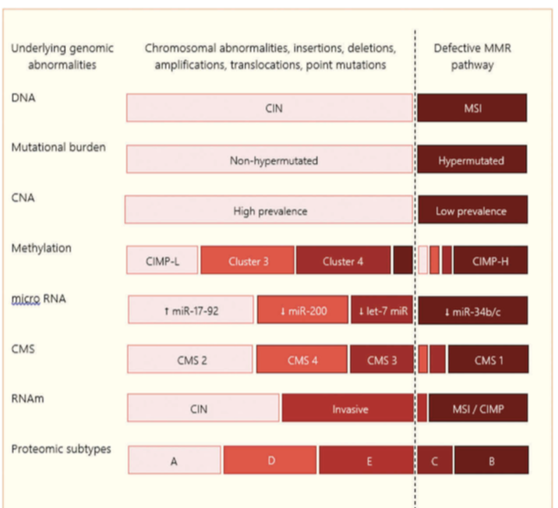
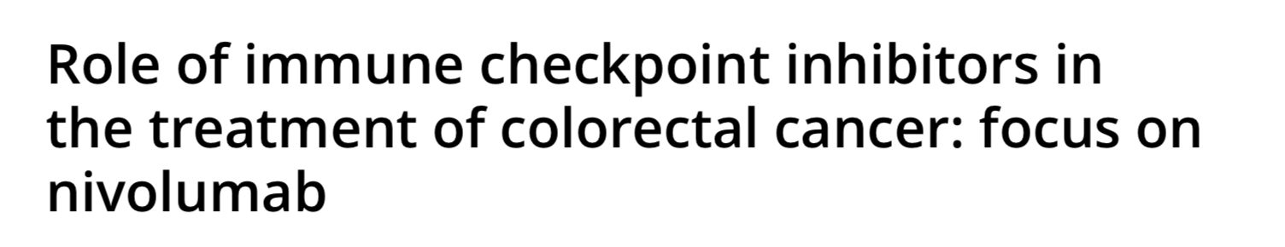
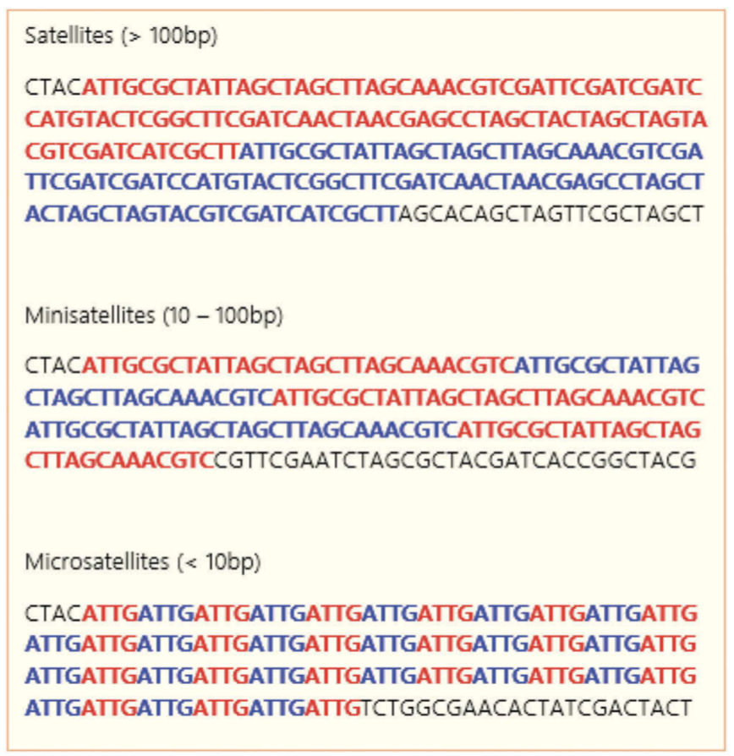
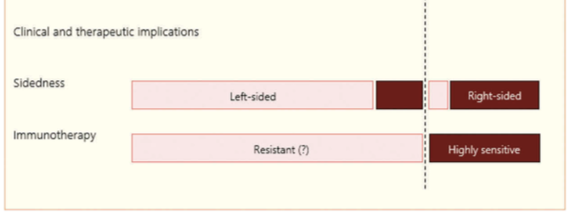
Notes:
Schematic representation of satellites, minisatellites, and microsatel- lites. Repetitive sequences of nucleotide bases throughout the genome are called satellites. According to their length, the sequences may be denominated satellites, minisatellites, and microsatellites, if they have >100 bp, between 10 to 100 bp, and <10 bp, respectively. These repetitive sequences are particularly vulnerable to mutations. The high frequency of mutations in the microsatellites will be called microsatellite instability (MSI-H). They are secondary to the presence of a defective MMR pathway, caused either by germline mutations in the MMR genes or by hypermethylation of the promoter regions of the MMR genes. Such condition results in tumors with high tumor mutational burden (TMB), and thereby a high number of neoantigens, which is the hypothesis to explain the presence of lymphocyte infiltration associated to these tumors, and the higher sensitivity to immune checkpoint inhibitors [5,63,64].

Slide 11
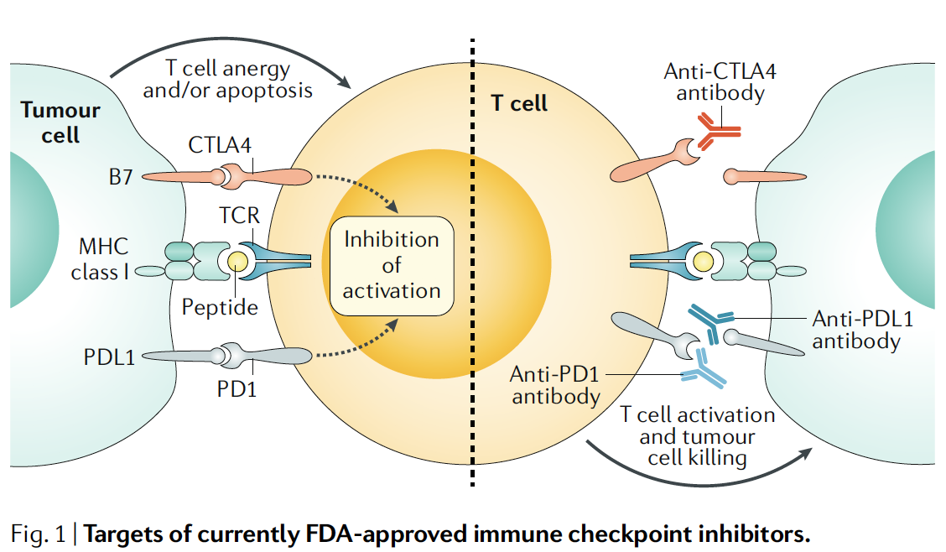
¿Cuál es el racional para el uso de I-CHP?
Notes:
Fig. 1 | targets of currently FDa- approved immune checkpoint inhibitors.
Endogenous peptides are processed and presented on major histocompatibility
complex (MHC) class I molecules on the surface of all human cells, including cancer cells.
The peptide–MHC complex is recognized by T cell receptors (TCRs). The response of the
T cell is fine- tuned by a range of co- inhibitory or co- stimulatory signals. The ligands CD80
and CD86 of the B7 family of membrane- bound ligands can bind to the co- stimulatory
CD28 and, especially in activated T cells, to cytotoxic T lymphocyte antigen 4 (CTL A4).
Similarly , membrane- bound programmed cell death 1 ligand 1 (PDL1) and programmed
cell death 1 ligand 2 (PDL2) can engage programmed cell death 1 (PD1), leading to
T cell anergy and/or apoptosis. Monoclonal antibodies that bind to either the inhibitory
receptors on T cells or their cognate ligands on cancer cells antagonize inhibitory
signalling and enable T cell activation and cytotoxic tumour cell killing. Currently , FDAapproved
immune checkpoint inhibitors target CTL A4 (ipilimumab), PD1 (pembrolizumab
and nivolumab) and PDL1 (atezolizumab and durvalumab). Pembrolizumab and
nivolumab, as well as the combination of nivolumab and ipilimumab, are currently
approved for colorectal cancer in the USA.

Slide 12
AGENDA
1- CCR actualmente
2- Racional
3- evidencia clinica

Slide 13
CheckMate 142 Study Design – MSI-H Cohorts
CheckMate 142: Study Design
Combination
(safety cohort)^{1,2}
Monotherapy
(NIVO)^{1,3}
Combination
(NIVO+IPI)^{1,4}
Cohort C3^{1,5}
Cohort C4¹
Cohort C5^{1,6}
Cohort C6¹
Nivolumab + Ipilimumab
3L+
Non–MSI-H mCRC
Nivolumab
2L+
MSI-H mCRC
Nivolumab + Ipilimumab
2L+
MSI-H mCRC
Nivolumab + Ipilimumab
1L
MSI-H mCRC
Nivolumab + Ipilimumab + Cobimetinib
Non–MSI-H mCRC
Nivolumab +
Relatlimab
MSI-H mCRC
Nivolumab + Daratumumab
Non–MSI-H mCRC
Non–MSI-H Cohort
MSI-H Cohort
1. Clinicaltrials.gov. NCT02060188. Accessed February 10, 2020; 2. Overman M, et al. J Clin Oncol 2016;34(suppl): Abstract 3501; 3. Overman M, et al. Lancet Oncol 2017;18:1182–1191; 4. Overman M, et al. J Clin Oncol 2018;36:773–779; 5. Lenz H-J, et al. ESMO 2018 oral presentation, presentation number LBA18_PR; 6. National Cancer Institute. NCI Drug Dictionary. https://www.cancer.gov/publications/dictionaries/cancer-drug/def/anti-lag-3-monoclonal-antibody-bms-986016. Accessed 28 November 2019.
Notes:
1L, first line; 2L, second line; 3L, third line; IPI, ipilimumab; mCRC, metastatic colorectal cancer; MSI-H, microsatellite instability-high; NIVO, nivolumab.
Key takeaways:
The purpose of this study is to examine if nivolumab, or nivolumab in combination with other anti-cancer drugs, will result in meaningful tumor size reduction in patients with colon cancer that has come back or has spread, and who have a specific biomarker in their tumors. The focus of this slide is on MSI-H cohorts—nivo alone or in combination with ipilimumab or relatlimab.
References:
1. Clinicaltrials.gov. NCT02060188. Accessed February 10, 2020.
2. Overman M, et al. J Clin Oncol. 2016;34(suppl): Abstract 3501.
3. Overman M, et al. Lancet Oncol 2017;18:1182–1191.
4. Overman M, et al. J Clin Oncol 2018;36:773–779.
5. Lenz H-J, et al. ESMO 2018 oral presentation, presentation number LBA18_PR.
6. National Cancer Institute. NCI Drug Dictionary. https://www.cancer.gov/publications/dictionaries/cancer-drug/def/anti-lag-3-monoclonal-antibody-bms-986016. Accessed 28 November 2019.
Clinicaltrials.gov; Overman JCO 2016, Abstract 3501; slide 5
NCT02060188 (CM142)
Clinicaltrials.gov; Overman Lancet Oncol 2017 page 2 (5 of the PDF) col 2 paragraph 2.
Clinicaltrials.gov; Overman JCO 2018 p774 col 1 paragraph 3.
Clinicaltrials.gov; CA209142 protocol for line of therapy
Clinicaltrials.gov; Lenz ESMO 2018 presentation slide 4.

Slide 14
CheckMate 142 Monotherapy Cohort Study Design^{1,2}
Histologically confirmed metastatic or recurrent CRC
MSI-H/dMMR per local laboratory
≥ 1 prior line of therapy
Primary endpoint:
ORR per investigator assessment
Other key endpoints:
ORR per BICR, DCR,^{b} DOR, PFS, OS, and safety
Monotherapy
cohortª
Nivolumab 3 mg/kg Q2W
Primary analysis (N = 74): efficacy per BICR and safety; median follow-up, 12 months (0.3–31.7),^{c} 13.4 months
(range, 10–32),^{d} and 21 months (range, 17–40)^{d}
Subset analysis¹:
Group A (n = 53): received ≥ 3 prior chemotherapies, including a fluoropyrimidine, oxaliplatin, and irinotecan
Group B (n = 21): did not receive prior treatment with all 3 of these chemotherapies (fluoropyrimidine, oxaliplatin, and irinotecan)
ªEnrollment was staggered with additional patients being enrolled if ≥ 7 of the first 19 centrally confirmed MSI-H patients had a confirmed response (CR or PR). ^{b} Patients with a CR, PR, or SD
for ≥ 12 weeks. ^{c}Time between first dose date and last known date alive. ^{d}Time from first dose to database cutoff.
1. Overman MJ, et al. Oral presentation at ASCO-GI 2018; 2. Overman MJ, et al. Lancet Oncol. 2017;18(9):1182–1191.
Notes:
BICR, blinded independent central review; CR, complete response; CRC, colorectal cancer; DCR, disease control rate; dMMR, DNA mismatch repair deficient; DOR, duration of response; IQR, interquartile range; mg/kg, milligrams per kilogram; MSI-H, microsatellite instability-high; ORR, objective response rate; OS, overall survival; PFS, progression-free survival; PR, partial response; Q2W, every 2 weeks; RECIST v1.1; Response Evaluation Criteria In Solid Tumors version 1.1; SD, stable disease.
Key takeaways:
In this phase 2 trial, patients with MSI-H metastatic CRC who had received prior therapy received 3 mg/kg intravenous nivolumab monotherapy every 2 weeks until disease progression, death, unacceptable toxic effects, withdrawal of consent, or study end.¹ The primary endpoint was investigator-assessed ORR by RECIST v1.1 criteria.¹ The secondary endpoint was blinded independent central review-assessed objective response (defined as the number of patients with a best overall response through confirmed complete response or partial response, according to RECIST criteria, divided by the number of those treated).
Median follow-up was at 12 months (median was considered 13.4 months when defining as time from first dose to database cut-off), and 21 months.
The updated analysis with 21 months follow-up looked comprehensively at all 74 patients. Additionally, patient subgroup analysis was performed by prior chemotherapy with a fluoropyrimidine, oxaliplatin, and irinotecan. Patients in group A (n = 53) had received ≥ 3 prior chemotherapies, including a fluoropyrimidine, oxaliplatin, and irinotecan. Patients in group B (n = 21) had not received prior treatment with all 3 of these chemotherapies (fluoropyrimidine, oxaliplatin, and irinotecan).
References:
Overman MJ, et al. Oral presentation at ASCO-GI 2018. [Ref 1: slide 3]
Overman MJ, et al. Lancet Oncol. 2017;18(9):1182–1191.
Ref 1: slide 3
Overman_CM142 Nivo mono_LancetOncol_2017, pg. 1186, right panel para 1
Ref 1 Overman ASCO-GI 2018 oral presentation slide 9
Ref 1: slide 3
Overman_CM142 Nivo mono_LancetOncol_2017, pg. 1186, right panel para 1
Ref 1 Overman ASCO-GI 2018 oral presentation slide 9
Follow-up definition email:
Median follow-up definitions

Slide 15
Best Reduction in Target Lesion: All Patients
100
80
60% of patients had a reduction in tumor burden from baseline with nivolumab monotherapy
60
40
20
20
Best reduction from baseline
in target lesion size (%)ª
†
0
-20
-40
-30
-60
-80
-100
*Confirmed response per BICR assessment; % Change truncated to 100%. † Patient from Group A with 0% best reduction in target lesion
Group A: patients received ≥3 prior chemotherapies including a fluoropyrimidine, oxaliplatin, and irinotecan
Group B: patients did not receive prior treatment with all 3 of these chemotherapies (fluoropyrimidine, oxaliplatin and irinotecan)
ªBICR data with a median follow-up of 21 months (range, 17-40).
Overman MJ, et al. Oral presentation at ASCO-GI 2018.
Notes:
Key takeaways:
Patients in both groups A and B experienced a reduction in tumor size regardless of the number of prior treatments, including those who did not receive prior treatment with all 3 chemotherapies (fluoropyrimidine, oxaliplatin, and irinotecan).
References:
Overman MJ, et al. Oral presentation at ASCO-GI 2018. [Ref 1: slide 8]
Ref 1: slide 8

Slide 16
Deepening of Response With Longer Follow-Up¹
 | All patients N = 74ª
 | 13-Month follow-up^{b,2} | 21-Month follow-up^{b}
ORR, n (%) [95% CI] | 24 (32) [22.0, 44.3] | 25 (34) [23.2, 45.7]
Best overall response, n (%) CR PR SD PD Not determined | 2 (3) 22 (30) 25 (34) 21 (28) 4 (5) | 7 (9) 18 (24) 23 (31) 22 (30) 4 (5)
Disease control, n (%)^{c} | 47 (64) | 46 (62)
CR rates increased in all patients with longer follow-up
Similar trends in CR were observed in groups A and B^{d}
ªBICR data; ^{b}Defined here as the time from first dose to data cutoff; ^{c}Patients with a CR, PR, or SD for ≥ 12 weeks; ^{d}Group A patients received ≥ 3 prior chemotherapies, including a fluoropyrimidine, oxaliplatin, and irinotecan. Group B patients did not receive treatment with all 3 of these chemotherapies (fluoropyrimidine, oxaliplatin, and irinotecan).
1. Overman MJ, et al. Oral presentation at ASCO-GI 2018; 2. Overman MJ, et al. Lancet Oncol 2017;18:1182–1191.
Notes:
Key takeaways:
Patients in this study had a deepening of response with longer follow-up. At 13 months, 2 patients had a complete response (3%), while at 21 months, the complete response increased to 9%.
References:
Overman MJ, et al. Oral presentation at ASCO-GI 2018. [Ref 1: slide 9]
Ref 1: slide 9

Slide 17

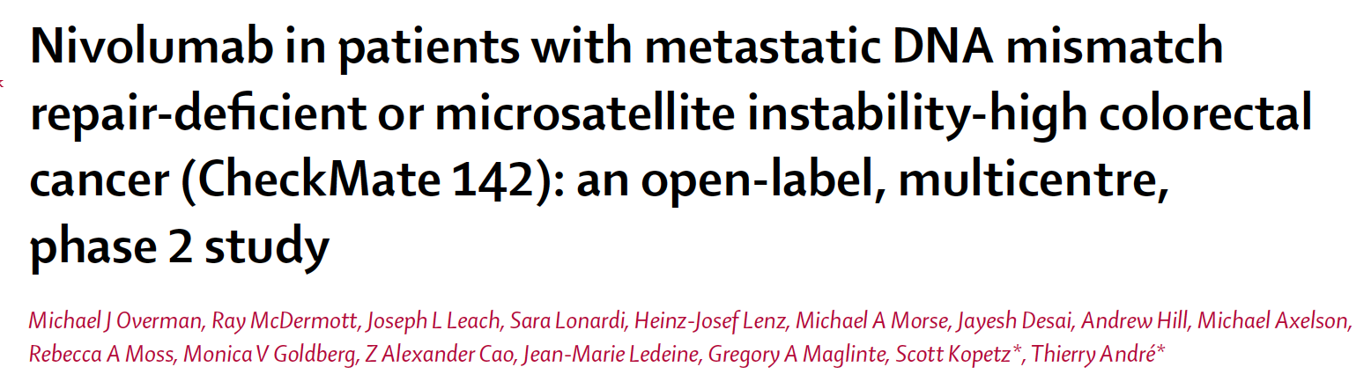
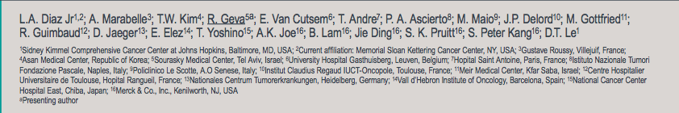


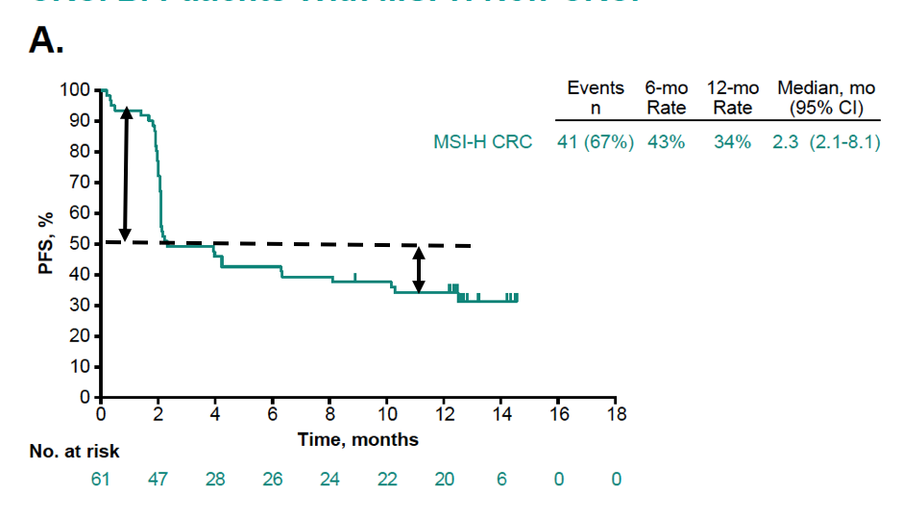
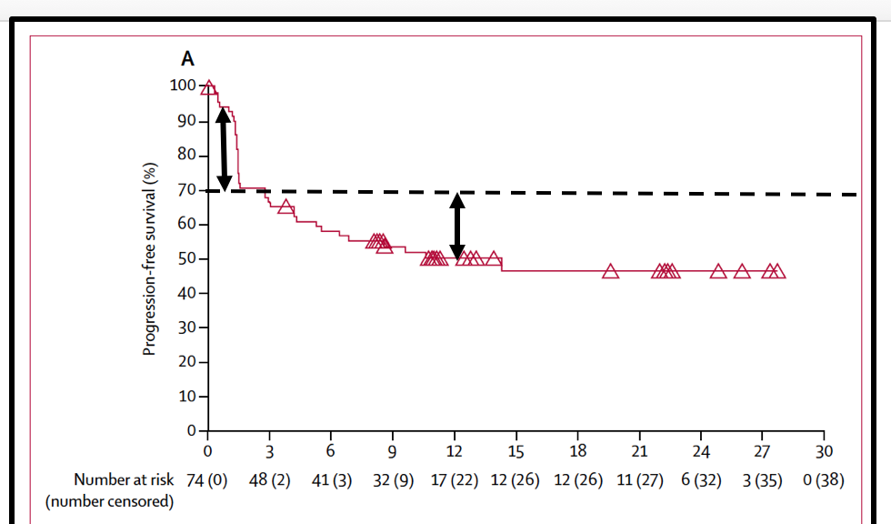
¿Existe Resistencia secundaria en los respondedores?
Keynote - 158
3ra línea
Checkmate -142
Resistencia primaria 46%
Resistencia primaria 28%
20%
20%
Resistencia
secundaria
Resistencia
secundaria
Cortesia Dr Dan Aderka

Slide 18

¿Cuál es la evidencia actual para Nivo/Ipilimumab?

Slide 19
CheckMate 142 Study Design (nivolumab + low-dose ipilimumab; 2L+)^{1–4}
Phase 2 Nonrandomized Study
Histologically confirmed metastatic or recurrent CRC
MSI-H/dMMR per local laboratory
≥ 1 prior line of therapy
Nivolumab 3 mg/kg +
low-dose ipilimumab
1 mg/kg Q3W
(4 doses and then
nivolumab 3 mg/kg Q2W)
Primary endpoint:
ORR per investigator assessment (RECIST v1.1)
Other key endpoints:
ORR per BICR, DCR,^{b}
DOR, PFS, OS, and safety
Combination
cohortª
Monotherapy
cohortª
Nivolumab 3 mg/kg Q2W
Results of the monotherapy cohort (N = 74) with a median follow-up of 13.4 months (range, 10–32) are presented^{1,2,c}
Results from the combination cohort (N = 119), after median follow-up of 13.4 months (range, 9–25) and
25.4 months (range, 21.4–37.2) are presented^{3,4,c}
ªEnrollment was staggered with additional patients being enrolled if ≥7 of the first 19 centrally confirmed MSI-H patients had a confirmed response (CR or PR). CheckMate 142 monotherapy and combination therapy cohorts were not randomized or designed for a formal comparison; ^{b}Patients with a CR, PR, or SD for ≥12 weeks; ^{c}Defined here as the time from first dose to data cutoff.
1. André T, et al. Oral presentation at ASCO-GI 2018. 2. Overman MJ, et al. Lancet Oncol 2017;18:1182–1191; 3. Overman MJ, et al. J Clin Oncol 2018;8:773–779. 4. Overman MJ, et al. Poster presentation at ASCO-GI 2019.
Notes:
2L, second line; BICR, blinded independent central review; CRC, colorectal cancer; DCR, disease control rate; dMMR, DNA mismatch repair deficient; DOR, duration of response; MSI-H, microsatellite instability-high; ORR, objective response rate; OS, overall survival; PFS, progression-free survival; Q2W, every 2 weeks; Q3W, every 3 weeks; RECIST, Response Evaluation Criteria In Solid Tumors.
Key takeaways:
CheckMate 142 is an ongoing, optimized, open-label, 2-stage, nonrandomized, multicohort, phase 2 trial investigating the efficacy and safety of nivolumab monotherapy or nivolumab in combination in patients with MSI-H metastatic colorectal cancer.
The primary endpoint was investigator-assessed ORR per RESIST v1.1. Other key endpoints included ORR by blinded independent central review (BICR), progression-free survival, overall survival, and safety
References:
André T, et al. Oral presentation at ASCO-GI 2018. [Ref 1: slide 3]
Overman MJ, et al. Lancet Oncol 2017;18:1182–1191
Overman MJ, et al. J Clin Oncol 2018;8:773–779..
Overman MJ, et al. Poster presentation at ASCO-GI 2019.
Ref 1: slide 3
Ref 4: Results, Patient Characteristics and Disposition, bullet 3
Ref. 1 slide 3

Slide 20
Baseline Demographics and Disease Characteristics (nivolumab + low-dose ipilimumab; 2L+)
 | Nivolumab + low-dose ipilimumab N = 119
Median age (range), years | 58.0 (21–88)
Male, n (%) | 70 (59)
ECOG performance status, n (%) 0 1 | 54 (45) 65 (55)
Disease stage at diagnosis, n (%)ª I–III IV | 66 (55) 53 (45)
Tumor PD-L1 expression at baseline, n (%) ≥ 1% < 1% Unknown | 27 (23) 75 (63) 17 (14)
 | Nivolumab + low-dose ipilimumab N = 119
Mutation status, n (%) BRAF/KRAS wild type BRAF mutation KRAS mutation Unknown | 31 (26) 30 (25) 44 (37) 14 (12)
Clinical history of Lynch syndrome, n (%)^{b} Yes No Unknown | 35 (29) 31 (26) 53 (45)
Prior lines of therapy, n (%)^{c} 1 2 3 ≥ 4 | 27 (23) 43 (36) 29 (24) 19 (16)
Median follow-up was 25.4 months (range, 21.4–37.2)
Percentages may not add up to 100% because of rounding. ªAll patients had stage IV disease at study entry; ^{b}Based on the clinical records of the patients at sites in countries where this reporting was permitted (excluded Italy); ^{c}One patient had received no prior lines of therapy.
Overman MJ, et al. Poster presentation ASCO-GI 2019.
Notes:
2L, second line; BRAF, B-Raf murine sarcoma viral oncogene homolog B1; CRC, colorectal cancer; dMMR, DNA mismatch repair deficient; ECOG, Eastern Cooperative Oncology Group; KRAS, Kirsten rat sarcoma viral oncogene homolog; MSI-H, microsatellite instability-high; PD-L1, programmed death-ligand 1.
Key takeaways:
Presented in this table are the demographics and disease characteristics of the 119 patients included in the analysis
The median age was 58 years, and the majority of patients were <65 years of age, with most having had at least 2 lines of therapy
Some key points/insights:
Patients are younger than what is anticipated for mCRC. This is most likely explained by the number of patients with Lynch syndrome who typically present with CRC at a younger age than those without
BRAF mutated—the rate is higher than in the general population of CRC patients. Sporadic MSI-H CRC is associated with BRAF mutations in CRC (MSI-H associated with Lynch syndrome is not associated with BRAF)
References:
1. Overman MJ, et al. Poster presentation ASCO-GI 2019.
Ref 1 Table 1

Slide 21
Investigator-Assessed Response and Disease Control (nivolumab + low-dose ipilimumab; 2L+)^{1,2,3}
 | Median FU 13.4 months^{1,2} Investigator assessment (N = 119) | Median FU 13.4 months^{1,2} BICR assessment (N = 119) | Median FU 25.4 months³ Investigator assessment (N = 119)
ORR, n (%) [95% CI] | 65 (55) [45–64] | 58 (49) [40–58] | 69 (58) [49–67]
Complete response | 4 (3) | 5 (4) | 7 (6)
Partial response | 61 (51) | 53 (45) | 62 (52)
Stable disease | 37 (31) | 39 (33) | 33 (28)
Progressive disease | 14 (12) | 17 (14) | 14 (12)
Not determined | 3 (3) | 4 (3) | 3 (3)
Not reported | 0 | 1 (1) | 0
Disease control for ≥12 weeks,ª n (%) [95% CI] | 95 (80) [72–87] | 94 (79) [71–86] | 96 (81) [72–87]
July 11, 2018: Nivolumab plus low-dose ipilimumab received accelerated approval from the US FDA for adult and pediatric
(12 years and older) patients with MSI-H/dMMR mCRC that progressed following treatment with a fluoropyrimidine, oxaliplatin, and irinotecan,⁴ based on overall response rate and duration of response from a median follow-up of 13.4 months¹
ªDisease control was defined as patients with a CR, PR, or SD for ≥ 12 weeks.
1. Overman MJ, et al. J Clin Oncol 2018;8:773–779; 2. André T, et al. Oral presentation at ASCO-GI 2018; 3. Overman MJ, et al. Poster presentation at ASCO-GI 2019; 4. OPDIVO® [prescribing information]. July 2018.
Notes:
2L, second line; BICR, blinded independent central review; CI, confidence interval; CR, complete response; DCR, disease control rate; dMMR, DNA mismatch repair deficient; FDA, Food and Drug Administration; FU, follow-up; MSI-H, microsatellite instability-high; ORR, objective response rate; PR, partial response.
Key takeaways:
After 13.4 months follow-up, the ORR per BICR was 49% and ORR per investigator assessment was 55%, with 4 CRs and 61 PRs. The ORR per investigator assessment was numerically higher after median follow-up of 25.4 months (58%), with a higher number of CRs (7) and PRs (62) compared with the earlier follow-up. On July 11, 2018, nivolumab plus low-dose ipilimumab received accelerated approval from the US FDA for adult and pediatric (12 years and older) patients with MSI-H/dMMR mCRC that progressed following treatment with a fluoropyrimidine, oxaliplatin, and irinotecan.
References:
Overman MJ, et al. J Clin Oncol. 2018;8:773–779.
André T, et al. Oral presentation at ASCO-GI 2018. [Ref 1: slide 7]
OPDIVO® [prescribing information]. July 2018.
Overman MJ, et al. Poster presentation at ASCO-GI 2019.
Overman_JCO_2018, Table 2 and A1 for 13.4 mo FU and Overman ASCO-GI 2019 Table 3 for 25.4 mo FU
Overman ASCO-GI 2019
OPDIVO® [Prescribing Information]. July 2018
Overman_JCO_2018, Table 2 and A1

Slide 22
Patient Disposition and Exposure (nivolumab + low-dose ipilimumab; 2L+)
 | Nivolumab + low-dose ipilimumab N = 119
Median number of doses (range) Nivolumab Ipilimumab | 45 (1–80) 4 (1–4)
Median duration of therapy, months (95% CI) | 24.9 (15.8–NE)
Continuing treatment, n (%) | 58 (49)
Reasons for treatment discontinuation, n (%) Disease progression AE related to study drug AE unrelated to study drug Otherª | 32 (27) 17 (14) 2 (2) 10 (8)
Median follow-up was 25.4 months (range, 21.4–37.2)
ªOther reasons included maximum clinical benefit (n = 5), patient request to discontinue (n = 3), lost to follow-up (n = 1), and patient unable to return for restaging (n = 1).
Overman MJ, et al. Poster presentation ASCO-GI 2019.
Notes:
2L, second line; AE, adverse event; CI, confidence interval; NE, not estimable.
Key takeaways:
Among the 119 patients, 49% were continuing treatment with nivolumab + ipilimumab, with a median follow-up of 25.4 months
References:
1. Overman MJ, et al. Poster presentation ASCO-GI 2019.
Ref 1: Table 2

Slide 23
Best Reduction in Target Lesions Based on Investigator-Assessed Response (nivolumab + low-dose ipilimumab; 2L+)ª
ASCO GI 2019
100
80
60
40
20
Best reduction from baseline in target lesion (%)
0
–20
–40
*
*
*
*
*
*
*
*
*
*
*
*
*
–60
*
*
*
*
*
*
*
*
*
*
*
*
*
*
*
*
*
*
–80
*
*
*
*
*
*
*
*
*
*
*
*
*
*
*
*
*
*
*
*
*
*
*
*
*
*
*
*
*
*
–100
*
*
*
Patients
*
*
*
*
*
79% of patients had a reduction in tumor burden from baseline with combination therapy
Median follow-up was 25.4 months (range, 21.4–37.2)
ªPatients with target lesion at baseline and ≥1 on-treatment tumor assessment; *Confirmed response per investigator assessment.
Overman MJ et al, Poster presentation at ASCO-GI 2019.
Notes:
2L, second line.
Key takeaways:
79% of patients treated with the combination regimen had a reduction in tumor burden from baseline after 25.4 months of median follow-up.
References:
1. Overman MJ et al, Poster presentation at ASCO-GI 2019.
Ref 1 Figure 2

Slide 24
Response and Disease Control in Patient Subsets (nivolumab + low-dose ipilimumab; 2L+)^{1,2}
 | Nivolumab + low-dose ipilimumab (N = 119)ª
 | n | ORR | DCR^{b}
Tumor PD-L1 expression, n (%) ≥ 1% < 1% | 26 65 | 14 (54) 34 (52) | 20 (77) 51 (78)
BRAF/KRAS mutation status, n (%) Wild type BRAF mutant KRAS mutant | 31 29 44 | 17 (55) 16 (55) 25 (57) | 24 (77) 23 (79) 37 (84)
Clinical history of Lynch syndrome, n (%)^{c} Yes No | 35 31 | 25 (71) 15 (48) | 30 (86) 25 (81)
Median follow-up was 13.4 months (range, 9–25)
Responses were observed irrespective of tumor PD-L1 expression, BRAF or KRAS mutational status, or clinical history of Lynch syndrome
ªPer investigator assessment; ^{b}Patients with a CR, PR, or SD for ≥ 12 weeks; ^{c}Based on the clinical records of the patients at sites in countries where this reporting was permitted (excluded Italy).
1. Overman MJ, et al. J Clin Oncol 2018;8:773–779. 2. André T, et al. Oral presentation at ASCO-GI 2018.
Notes:
2L, second line; BRAF, B-Raf murine sarcoma viral oncogene homolog B1; CR, complete response; DCR, disease control rate; dMMR, DNA mismatch repair deficient; KRAS, Kirsten rat sarcoma viral oncogene homolog; mCRC, metastatic colorectal cancer; MSI-H, microsatellite instability-high; ORR, objective response rate; PD-L1, programmed death-ligand 1; PR, partial response; SD, stable disease.
Key takeaways:
With a median follow-up of 13.4 months, responses were observed irrespective of tumor PD-L1 status, BRAF and KRAS mutation status, or clinical history of Lynch syndrome
Among patients with BRAF-mutant tumors, nivolumab plus ipilimumab led to an ORR of 55% and a DCR of 79%.
References:
Overman MJ, et al. J Clin Oncol 2018;8:773–779.
André T, et al. Oral presentation at ASCO-GI 2018. [Ref 1: slide 10]
Ref 2: slide 10

Slide 25
Progression-Free and Overall Survival (nivolumab + low-dose ipilimumab; 2L+)
PFS | Nivolumab + low-dose ipilimumab
Median PFS (95% CI), months | NR (23–NE)
12-month rate (95% CI), % | 71 (62–78)
24-month rate (95% CI), % | 60 (50–69)
OS | Nivolumab + low-dose ipilimumab
Median OS (95% CI), months | NR (NE)
12-month rate (95% CI), % | 85 (77–90)
24-month rate (95% CI), % | 74 (65–81)
100
100
90
90
80
80
70
70
60
60
50
50
Progression-free survival (%)
Overall survival (%)
40
40
30
All patients
30
All patients
20
N = 119
20
N = 119
10
10
0
0
0
3
6
9
12
15
18
21
24
27
30
33
36
39
0
3
6
9
12
15
18
21
24
27
30
33
36
39
Months
Months
No. at risk
119
95
86
83
79
75
73
62
32
13
11
6
1
0
119
113
107
104
101
97
92
91
64
26
18
16
10
0
Median follow-up was 25.4 months (range, 21.4–37.2)¹
Overman MJ, et al. Poster presentation at ASCO-GI 2019.
Notes:
2L, second line; NE, not evaluable; NR, not reached; OS, overall survival; PFS, progression-free survival.
Key takeaways:
With a median follow-up of 25.4 months (range, 21–37 months), the median PFS was not reached; the 12- and 24-month PFS rates were 71% and 60%, respectively
The median OS was not reached at the time of the analysis; the 12- and 24-month OS rates were 85% and 74%, respectively
References:
1. Overman MJ, et al. Poster presentation at ASCO-GI 2019.
Ref 1: Figure 3 and 4

Slide 26
Overall Survival by Best Overall Response (nivolumab + low-dose ipilimumab; 2L+)
Overall survival by BOR
Antitumor activity in patients with BOR of PD (n = 14)ª
 | CR + PR n = 69 | SD n = 33 | PD n = 14
Median OS (95% CI), months | NR (NE) | 31 (17–NE) | 9 (3–NE)
100
1st occurrence of new lesion
Off treatment
75
Off treatment + progression
Progression
100
CR + PR
50
Patients with OS <12 months
90
Patients with OS ≥12 months
80
25
70
60
0
50
Change from baseline in sum of target lesions (%)
Overall survival (%)
SD
40
–25
30
PD
20
CR + PR
SD
PD
–50
10
N = 69
N = 33
N = 14
0
0
3
6
9
12
15
18
21
24
27
30
33
36
39
–75
No. at risk
Months
–100
CR+PR
69
69
68
68
67
67
66
66
51
19
13
12
8
0
SD
33
32
30
29
28
25
22
21
10
5
4
3
1
0
0
6
12
18
24
30
36
42
48
54
60
66
72
78
84
90
96
102
PD
14
12
9
7
6
5
4
4
3
2
1
1
1
0
Weeks
Median follow up was 25.4 months (range, 21.4–37.2)¹
In patients with best overall response of PD who continued treatment beyond progression, those with a reduction in or stabilization of target lesions (n = 6) were more likely to survive ≥12 months
ªInvestigator assessments using RECIST v1.1; confirmation of response required.
Overman MJ, et al. Poster presentation at ASCO-GI 2019.
Notes:
2L, second line; BOR, best overall response; CI, confidence interval; CR, complete response; NE, not evaluable; NR, not reached; OS, overall survival; PD, progressive disease; PR, partial response; RECIST, Response Evaluation Criteria In Solid Tumors; SD, stable disease.
Key takeaways:
After a median follow-up of 25.4 months (range, 21–37 months), best overall response correlated with OS, with median OS not reached for CR + PR. At 24 months, OS rates were 96%, 56%, and 29% in patients with CR + PR, SD, and PD, respectively.
In patients with best overall response of PD who continued treatment beyond progression, those with a reduction in or stabilization of target lesions (n = 6) were more likely to survive ≥12 months.
References:
Overman MJ, et al. Poster presentation at ASCO-GI 2019.
Ref 1. Figure 5
Ref 1. Figure 5, text under Figure 3, second bullet
Ref 1. Figure 6, text above
Ref 1. Figure 6, text above

Slide 27
Select Treatment-Related Adverse Events With Immune-Related Etiology (≥ 2%) (nivolumab + low-dose ipilimumab; 2L+)ª
sTRAEs, n (%) | NIVO3 + IPI1 (Q3W) x 4, then NIVO3 (Q2W) (n = 119)
 | Any grade | Grade 3 or 4
Patients with an event | 67 (56) | 29 (24)
Endocrine Hypothyroidism Hyperthyroidism Adrenal insufficiency Decreased blood thyroid stimulating hormone Hypophysitis Thyroiditis | 30 (25) 17 (14) 14 (12) 5 (4) 4 (3) 3 (3) 3 (2) | 6 (5) 1 (1) 0 0 0 2 (2) 1 (1)
Gastrointestinal Diarrhea Colitis | 27 (23) 26 (22) 3 (3) | 4 (3) 2 (2) 3 (3)
Hepatic Increased aspartate aminotransferase Increased alanine aminotransferase Increased transaminases Increased blood bilirubin Autoimmune hepatitis Increased blood alkaline phosphatase | 23 (19) 17 (14) 14 (12) 4 (3) 3 (3) 2 (2) 2 (2) | 13 (11) 9 (8) 8 (7) 4 (3) 1 (1) 2 (2) 0
Median follow up was 13.4 months (range, 9–25 months)
ªIncludes events reported between first dose and 30 days after last dose of study therapy.
Morse M, et al. Oncologist [Epub ahead of print May 30, 2019] pii: theoncologist.2019-0129. doi: 10.1634/theoncologist.2019-0129..
Notes:
2L, second line; IPI1, ipilimumab 1 mg/kg; NIVO3, nivolumab 3 mg/kg; Q2W, every 2 weeks; Q3W, every 3 weeks; sTRAE, select treatment-related adverse event.
Key takeaways:
Any grade sTRAEs (events with potential immunologic etiology) analyzed by organ category occurred in 29% (skin), 25% (endocrine), 23% (gastrointestinal), 19% (hepatic), 5% (pulmonary), and 5% (renal) of patients
The most common sTRAEs of any grade were skin-related (29%), while the most common grade 3 or 4 sTRAEs were hepatic (11%)
Reference:
Morse M, et al. Oncologist. [Epub ahead of print May 30, 2019] pii: theoncologist.2019-0129. doi: 10.1634/theoncologist.2019-0129.
Morse, M et al. The Oncologist. Accepted for publication. Table 1
Morse, M et al. The Oncologist. Accepted for publication. Table 1 and Pg 5 col1 para1

Slide 28
Median (Range) Time to Onset of Select TRAEs (nivolumab + low-dose ipilimumab; 2L+)^{a,1}
Patients with onset, n (%)
Endocrine
9.1 (3.0–42.4)
30 (25)
Gastrointestinal
9.1 (0.3–41.3)
27 (23)
Hepatic
7.0 (1.3–42.4)
23 (19)
Pulmonary
10.5 (3.9–14.9)
6 (5)
Renal
12.6 (1.3–36.1)
6 (5)
Skin
5.2 (0.3–38.4)
34 (29)
0
25
50
Median follow up was 13.4 months (range, 9–25 months)
Weeks
ªTime to onset includes events reported between first dose and 30 days after last dose of study therapy. Events without a stop date or with a stop date equal to the death, as well as grade 5 events, were considered unresolved. Blue shading indicates the first 12 weeks of therapy.
1. Morse M, et al. Oncologist [Epub ahead of print May 30, 2019] pii: theoncologist.2019-0129. doi: 10.1634/theoncologist.2019-0129.
Notes:
2L, second line; sTRAE, select treatment-related adverse event.
Key takeaways:
The median time onset of sTRAEs ranged from 5.2 to 12.6 weeks
Most sTRAEs of any grade occurred early, with median time to onset in the first 12 weeks of therapy
Reference:
1. Morse M, et al. Oncologist [Epub ahead of print May 30, 2019] pii: theoncologist.2019-0129. doi: 10.1634/theoncologist.2019-0129.
Morse, M et al. The Oncologist. Accepted for publication. Figure 1A, p4, col 2, para 1
Morse, M et al. The Oncologist. Accepted for publication. Figure 1A, p4, col 2, para 1

Slide 29
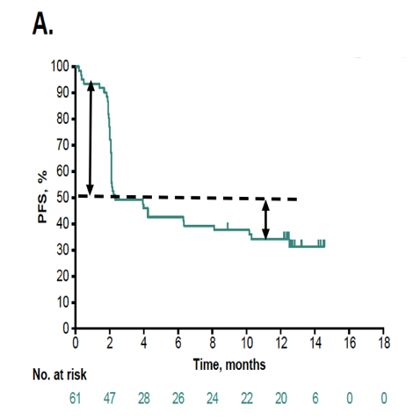

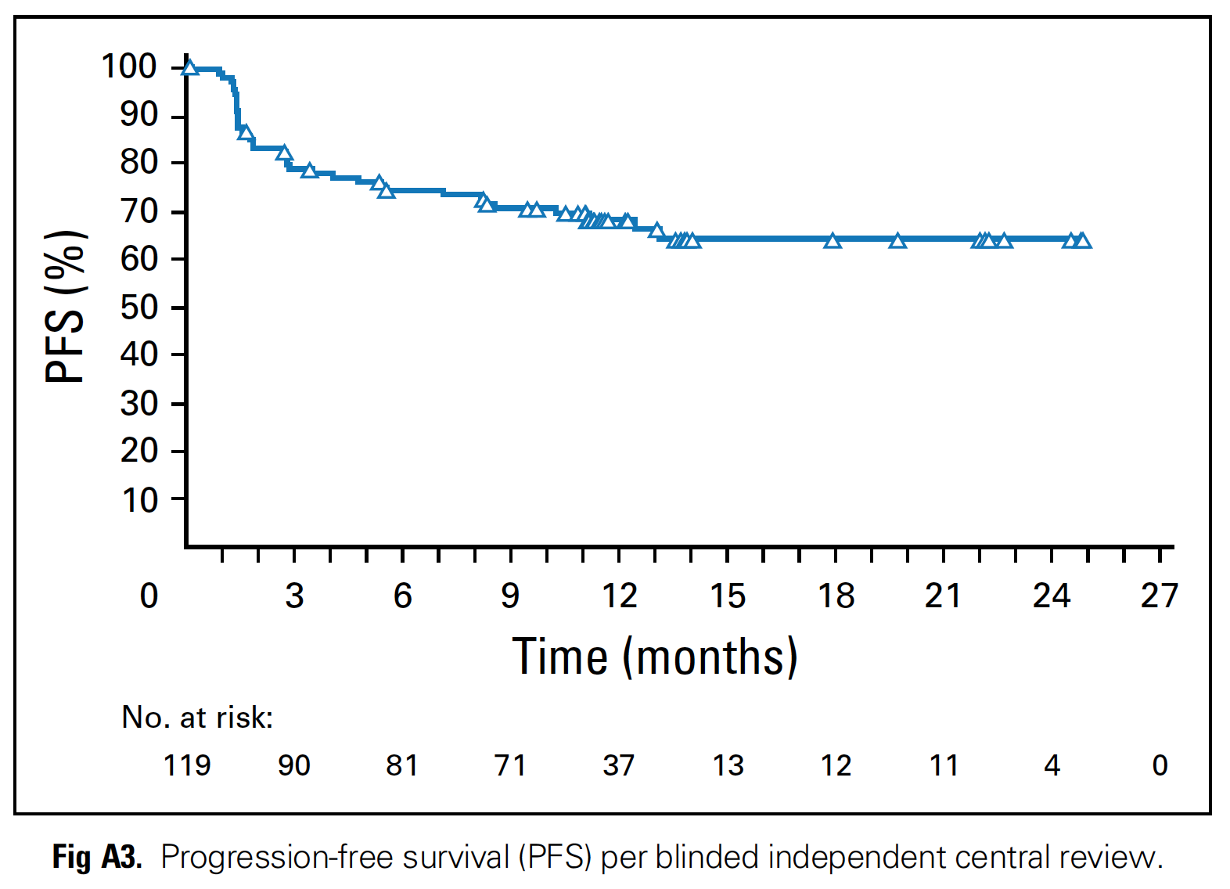



Less primary resistance ?
DIFERENCIAS ENTRE AGENTES ANTI PD 1 Y COMBINACIÓN EN PACIENTES PRETRATADOS
Checkmate -142
Keynote - 164
Checkmate -142
Nivolumab, Ipilimumab
Pembrolizumab
Nivolumab
2nd-3rd line
3rd line
3rd line
Resistencia primaria
Resistencia
secundaria
Resistencia primaria
Resistencia primaria
18%
15%
46%
28%
Resistencia
secundaria
Resistencia
secundaria
70%
1y-PFS
20%
20%
1y-PFS
35%
50%
1y-PFS
Cortesia Dan Aderka

Slide 30
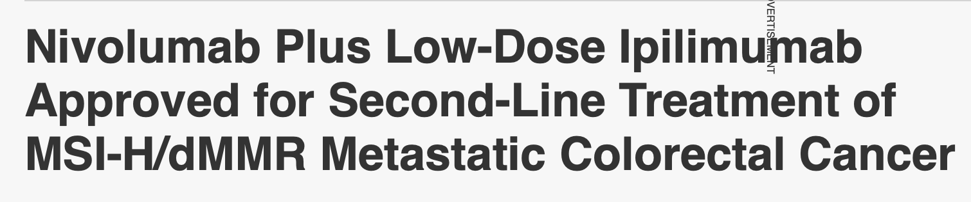
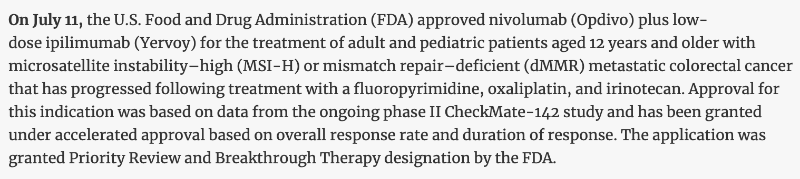
2018
Checkmate -142

Slide 31
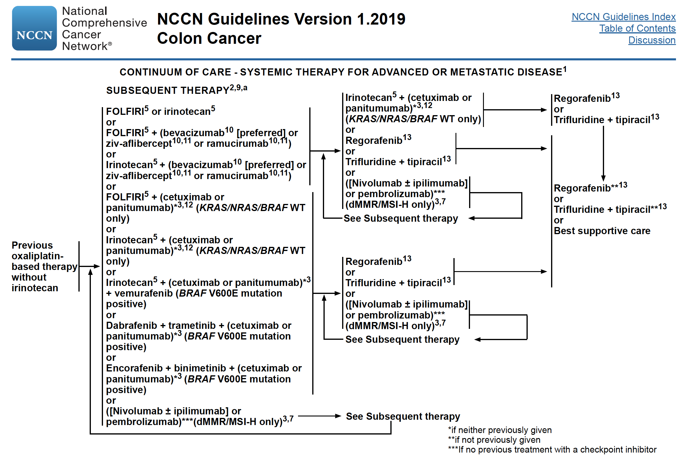
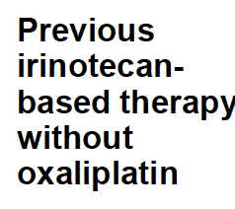

2nd line
NCCN

Slide 32

¿Es posible pensar en la inmunoterapia
como primera línea?

Slide 33
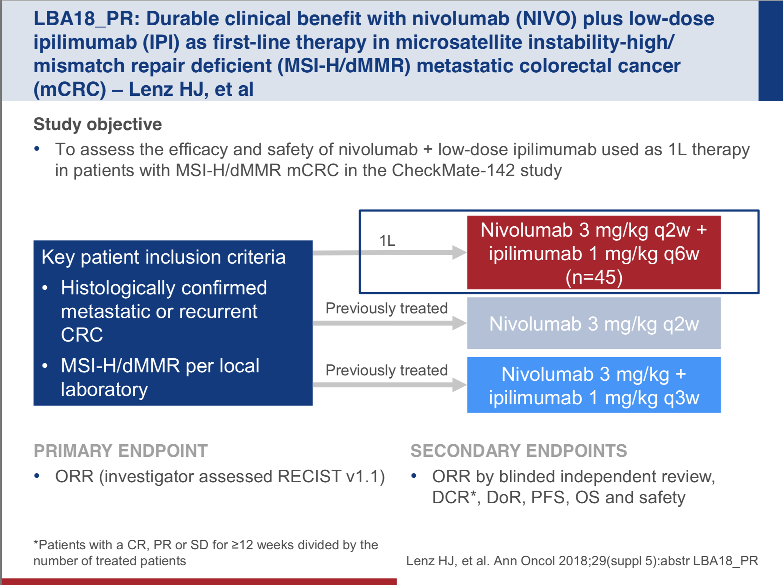
El rol del tratamiento IO en primera línea…
Nivolumab 3mg/kg
2w
2w
2w
2w
2w
2w
2w
2w
Ipilimumab 1mg/kg
6w
6w
6w

Slide 34
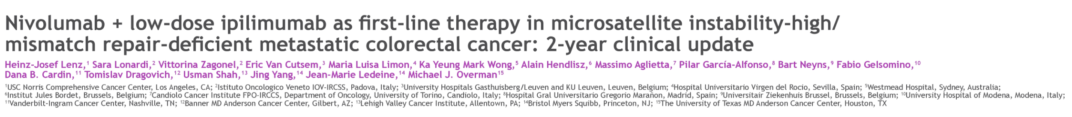
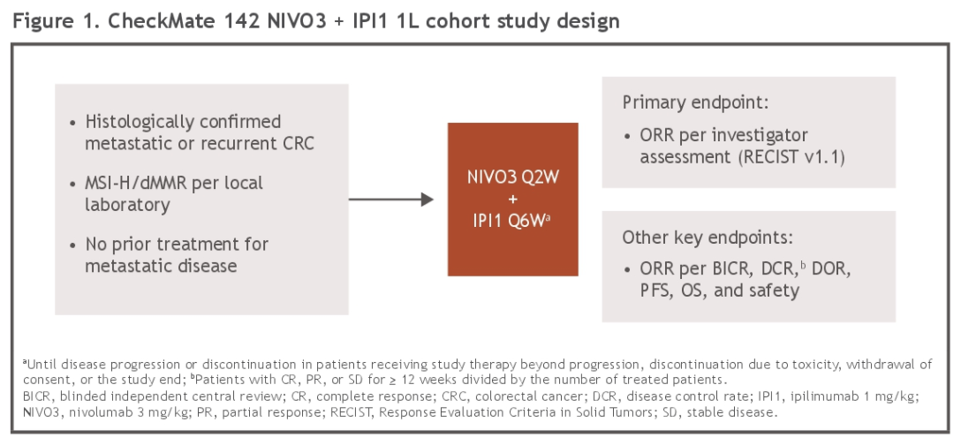
ASCO 2020

Slide 35
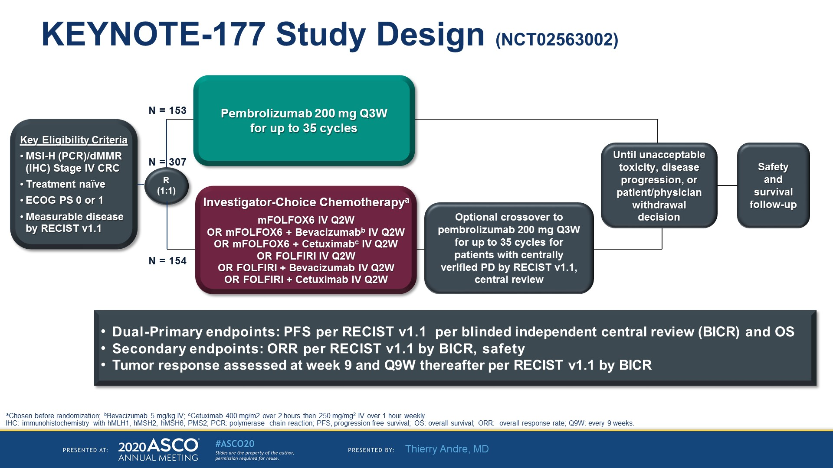

Slide 36
8HW Study Design
CA209-8HW: a phase 3 study of nivolumab, nivolumab plus ipilimumab, or investigator’s choice chemotherapy for the treatment of patients with MSI-H/dMMR mCRC^{1,2}
N=494
Study population:
Recurrent or metastatic CRC
MSI-H/dMMR by local testing
ECOG 0 and 1
Stratification:
Prior treatment for metastatic disease (0 vs 1 vs ≥2)
Location of primary tumor
(right vs left)
Arm A
Nivo 240 mg q2w x 6,
followed by
nivo 480 mg q4w
Tumor evaluation q6w for the first 24 weeks and then q12w until disease progression
Treatment until progression or toxicity
Max treatment duration
2 years EXCEPT in participants with late response (during second year of treatment) for additional 12 months after onset of response
Endpoints
• Primary
  PFS per BICR between arms B and A
Secondary
  PFS per BICR between arms B and C
  OS
  BICR-assessed ORR,
  DCR, DOR
  Investigator-assessed
  PFS, ORR, DCR, DOR
Nivo 240 mg + ipi 1 mg/kg q3w x 4,
followed by
nivo 480 mg q4w
R
2:2:1
Arm B
Arm C
Investigator’s choice chemotherapy
Status: Actively recruiting
Optional crossover to
I-O regimen for patients from arm C
BICR=blinded independent central review; CRC=colorectal cancer; DCR=disease control rate; DOR=duration of response; ECOG PS=Eastern Cooperative Oncology Group performance status; I-O=immuno-oncology; mCRC=metastatic CRC; MSI-H=microsatellite instability-high; nivo=nivolumab; ORR=objective response rate; OS=overall survival; PFS=progression-free survival; q2w=every 2 weeks; q3w=every 3 weeks; q4w=every 4 weeks; q6w=every 6 weeks; q12w=every 12 weeks.
1. BMS Internal Data (April 2019). 2. Clinicaltrials.gov. NCT04008030. Accessed October 4, 2019.

Slide 37

…
Algunas conclusiones…

Slide 38
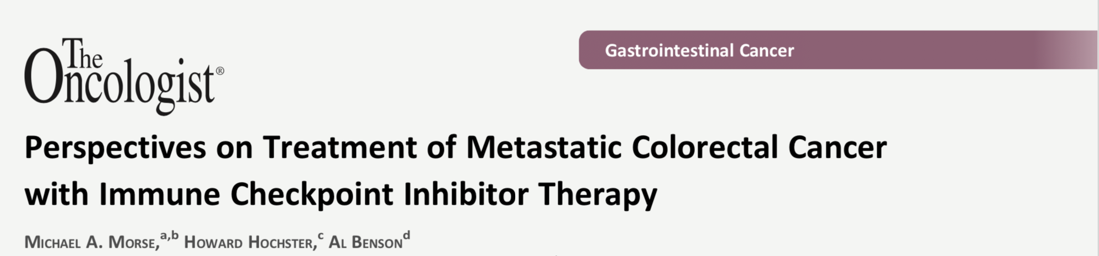

Slide 39
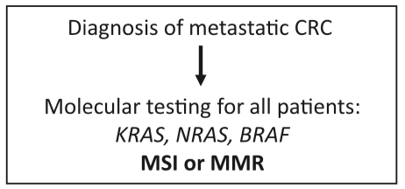
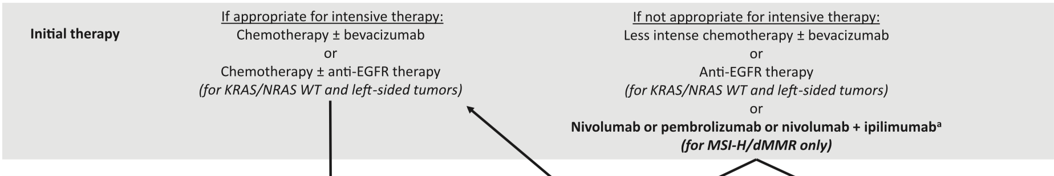
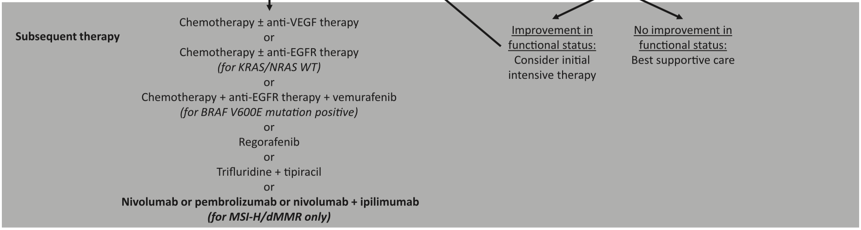



El 29 /11/ 2018 se aprobó combinación en CRC
CRC aprobado el 23/sep/2019
CRC aprobado el 9/oct/2019

Slide 40
EN CONCLUSION
La combinación de NIVO/IPI, recibió aprobación en base al estudio de comparación indirecta CHM 142, versus NIVO mono, en pacientes con MSI (ORR 55%, SLP a 12 meses, 71% y SVG a 12 meses de 85%)
En un análisis de subgrupos del CHM 142, no se encuentran diferencias en cuanto a beneficios en pacientes con BRAF mut, KRAS mut/wt, Sme Lynch o expr PD L1.
La toxicidad inmune relacionada incluye efectos en piel, GI, endocrina y pulmonar. Se dan en gral dentro de las primeras 12 semanas de tto y resuelven en un periodo similar.
Debemos aún dilucidar mecanismos de resistencia y su incorporación en una primera línea de tratamiento en CRC avanzado

Slide 41


Muchas gracias!!

