Slide 1


El potencial de IO y la evolución de las opciones de tratamiento para pacientes con Hepatocarcinoma
Dr. Guillermo Méndez
Jefe de Sección Oncología
Hospital de Gastroenterología
“Carlos B. Udaondo” y Fundación Favaloro
1506LA2003858-01

Slide 2
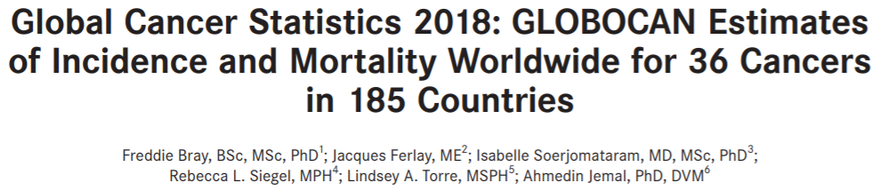
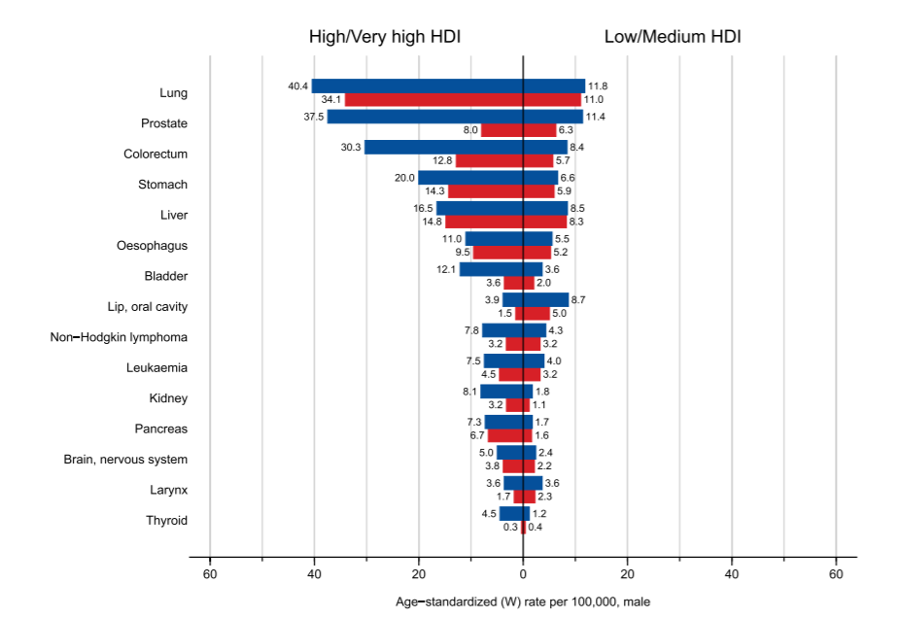
Liver Cancer (HCC: 75-85% de los casos)
- Sexta lugar en incidencia
Cuarto lugar en mortalidad
841000 nuevos casos por año
782000 muertes por año
3 veces mas frecuente en hombres

Slide 3
ALGUNOS DESAFÍOS EN HEPATOCARCINOMA
Tratar 2 enfermedades en un mismo paciente (cirrosis y HCC)
Seleccionar la mejor primera línea en enfermedad avanzada
Elegir las líneas ulteriores (¿secuenciación?)
Selección clínica y molecular de los pacientes

Slide 4
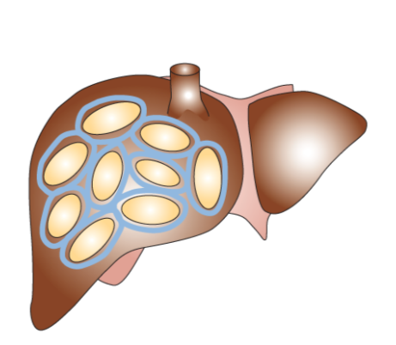
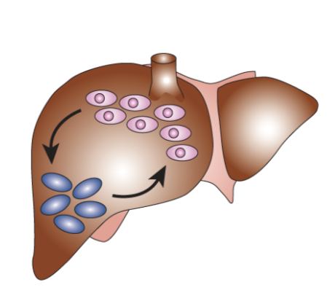


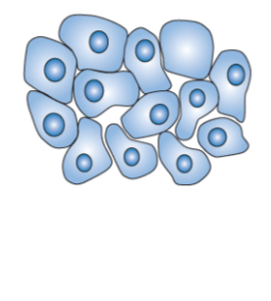
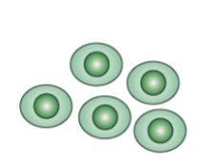
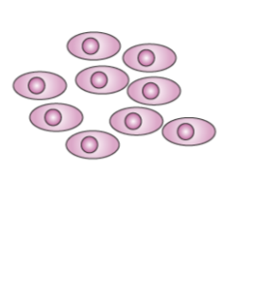


Progresión histopatológica y características moleculares del HCC
Enfermedad hepática crónica
Cirrosis hepática
Secuestro de la
Proliferación
de hepatocitos
Activación
Stellate cell
VHB
VHC
Alcohol
Aflatoxina B1
Daño
Necrosis
Proliferación
Señales proinflamatorias
Fibrosis extensa
(colágeno)
Nódulos hepáticos
anormales
Bien diferenciado
Marcada Inestabilidad genómica
Pérdida de p53, otros
Pérdida de NORE1A, Rb, p16, p21
Inestabilidad
Genómica moderada
Moderadamente diferenciado
Carcinoma
hepatocelular
Nódulos displásicos
Nódulos
hiperplásicos
Pobremente diferenciado
Farazi PA, DePinho RA. Nat Rev Cancer. 2006;6:674-87.
Notes:
4

Slide 5
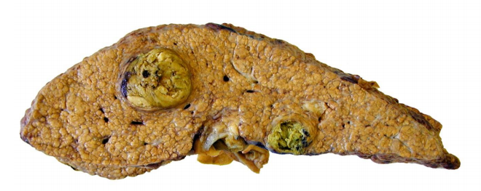
HCC
Pronóstico
80-90% de los pacientes tiene enfermedad hepática crónica de base
Pronóstico determinado por:
Función hepática
Factores relacionados al tumor
- PS

Slide 6
Complicaciones clínicas frecuentes en pacientes cirróticos
NOS TENEMOS QUE INTEGRAR A LOS COMITÉS DE HÍGADO PARA TRABAJAR EN MULTIDISCIPLINA CON HEPATÓLOGOS, CIRUJANOS, INTERVENCIONISTAS, …
Hemorragia digestiva
Varices esofágicas
Ascitis
Colestasis
PBE
PBS
Encefalopatía
HCC

Slide 7
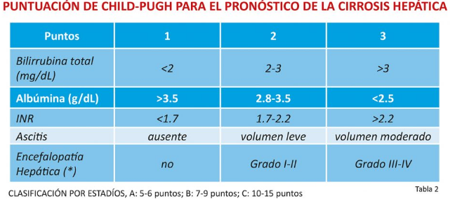
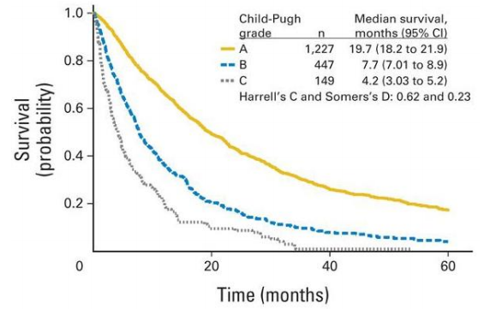
HCC
Pronóstico
Función hepática

Slide 8
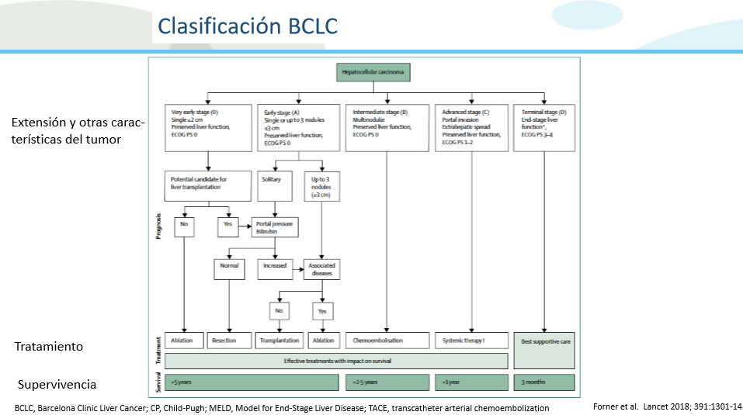

Slide 9
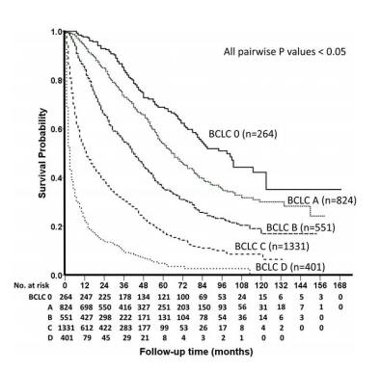
HCC
Pronóstico
BCLC y otros sistemas pronósticos

Slide 10
Tratamiento sistémico del HCC avanzado

Slide 11
Opciones actuales de tratamiento
1L
Sorafenib
Lenvatinib
2L
Regorafenib
Cabozantinib
Pembrolizumab*‡
Nivolumab‡
Ramucirumab
(AFP ≥400ng/mL)
Currently approved | ■ TKI | ■ Anti-PD1
Phase III data reported: not yet approved | ■ Anti-PDL1 + anti-VEGF | ■ Anti-VEGFR
*Negative phase III trial (KEYNOTE-240);^{1 ‡}Accelerated approval
1. Finn et al. ASCO 2019

Slide 12
Opciones actuales de tratamiento
1L
Sorafenib
Lenvatinib
2L
Regorafenib
Cabozantinib
Pembrolizumab*‡
Nivolumab‡
Ramucirumab
(AFP ≥400ng/mL)
Currently approved | ■ TKI | ■ Anti-PD1
Phase III data reported: not yet approved | ■ Anti-PDL1 + anti-VEGF | ■ Anti-VEGFR
*Negative phase III trial (KEYNOTE-240);^{1 ‡}Accelerated approval
1. Finn et al. ASCO 2019

Slide 13
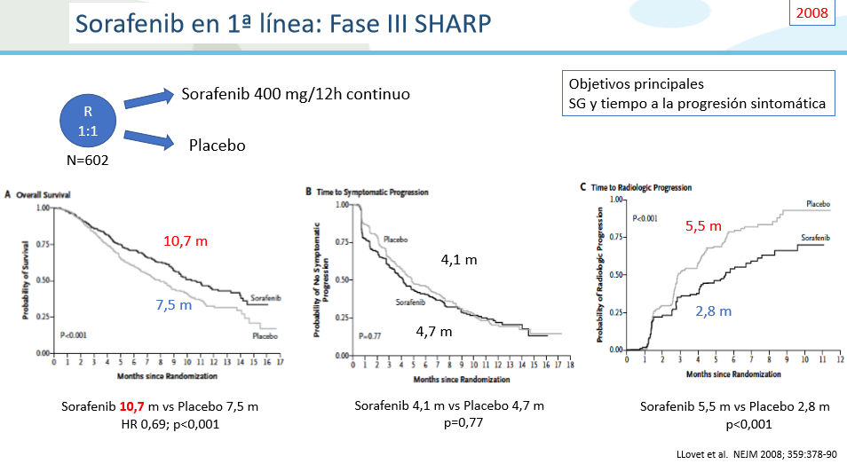
RR 2% VS 1%

Slide 14
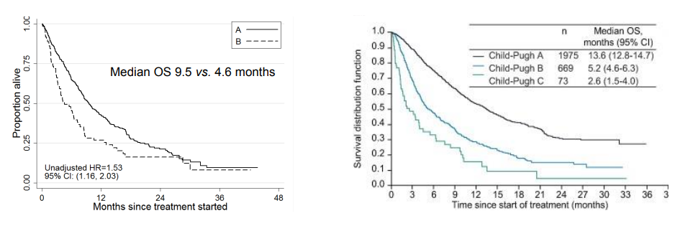
SORAFENIB
Actividad limitada en Child B y C

Slide 15
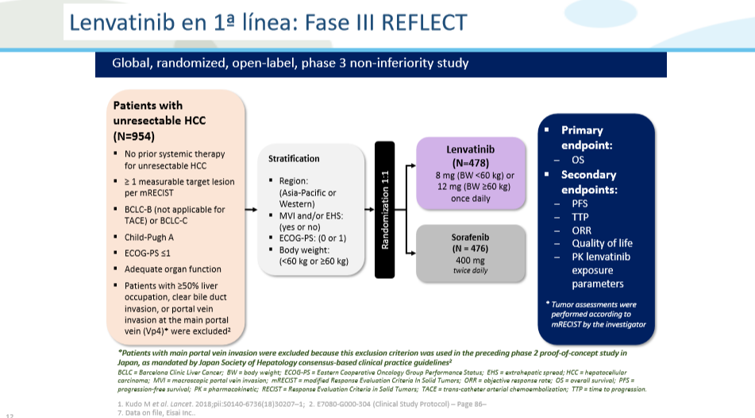

Slide 16
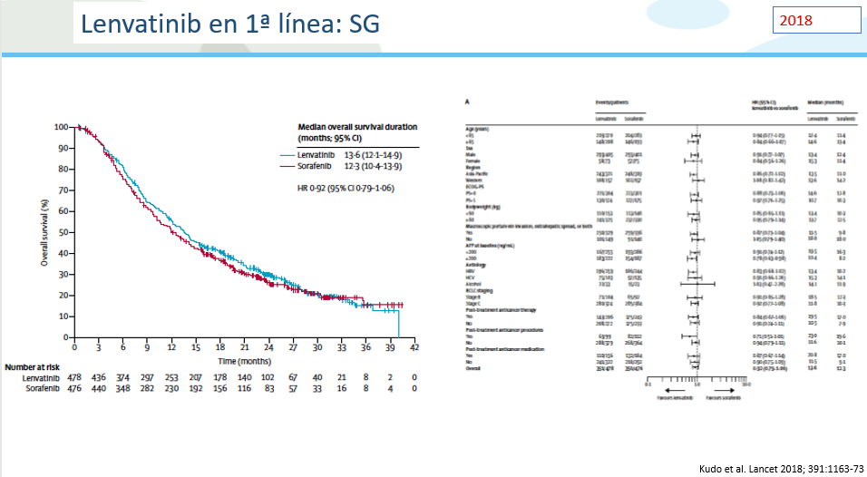


Slide 17
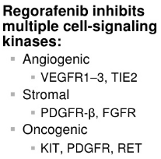
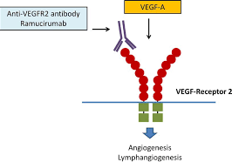
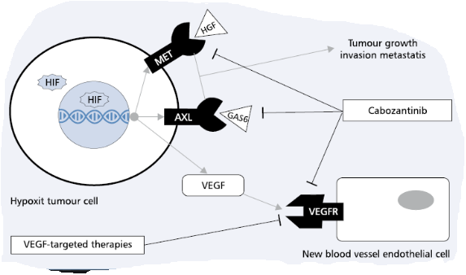
SEGUNDA LINEA
Regorafenib-Ramucirumab-Cabozantinib
MECANISMOS DE ACCIÓN y EFICACIA
Estudio RESORCE
n 573
Comparador: placebo
RR: 11 vs 4%
OS: 10.6 vs 7.8 m (HR 0.63)
PFS: 3.1 vs 1.5 m (HR 0.46)
Estudio REACH2
n 279 (aFP >400 ng/ml)
Comparador: Placebo
RR: 5 vs 1%
OS: 8.5 vs 7.3 m (HR 0.71)
PFS: 2.8 vs 1.6 m (HR 0.41)
Estudio CELESTIAL
n 707
Comparador: Placebo
RR: 4 vs 0.4%
OS: 10.2 vs 8 m (HR 0.76)
PFS: 5.2 vs 1.9 (HR 0.44)

Slide 18


Slide 19
INMUNOTERAPIA en HCC

Slide 20
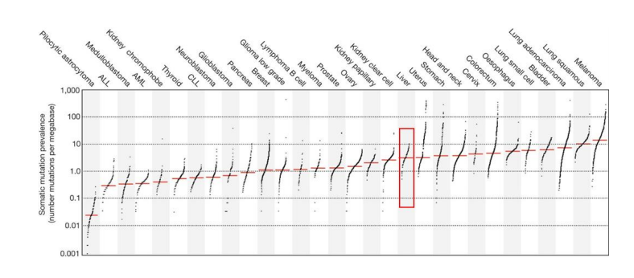
HCC
Inmunoterapia

Slide 21
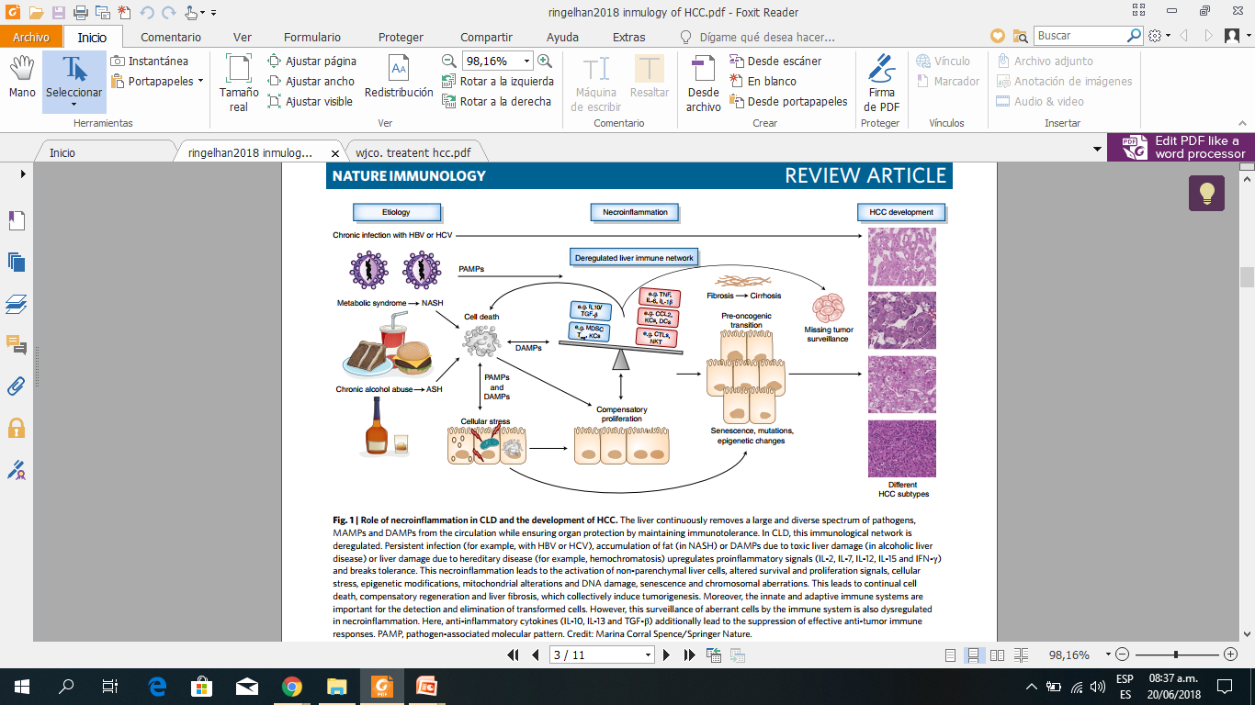
Inmunidad y hepatocarcinoma
Ringenhal et al: Nature immunoloy, 2018. doi.org/10.1038/s41590-018-0044-z
Notes:
A diferencia de la mayoría de las otras enfermedades malignas, el carcinoma hepatocelular (CHC), que representa aproximadamente el 90% de los cánceres de hígado, surge casi exclusivamente en el contexto de la inflamación crónica. Independientemente de la etiología, una secuencia típica de La necroinflamación crónica, la regeneración compensatoria del hígado, la inducción de la fibrosis hepática y la posterior cirrosis suelen preceder hepatocarcinogénesis. El hígado es un inmunomodulador central que asegura la protección sistémica y sistémica mientras mantiene inmunotolerancia. La desregulación de esta red inmunológica hepática estrechamente controlada es un sello distintivo de la enfermedad hepática crónica y HCC. Notablemente, las inmunoterapias han aumentado las esperanzas para el tratamiento exitoso del HCC avanzado

Slide 22
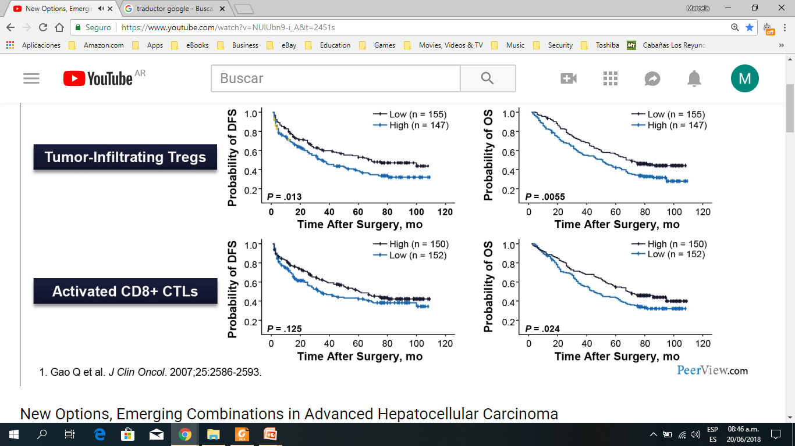
Balance intratumoral CTL regulatorios y citotóxicos está asociado con prónostico en HCC post resección
Infilt.
tumoral
Tregs
CTL
CD8+ activado

Slide 23
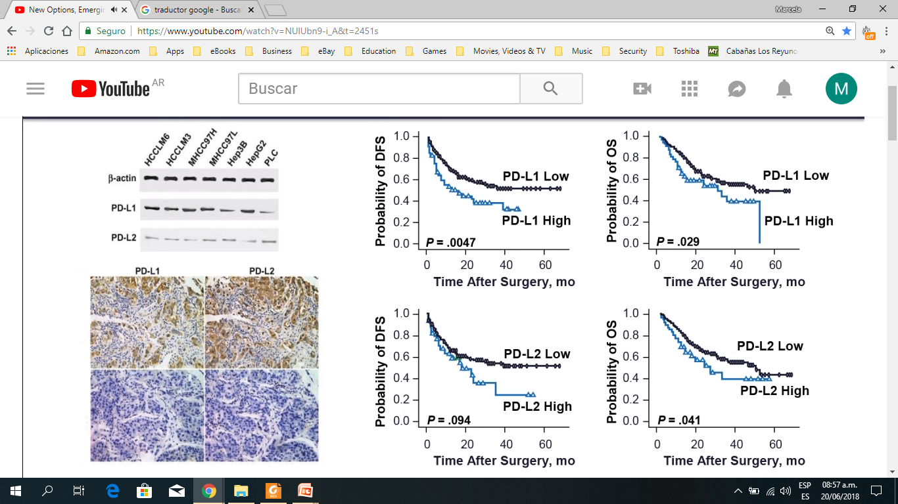
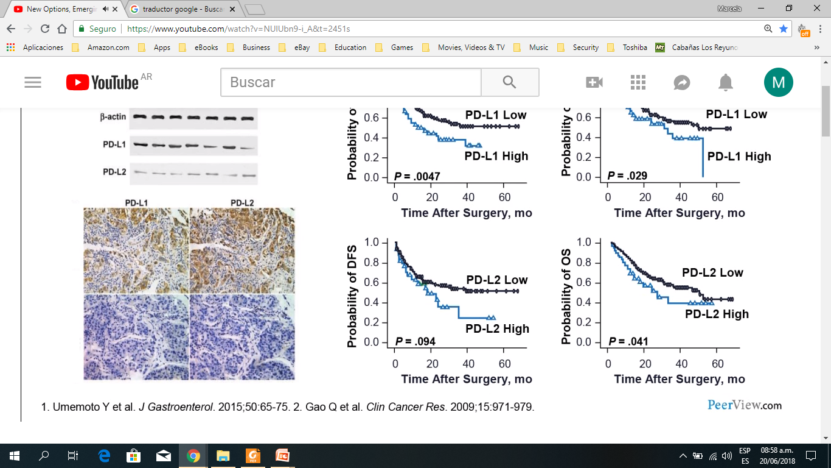
Inmunosupresión en HCC

Slide 24
NIVOLUMAB en HCC

Slide 25
Nivolumab en HCC
CheckMate-040 (CA209-040): Diseño
1
Dose-Escalation Phase^{1,2}
(1º endpoint = safety/tolerability)¹
2
Expansion Phase^{1,2}
(1º endpoint = ORR)¹
3
1L Nivolumab vs Sorafenib Cohort
(1º endpoint = ORR)¹
Nivolumab
0.1–10 mg/kg
Uninfected
Sorafenib experienced (2L)
Nivolumab
3 mg/kg
Uninfected
Sorafenib experienced (2L)
Eligibility Criteria Advanced HCC
Systemic therapy naive
CP ≤ 6
R
Nivolumab vs
sorafenib
HCV infected
Sorafenib naive (1L)
HCV infected
Sorafenib naive (1L)
HBV infected
HBV infected
4
Nivolumab + Ipilimumab
Combination Cohort
(1º endpoints = safety/tolerability and ORR)¹
5
Child-Pugh B Cohort
(1º endpoint = ORR)¹
6
Nivolumab + Ipilimumab + Cabozantinib Combination Cohort
(1º endpoint = ORR)¹
Eligibility Criteria Advanced HCC
CP class B (B7-B8)
Eligibility Criteria Advanced HCC
CP ≤ 6
Nivolumab
+
ipilimumab
+
cabozantinib
Eligibility Criteria Advanced HCC
CP ≤ 6
Nivolumab
+
ipilimumab
Nivolumab
1. ClinicalTrials.gov. NCT01658878, https://clinicaltrials.gov/ct2/show/NCT01658878; 2. Melero I et al. Oral presentation at ASCO GI 2017.
Notes:
CP, Child-Pugh; HBV, hepatitis B virus; HCC, hepatocellular carcinoma; HCV, hepatitis C virus; ORR, objective response rate; R, randomized.
Key Takeaways
The design of the phase 1/2 CheckMate-040 study of nivolumab in hepatocellular carcinoma (HCC) includes a dose-escalation and expansion phase, a randomized open-label study vs sorafenib, a nivolumab plus ipilimumab cohort, and a Child-Pugh B cohort
Narrative
The international phase 1/2 CheckMate-040 (CA209-040) study is currently evaluating safety, tolerability, and preliminary efficacy of the agent in patients with advanced HCC^{.[1,2]} The overall experimental design is outlined in this figure.^{[1]} The first part is a dose-escalation phase designed to establish safety and tolerability of nivolumab at different dose levels for each of three cohorts which include uninfected hepatocellular carcinoma (HCC) patients, hepatitis C virus (HCV)-infected HCC patients, and hepatitis B virus (HBV)-infected patients. This phase is followed by an expansion phase at specified doses for each of the 3 cohorts, with objective response rate (ORR) as the primary outcome.^{[1]} A third cohort with randomized allocation is designed to compare the efficacy of nivolumab and sorafenib for the first-line treatment of advanced HCC, with ORR as primary endpoint.^{[1]} A fourth cohort is designed to evaluate safety and efficacy of nivolumab plus ipilimumab in patients with advanced HCC. The fifth cohort is evaluating nivolumab in Child-Pugh B patients.^{[1]}
References
1. Clinicaltrials.gov. NCT01658878, https://clinicaltrials.gov/ct2/show/NCT01658878. [pg 1; Current Primary outcome measures / pg 3; Brief Title; Official Title; Brief Summary; para 1; para 2; pg 4; Study Arms; bullets 4-75; Eligibility Criteria; Inclusion Criteria; bullet 3]
2. Melero I, et al. Oral presentation at ASCO 2017. [Slide 4]

Slide 26
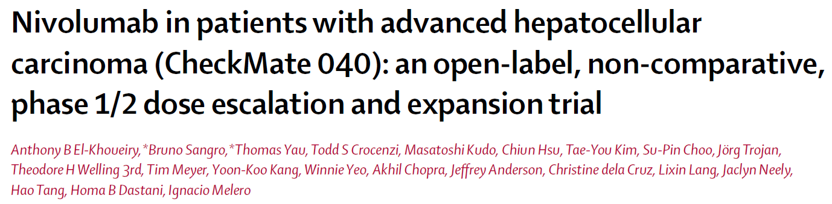
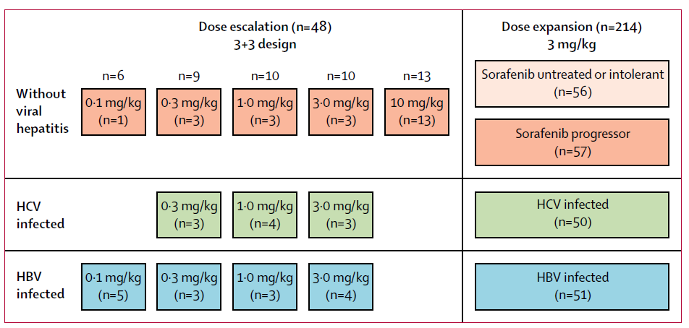
Criterios de inclusión
Confirmación histológica de HCC
Cohortes pre y post sorafenib
PS <2
Carga viral <100 UI/ml y con terapia antiviral
Grupo escalamiento de dosis Child A y B7
Grupo expansión Child A
El-Khoueiry_Checkmate 040 Esc-Exp_The Lancet 20April2017

Slide 27
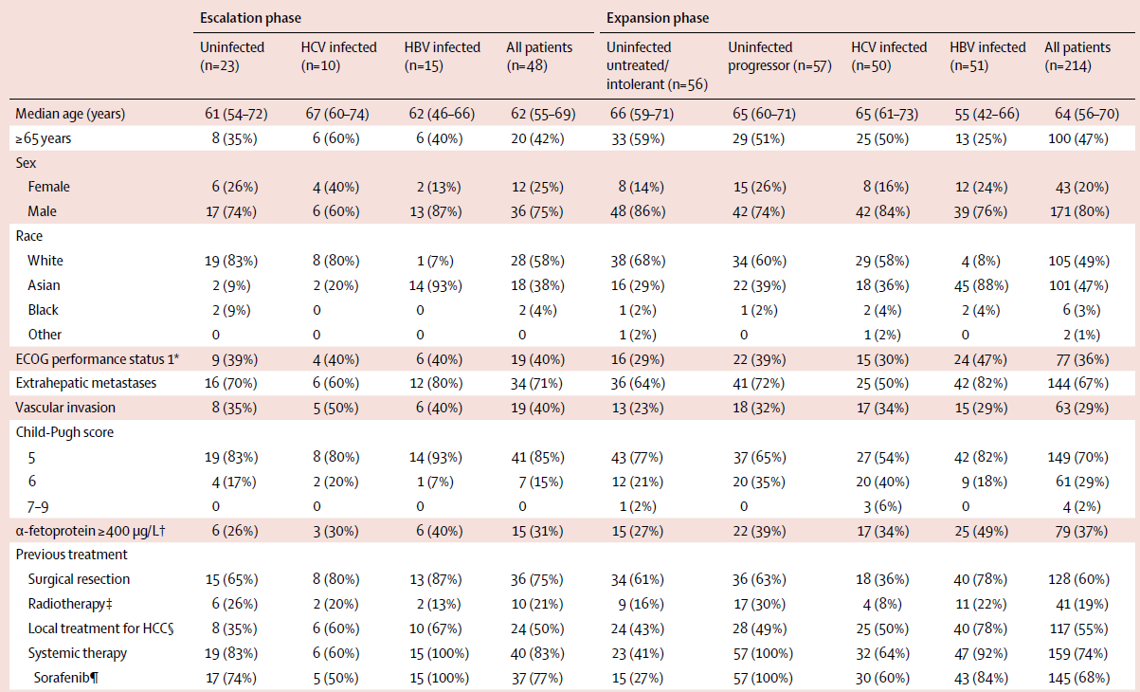
CheckMate 040
Características de la población en estudio
El-Khoueiry_Checkmate 040 Esc-Exp_The Lancet 20April2017

Slide 28
CheckMate 040
Eficacia: Tasa de respuesta (OBJETIVO PRIMARIO)
Sorafenib Experienced (2L)
Patients, n (%) | Sorafenib Experienced ESC (n = 37) |  | Sorafenib Experienced EXP (n = 145)
 | BICR | INV | BICR | INV
Objective response using RECIST v1.1 | 7 (19) | 6 (16) | 21 (14) | 28 (19)
Complete response | 1 (3) | 3 (8) | 2 (1) | 4 (3)
Partial response | 6 (16) | 3 (8) | 19 (13) | 24 (17)
Stable diseaseª | 13 (35) | 15 (41) | 60 (41) | 65 (45)
Progressive disease | 13 (35) | 12 (32) | 56 (39) | 47 (32)
Not evaluable | 4 (11) | 4 (11) | 8 (6) | 5 (3)
Objective response using mRECIST | 8 (22) | NA | 27 (19) | NA
ª Includes 2 sorafenib-naive patients and 1 sorafenib-experienced (ESC) patient who had a best overall response reported as non-CR/non-PD by BICR.
1. Crocenzi TS et al. Poster presentation at ASCO 2017. 4013.
Notes:
1L, first line; BICR, blinded independent central review; CR, complete response; ESC, escalation phase; EXP, expansion phase; INV, investigator assessment; mRECIST, modified RECIST; NA, not applicable; PD, progressive disease; RECIST, Response Evaluation Criteria In Solid Tumors.
Key Takeaways
The objective response rates (ORRs) by blinded independent central review (BICR) were 14%–19% in 2L patients across the dose-escalation and -expansion phases, and the disease control rate (CR + PR + SD + non-CR/non-PD was 55% in 2L patients overall.
Objective response rates by BICR and investigator assessment were highly concordant (≈ 90%).
Narrative
Tumor response rates were reported by both investigator assessment and by BICR is intended to minimize subjectivity by providing independent verification of imaging assessments at a central location by blinded reviewers who were not involved in the study, and is preferred by regulatory agencies for primary endpoint assessments in registrational studies.
Key efficacy endpoints for tumor response were analyzed by BICR and investigator assessment using the Response Evaluation Criteria In Solid Tumors (RECIST; version 1.1).^{[1]} Exploratory endpoints included tumor assessments that used modified RECIST (mRECIST; by BICR). RECIST version 1.1 was used for assessment of the primary endpoint because it is well established and provides a more conservative estimation of response than mRECIST. Assessment by RECIST version 1.1 also allows for comparisons of response data with pivotal studies in patients with hepatocellular carcinoma (eg, sorafenib/SHARP trial).^{[2]} mRECIST has not been prospectively validated and has not been evaluated for immuno-oncology therapies.
ORRs by BICR and investigator assessment were highly concordant. ORRs by BICR were 14%–19% across dose-escalation and -expansion phases.^{[3]}
References
Eisenhauer EA, Therasse P, Bogaerts J, et al. New response evaluation criteria in solid tumours: revised RECIST guideline (version 1.1). Eur J Cancer. 2009;45:228-247.
Llovet JM, Ricci S, Mazzaferro V, et al. Sorafenib in advanced hepatocellular carcinoma. N Engl J Med. 2008;359:378-390.
Crocenzi TS, et al. Poster presentation at ASCO 2017. [4013] [Ref 1: Column 3; Table 4; Ref 1: Column 3; Table 4; footnote]

Slide 29
CheckMate 040
Eficacia: Sobrevida global
Sorafenib Experienced (2L)
Sorafenib Experienced
1.0
0.9
Probability of survival
0.8
ESC:
Median OS (95% CI), mo = 15.0 (5.0–28.1)
OS Rate (95% CI), % | ESC | EXP
12 months | 58 (40.2–72.2) | 60 (51.4–67.5)
18 months | 46 (29.5–61.7) | 44 (35.3–51.9)
0.7
0.6
0.5
Kaplan-Meier method; closed circles denote censored patients.
0.4
0.3
0.2
0.1
EXP:
Median OS (95% CI), mo = 15.6 (13.2–18.9)
0
0
3
6
9
12
15
18
21
24
27
30
33
36
39
42
45
48
Months
1. Crocenzi TS et al. Poster presentation at ASCO 2017. 4013.
Notes:
1L, first line; DBL, database lock; ESC, escalation phase; EXP, expansion phase; OS, overall survival.
Key Takeaways
Nivolumab demonstrated long-term OS, with a median OS of 16 months and an 18-month OS rate of 44% in 2L patients.
Narrative
With median follow-up times of 14–15 months at the time of data cutoff, the median OS in sorafenib-experienced patients was 15 months in the dose-escalation phase and 16 months in the dose-expansion phase. Together with 18-month OS rates of 46% and 44%,respectively, nivolumab demonstrated long-term survival in sorafenib-experienced patients. CheckMate-040 authors concluded that the durable disease control observed in many patients with nivolumab likely contributed to the long-term overall survival results.
Reference
Crocenzi TS, et al. Poster presentation at ASCO 2017. [4013]. [Ref 1: Column 4; Figure 4; Ref 1: Column 4; Figure 4]

Slide 30
CheckMate 040
Eficacia: tiempo a la respuesta
Sorafenib Experienced (2L)
Sorafenib Experienced
ESC
Sorafenib Experienced
EXP
CR
PR
Last dose
Off treatment
Ongoing response
#
Censored
Death
Uninfected
HCV
HBV
0
3
6
9
12
15
18
21
24
27
30
33
36
39
42
0
3
6
9
12
15
18
21
24
27
30
33
36
39
42
Months
Months
TTR, median (range), mo | 1.4 (1.3–6.9)
DOR, median (range), mo | 19.35 (2.8–38.2+)
TTR, median (range), mo | 2.8 (1.2–7.0)
DOR, median (range), mo | 16.59 (3.2–16.8+)
Tumor response assessed by BICR using RECIST v1.1.
Notes:
1L, first line; BICR, blinded independent central review; CR, complete response; HBV, hepatitis B virus; HCV, hepatitis C virus; PR partial response; TTR, time to response; DOR, duration of response.
Key Takeaways
Among sorafenib-experienced patients with a response, responses occurred early (most within 3 months) and were durable, with median durations of 17–19 months across the escalation and expansion phases.
Narrative
As chronic viral hepatitis is one of the major underlying cause of HCC, CheckMate-040 included patients with HCV or HBV infection as well as uninfected patients to establish efficacy and safety in these subpopulations. The majority of objective responses in sorafenib-experienced patients (64% [18/28]) occurred in ≤ 3 months, and the median time to response (TTR) was 1.4 and 2.8 months in 2L patients in the dose-escalation and -expansion phases, respectively. Responses were ongoing at the time of data cutoff in 39% (11/28) of sorafenib-experienced patients overall. Responses were durable, with median durations of response (DORs) of at least 17 months.
Reference
Crocenzi TS, et al. Poster presentation at ASCO 2017. [4013]. [Ref 1: Column 3; Figure 2; Ref 1: Column 3; Table 4]

Slide 31
CheckMate 040
Eficacia: respuesta segun etiología
Sorafenib Experienced (2L)
Sorafenib Experienced
ESC
Sorafenib Experienced
EXP
 | Uninfected | HCV | HBV
ORR, n/N (%) | 3/17 (18) | 2/5 (40) | 2/15 (13)
 | Uninfected | HCV | HBV
ORR, n/N (%) | 9/72 (13) | 6/30 (20) | 6/43 (14)
Best change from baseline in target lesion, %
100
100
ª
80
80
60
60
40
40
20
20
0
0
–20
–20
–40
–40
–60
–60
–80
–80
–100
Patients
–100
Patients
Tumor response assessed by BICR using RECIST v1.1; plots include patients who were evaluable for tumor response and had ≥ 1 postbaseline target lesion assessment (sorafenib naive, n = 72; sorafenib experienced [ESC], n = 32; and sorafenib experienced [EXP], n = 135).
ª Percent change truncated to 100%.
1. Crocenzi TS et al. Poster presentation at ASCO 2017. 4013.
Notes:
1L, first line; BICR, blinded independent central review; HCV, hepatitis C virus; HBV, hepatitis B virus; ORR, objective response rate.
Key Takeaways
Objective responses, including significant reductions in target lesions, were observed irrespective of HCC etiology and prior sorafenib treatment status.
Narrative
Here we show best change from baseline in target lesion for the sorafenib-experienced patients in the escalation phase (left figure) and expansion phase (right figure). While not all patients with a best reduction in target lesion size > 30% achieved an objective response, disease control of ≥ 6 months was achieved by 27% of all sorafenib-experienced patients. Objective responses, including significant reductions in target lesions, were observed irrespective of HCC etiology and prior sorafenib treatment status.
Reference
Crocenzi TS, et al. Poster presentation at ASCO 2017. 4013. [Ref 1: Column 4; Figure 3; Ref 1: Column 4; Figure 3; Footnote; Ref 1: Column 4; Figure 3]

Slide 32
CheckMate 040
Eficacia: sobrevida global según etiología
Sorafenib Experienced (2L) – Dose Expansion
 | HCV Infected (n = 30) | HBV Infected (n = 43) | Uninfected (n = 72) | All Patients (N = 145)
Median OS (95% CI)ª | NR | NR | 16.7 (11.3–NE) | 16.7 (13.2–NE)
12-mo OS rate (95% CI), %ª | 67.1 (46.2–81.4) | 55.6 (39.6–69.0) | 59.7 (47.4–70.0) | 59.9 (51.3–67.4)
ª Kaplan-Meier method.
1.0
0.9
Probability of survival
0.8
0.7
0.6
0.5
0.4
0.3
0.2
0.1
0.0
0
3
6
9
12
15
18
21
24
Months
1. Sangro B et al. Oral presentation at EASL 2017. LB-4188.
Notes:
2L, second line; HBV, hepatitis B virus; HCV, hepatitis C virus; NR, not reached; NE, not estimable; OS, overall survival.

Slide 33
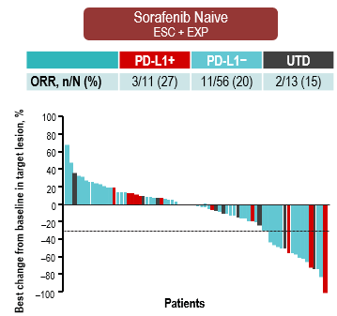
CheckMate 040
Eficacia acorde al status de PD-L1
Sorafenib Experienced (2L)
Sorafenib Experienced
ESC
Sorafenib Experienced
EXP
Best change from baseline in target lesion, %
 | PD-L1+ | PD-L1− | UTD
ORR, n/N (%) | 2/9 (22) | 5/26 (19) | 0/2 (0)
 | PD-L1+ | PD-L1− | UTD
ORR, n/N (%) | 7/25 (28) | 13/102 (13) | 1/18 (6)
100
100
ª
80
80
60
60
40
40
20
20
0
0
–20
–20
–40
–40
–60
–60
–80
–80
–100
Patients
–100
Patients
Tumor response assessed by BICR using RECIST v1.1; plots include patients who were evaluable for tumor response and had ≥ 1 postbaseline target lesion assessment (sorafenib naive, n = 72; sorafenib experienced [ESC], n = 32; and sorafenib experienced [EXP], n = 135). ª Percent change truncated to 100%.
1. Crocenzi TS et al. Poster presentation at ASCO 2017. 4013.
Notes:
BICR, blind independent central review; ESC, escalation phase; EXP, expansion phase; ORR, objective response rate; PD-L1, programmed death ligand 1; PD-L1+, ≥ 1% tumor cells expressing PD-L1; PD-L1−, < 1% tumor cells expressing PD-L1; RECIST, response evaluation criteria in solid tumors; UTD, unable to determine PD-L1 expression.
Key Takeaways
Objective responses in sorafenib-experienced patients were observed irrespective of PD-L1 expression on tumor cells using a 1% cutoff.
Narrative
Tumor response stratified by patients with PD-L1 expression on tumor cells was evaluated as an exploratory analysis. Approximately 20% of patients treated in the study had PD-L1 expressed on ≥ 1% of tumor cells, and objective responses were observed regardless of PD-L1 expression on tumor cells using this 1% cutoff. Thus far in CheckMate-040, PD-L1 expression has been measured only on tumor cells. Analysis of PD-L1 expression on tumor-infiltrating lymphocytes (TILs) in CheckMate-040 patients is in progress, and results will be published separately. On the left is a waterfall plot of best change from baseline in target lesion for sorafenib-experienced patients in the escalation phase; the expansion phase is shown on the right. Red bars represent patients with PD-L1 tumor cell expression levels ≥ 1%; blue bars represent patients with PD-L1 tumor cell expression levels < 1%. Black bars represent patients whose PD-L1 expression levels could not be determined.
Reference
Crocenzi TS, et al. Poster presentation at ASCO 2017. [4013]. [Ref 1: Column 4; Figure 3; Ref 1: Column 4; Figure 3; Footnote]

Slide 34
CheckMate 040
Eficacia acorde a mejor respuesta
Overall Survival by Best Overall Response
Overall Survival by Change in Target Lesion Size
Sorafenib experienced receiving 3 mg/kg (n=154)
Overall survival was analyzed by BOR
Patients with BORs of SD or PD achieved median OS of
16.7 and 8.9 months, respectively
To assess impact of degree of tumor reduction/growth on OS, OS was analyzed by best change in target lesion size from baseline
Patients with increases in target lesion sizes of up to 25% or ≥ 25% achieved median OS of 11.7 and 8.9 months, respectively
1.0
Median OS (95% CI), mo = NR (NE–NE)
1.0
Probability of survival
0.9
Probability of survival
0.9
Median OS (95% CI), mo = NR (NE–NE)
0.8
Complete or partial response (n = 22) Stable disease (n = 65)
Progressive disease (n = 59)
0.8
0.7
0.7
≥ 25% reduction (n = 30)
0–25% reduction (n = 33)
0–25% increase (n = 61)
≥ 25% increase (n = 21)
0.6
0.6
0.5
0.5
0.4
Median OS (95% CI), mo = 16.7 (13.8–20.2)
0.4
Median OS (95% CI), mo = 17.7 (13.3–22.3)
0.3
Median OS (95% CI), mo = 8.9 (7.3–13.4)
0.3
Median OS (95% CI), mo = 11.7 (8.0–16.7)
0.2
0.2
0.1
n = 146ª
0.1
n = 145^{b}
Median OS (95% CI), mo = 8.9 (5.0–14.9)
0
0
0
3
6
9
12
15
18
21
24
27
30
33
36
39
42
45
48
0
3
6
9
12
15
18
21
24
27
30
33
36
39
42
45
48
Months
Months
OS rate [95% CI], % | Complete/partial response n = 22 | Stable disease n = 65 | Progressive disease n = 59
12 month | 100 [100–100] | 67 [55–77] | 41 [28–53]
18 month | 100 [100–100] | 45 [33–57] | 26 [15–38]
OS rate [95% CI], % | ≥ 25% Reduction n = 30 | 0–25% Reduction n = 33 | 0–25% Increase n = 61 | ≥ 25% Increase n = 21
12 month | 90 [72–97] | 72 [53–85] | 48 [35–60] | 40 [20–60]
18 month | 87 [68–95] | 49 [31–65] | 29 [18–41] | 25 [9–45]
Median OS in the analysis population (N = 154) was 15.1 months (95% CI: 13.2–18.8); 12- and 18-month OS rates were 60% and 44%, respectively
ªBest overall response was unable to be determined in 8 patients.
^{b}Best overall response was unable to be determined in 9 patients.
El-Khoueiry A, et al. Poster presentation at ASCO-GI 2018 [Abstract 475].
Notes:
BOR, best overall response; NE, not estimable; NR, not reached; OS, overall survival; PD, progressive disease; SD, stable disease.
Key Takeaways
22 patients experienced a complete response or partial response. The median OS in those with a complete response was not reached. 30 patients had ≥ 25% reduction in target legion size. The median OS was 11.7 and 8.9 months for patients with increases in target lesion sizes of up to 25% or ≥ 25%.
Reference
1. El-Khoueiry A, et al. Poster presentation at ASCO-GI 2018. 475. [Ref 1: column 3; results; efficacy; figure 2 and footnotes; Ref 1: column 2; results; efficacy; figure 2; bullets 1,2 on the left; Ref 1: column 2; results; efficacy; figure 2; bullets 1,2 on the right; Ref 1: column 2; results; efficacy; figure 2; bullet below tables].

Slide 35
CheckMate 040
Seguridad en segunda linea
Sorafenib Experienced (2L)
n (%) | Sorafenib Experienced ESC + EXP (n = 182)
 | Any Grade | Grade 3/4
Patients with any treatment-related AE | 141 (77) | 32 (18)
Treatment-related AEs (≥ 5%)ª
Fatigue | 40 (22) | 4 (2)
Pruritus | 37 (20) | 1 (1)
Rash | 33 (18) | 1 (1)
Diarrhea | 26 (14) | 2 (1)
Nausea | 14 (8) | 0
Decreased appetite | 12 (7) | 1 (1)
Anemia | 9 (5) | 1 (1)
Dry mouth | 10 (5) | 0
Laboratory treatment-related AEs (≥ 5%)ª
ALT increased | 16 (9) | 5 (3)
AST increased | 16 (9) | 7 (4)
Blood bilirubin increased^{b} | 4 (2) | 0
Lipase increased | 12 (7) | 8 (4)
Amylase increased | 10 (5) | 2 (1)
ª Reported in ≥ 5% of all patients (N = 262), any grade; ^{b} Blood bilirubin increases were reported in < 5% of all patients.
1. Crocenzi TS et al. Poster presentation at ASCO 2017. 4013.
Notes:
2L, second line; AE, adverse event; ALT, alanine aminotransferase; AST, aspartate aminotransferase; ESC, escalation phase; EXP, expansion phase.
Key Takeaways
Nivolumab had a manageable safety profile similar to that observed in other tumor types, with no new safety signals observed.
Narrative
Grade 3/4 treatment-related AEs occurred in 32 sorafenib-experienced patients (18%) Frequencies of grade 3/4 ALT or AST elevations were 3% and 4%, respectively. One sorafenib-experienced patient in the dose-expansion phase died due to study drug (pneumonitis). No new safety signals were observed with nivolumab in patients with advanced HCC. Nivolumab had a manageable safety profile similar to that observed with nivolumab in other tumor types.
Reference
Crocenzi TS, et al. Poster presentation at ASCO 2017. [4013]. [Ref 1: Column 5; Table 5; Ref 1: Column 5; Table 5; Footnote]

Slide 37
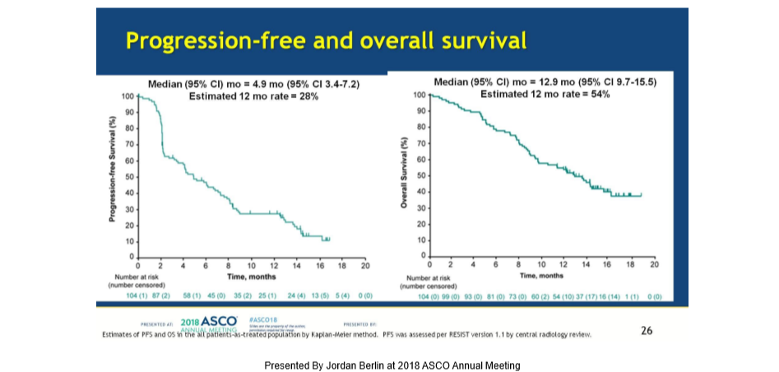
HCC
Pembrolizumab – KEYNOTE – 224 (Fase II)
RR 18%

Slide 38
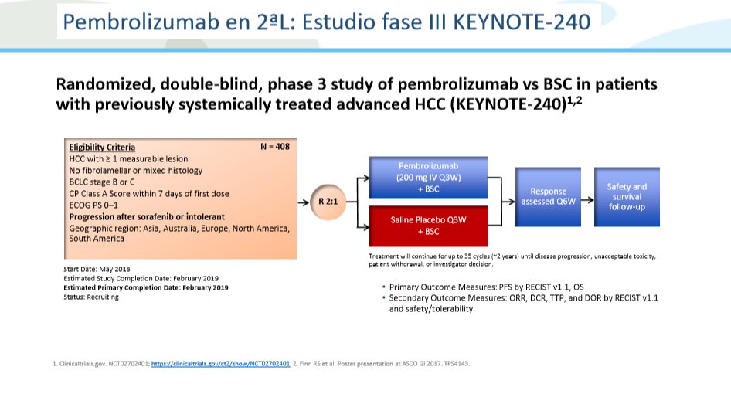

Slide 39
Pembrolizumab en segunda línea
KEYNOTE 240: sobrevida global
RR 18.4%

Slide 40


Slide 41
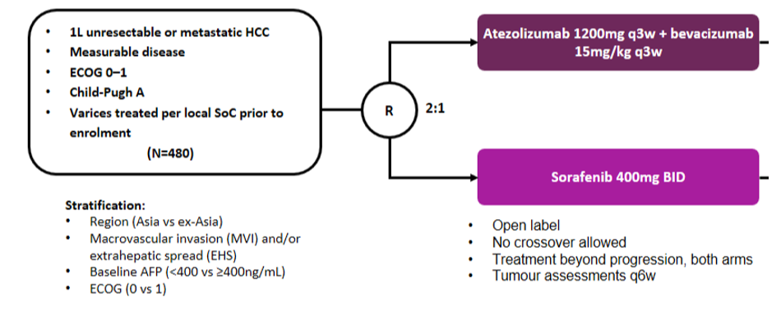
Estudio IMbrave 150
Atezolizumab + bevacizumab
https://clinicaltrials.gov/ct2/show/NCT03434379

Slide 42


Slide 43
Nivolumab en HCC
CheckMate-040 (CA209-040): Cohorte 4: 2L NIVO-IPI
1
Dose-Escalation Phase^{1,2}
(1º endpoint = safety/tolerability)¹
2
Expansion Phase^{1,2}
(1º endpoint = ORR)¹
3
1L Nivolumab vs Sorafenib Cohort
(1º endpoint = ORR)¹
Nivolumab
0.1–10 mg/kg
Uninfected
Sorafenib experienced (2L)
Nivolumab
3 mg/kg
Uninfected
Sorafenib experienced (2L)
Eligibility Criteria Advanced HCC
Systemic therapy naive
CP ≤ 6
R
Nivolumab vs
sorafenib
HCV infected
Sorafenib naive (1L)
HCV infected
Sorafenib naive (1L)
HBV infected
HBV infected
4
Nivolumab + Ipilimumab
Combination Cohort
(1º endpoints = safety/tolerability and ORR)¹
5
Child-Pugh B Cohort
(1º endpoint = ORR)¹
6
Nivolumab + Ipilimumab + Cabozantinib Combination Cohort
(1º endpoint = ORR)¹
Eligibility Criteria Advanced HCC
CP class B (B7-B8)
Eligibility Criteria Advanced HCC
CP ≤ 6
Nivolumab
+
ipilimumab
+
cabozantinib
Eligibility Criteria Advanced HCC
CP ≤ 6
Nivolumab
+
ipilimumab
Nivolumab
1. ClinicalTrials.gov. NCT01658878, https://clinicaltrials.gov/ct2/show/NCT01658878; 2. Melero I et al. Oral presentation at ASCO GI 2017.
Notes:
CP, Child-Pugh; HBV, hepatitis B virus; HCC, hepatocellular carcinoma; HCV, hepatitis C virus; ORR, objective response rate; R, randomized.
Key Takeaways
The design of the phase 1/2 CheckMate-040 study of nivolumab in hepatocellular carcinoma (HCC) includes a dose-escalation and expansion phase, a randomized open-label study vs sorafenib, a nivolumab plus ipilimumab cohort, and a Child-Pugh B cohort
Narrative
The international phase 1/2 CheckMate-040 (CA209-040) study is currently evaluating safety, tolerability, and preliminary efficacy of the agent in patients with advanced HCC^{.[1,2]} The overall experimental design is outlined in this figure.^{[1]} The first part is a dose-escalation phase designed to establish safety and tolerability of nivolumab at different dose levels for each of three cohorts which include uninfected hepatocellular carcinoma (HCC) patients, hepatitis C virus (HCV)-infected HCC patients, and hepatitis B virus (HBV)-infected patients. This phase is followed by an expansion phase at specified doses for each of the 3 cohorts, with objective response rate (ORR) as the primary outcome.^{[1]} A third cohort with randomized allocation is designed to compare the efficacy of nivolumab and sorafenib for the first-line treatment of advanced HCC, with ORR as primary endpoint.^{[1]} A fourth cohort is designed to evaluate safety and efficacy of nivolumab plus ipilimumab in patients with advanced HCC. The fifth cohort is evaluating nivolumab in Child-Pugh B patients.^{[1]}
References
1. Clinicaltrials.gov. NCT01658878, https://clinicaltrials.gov/ct2/show/NCT01658878. [pg 1; Current Primary outcome measures / pg 3; Brief Title; Official Title; Brief Summary; para 1; para 2; pg 4; Study Arms; bullets 4-75; Eligibility Criteria; Inclusion Criteria; bullet 3]
2. Melero I, et al. Oral presentation at ASCO 2017. [Slide 4]

Slide 44
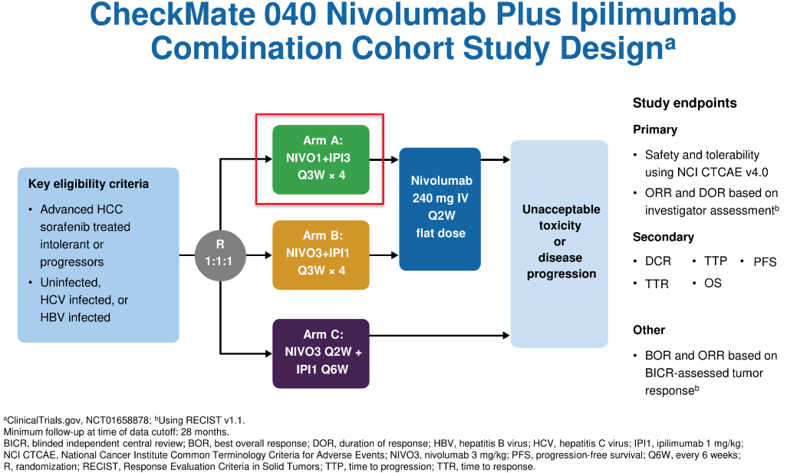
ClinicalTrials.gov. NCT01658878, https://clinicaltrials.gov/ct2/show/NCT01658878; 2. Melero I et al. Oral presentation at ASCO GI 2017.

Slide 45
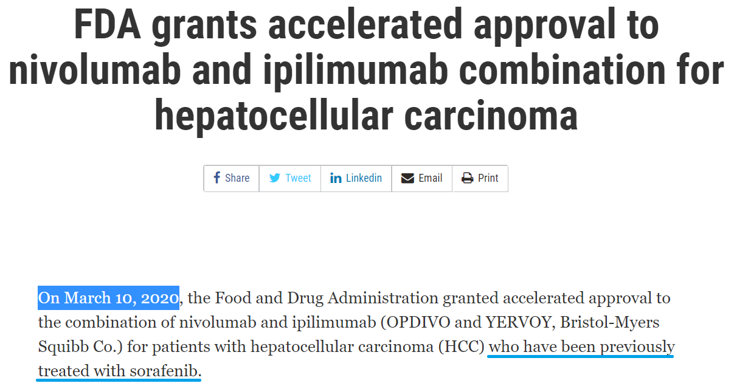
https://www.fda.gov/drugs/resources-information-approved-drugs

Slide 46
CheckMate 9DW Diseño
Fase 3 1L Nivolumab-Ipilimumab vs Sorafenib/Lenvatinib
A Randomized, Open Label, Phase 3 Study of Nivolumab in Combination With Ipilimumab Compared to Sorafenib or Lenvatinib as First-Line Treatment in Participants With Advanced Hepatocellular Carcinoma
N = 1084
Nivolumab + Ipilimumab
Study endpoints
Key eligibility criteriaª
Advanced HCC
At least one measurable lesion (RECIST 1.1)
Systemic therapy naive
Child-Pugh score 5 or 6
ECOG PS 0 or 1
Primary
OS
Secondary
Unacceptable toxicity
or
disease
progression
R
ORR
DOR
Time to symptom deterioration
Sorafenib/Lenvatinib
Start date: September 2019
Estimated study completion date: September 2023 Estimated primary completion date: September 2023 Status: Recruiting
Study sponsor: Bristol-Myers Squibb
ªClinicalTrials.gov. NCT04039607.
17
Slides are the property of the author and AASLD. Permission is required from both AASLD and the author for reuse.

Slide 47
Cabo + atezo frente a sorafenib como primera línea en CHC avanzado
N = 384
40 mg de cabozantinib una vez por día +
1200 mg de atezolizumab c/3 sem.
Estudio de fase III, aleatorizado, abierto en CHC avanzado (N = 640)
Ausencia de terapia antineoplásica sistémica previa.
Clase A de Child-Pugh.
PS de ECOG de 0 o 1.
Factores de estratificación:
Etiología de la enfermedad (VHB, VHC, otra).
Región (Asia, otra).
Presencia de MVI o EHD (sí, no).
Tratamiento hasta progresión o toxicidad inaceptable definida conforme a RECIST 1.1
Los pacientes pueden recibir tratamiento luego de la progresión
Aleatorización en proporción 6:3:1
N = 192
400 mg de sorafenib dos veces al día
N = 64
60 mg de cabozantinib por día*
https://clinicaltrials.gov/ct2/show/NCT03755791

Slide 48

Opciones actuales de tratamiento
Pembrolizumab +
Lenvatinib ?
Nivolumab + Ipilimumab ?
Atezolizumab + Cabozantinib ?
1L
Sorafenib
Lenvatinib
Atezolizumab + bevacizumab
2L
Regorafenib
Cabozantinib
Pembrolizumab*‡
Nivolumab‡
Ramucirumab
(AFP ≥400ng/mL)
Aprovados por FDA | ■ TKI | ■ Anti-PD1
Datos no presentados | ■ Anti-PDL1 + anti-VEGF | ■ Anti-VEGFR
*Negative phase III trial (KEYNOTE-240);^{1 ‡}Accelerated approval
1. Finn et al. ASCO 2019

Slide 49
El potencial de IO y la evolución de las opciones de tratamiento para pacientes con Hepatocarcinoma
CONCLUSIONES
El abordaje de los pacientes con HCC constituye un gran desafío puesto que se desarrolla mas frecuentemente en pacientes con hepatopatía previa siendo ésta una de las principales causas de muerte en estos pacientes
Un nuevo horizonte en posibilidades terapéuticas está arribando en el tratamiento de esta enfermedad.
La inmunoterapia constituye una opción de tratamiento con mejor eficacia y perfil de seguridad, en primera y segunda línea de tratamiento
La secuenciación del tratamiento en HCC parece ser la estrategia
El trabajo multidisciplinario entre hepatólogos, oncólogos, cirujanos hepáticos entrenados en TX, médicos intervencionistas, médicos especialistas en imágenes, cuidados paliativos es fundamental para ofrecer al paciente el tratamiento adecuado

Slide 50
GRACIAS

