Slide 1



Inmunoterapia en Ca de cabeza y Cuello. Progresados a Platinos
Agustín Falco
Oncología Clínica
Instituto Alexander Fleming
1506AR19PR03429-01

Slide 2

Ca de Cabeza y Cuello: Epidemiología
H&N Ca: 5% de los tumores malignos!
• Incidencia mundial: 633,000 casos/año¹
• Letalidad mundial: 355,000 muertes/año¹
> 90% Carcinoma Epidermoide
1. Ferlay J, et al. Int J Cancer 2010;127:2893–2917

Slide 3
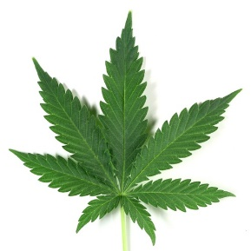
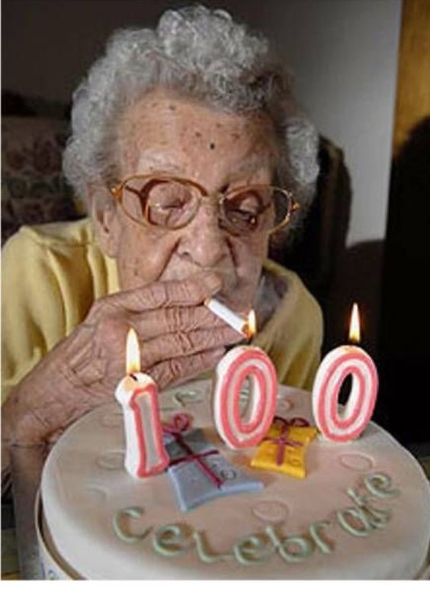
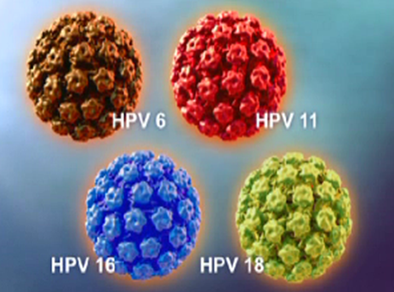

Dos enfermedades diferentes!!
E7
E6
p53 mut
pRB
p53
P 16
3p,4q,5q,8p, 13 q del
P 16

Slide 4
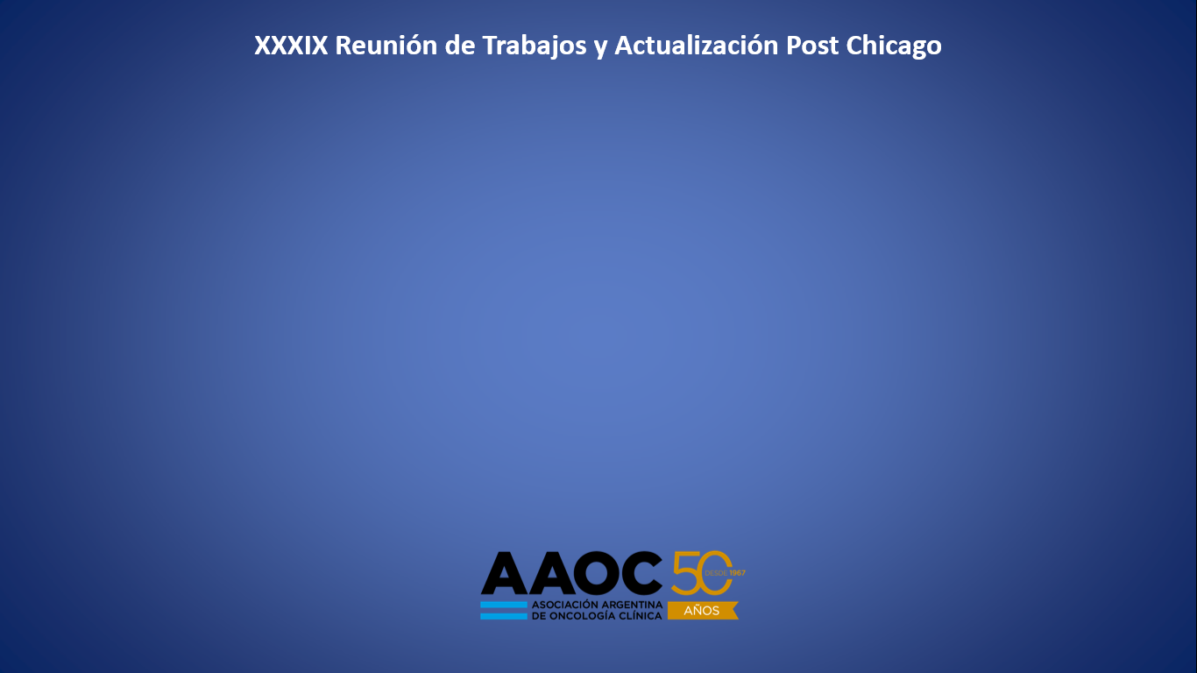
Tumores de orofaringe relacionados con el virus del papiloma humano (HPV). Experiencia institucional.
Cefarelli G*, Falco A**, Angel M**, Ostinelli A*, Coria MC*, Pombo MT**, Mandó P*, Chacón M**, Chacón R**.
(*) FUCA
(**) Servicio de Oncología Clínica. Instituto Alexander Fleming

Slide 5

Resultados:
n: 302 pts

Slide 6
RESULTADOS % (n) Ptes Orofaringe HPV +
Sexo | Femenino | 33% (15)
 | Masculino | 67% (31)
Edad mediana | 56 años | r39-81
Histología | Bien diferenciada | 13% (6 )
 | Moderadamente diferenciada | 28% (13)
 | Pobremente diferenciada | 59% (27)
Mediana de seguimiento: 18 meses
30 ptes (14%) con p16 (+) y CISH (+)
Estadificación (al diagnóstico) | Estadio I | 17% (8)
 | Estadio II | 41% (19)
 | Estadio III | 35% (16)
 | Estadio IV | 7% (3)
Tabaquismo | No tabaquistas | 35% (16)
 | Tabaquistas menor a 10 pack/year | 35% (16)
 | Tabaquistas mayor a 10 pack/year | 30% (14)
4 ptes (8%) consumía marihuana de manera habitual
70% (n32)
ganglios positivos
Notes:
El 47%, en estadio T1/2 y el
Remarcar sexo, edad mediana, histologia pobremente diferenciada, estadio II-III 76%, no tabaq o menos de 10 pack / year 70%
Como les fue a los ptes cish +??? Por n bajo aun no tenemos la rta. Pero lo estamos viendo retrospectivamente para ver como les fue.
Marihuana: inmunosupresor local?

Slide 7
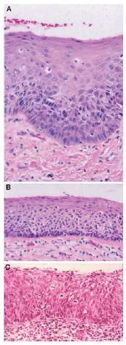
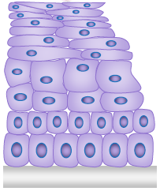
Ca de Cabeza y Cuello: Patogénesis
Tabaco, alcohol, infecciones virales…
Displasia leve
Sobrexpresión EGFR
Mutación p53
Sobreexpresión Ciclina D1
Activación de STATs
Alteración p16
Displasia moderada
“Cancerización de campo”
Displasia severa
Ca in situ
Epitelio escamoso normal
1.Park BJ, et al. Cancer Biomark 2010;9:325–339;
2. Moody CA, Laimins LA. Nature Rev Canc 2010;10:550–560;
3. Herbst RS, et al. Cancer 2002;94:1593–1611,
4. Wenig et al. Mod Pathol 2002;15(3):229–254
Notes:
>90% Sobreexpresión de EGFR

Slide 8
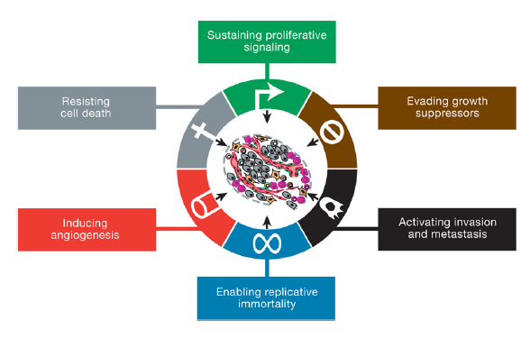


Notes:
Hallmarks of cáncer Hannahan 2000

Slide 9
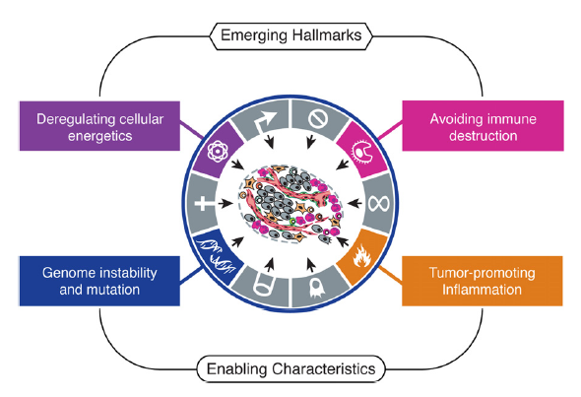
Notes:
An increasing body of research suggests that two additional hallmarks of cancer are involved in the pathogenesis of some and perhaps all cancers. One involves the capability to modify, or reprogram, cellular metabolism in order to most effectively support neoplastic proliferation. The second allows cancer cells to evade immunological destruction, in particular by T and B lymphocytes, macrophages, and natural killer cells.

Slide 10
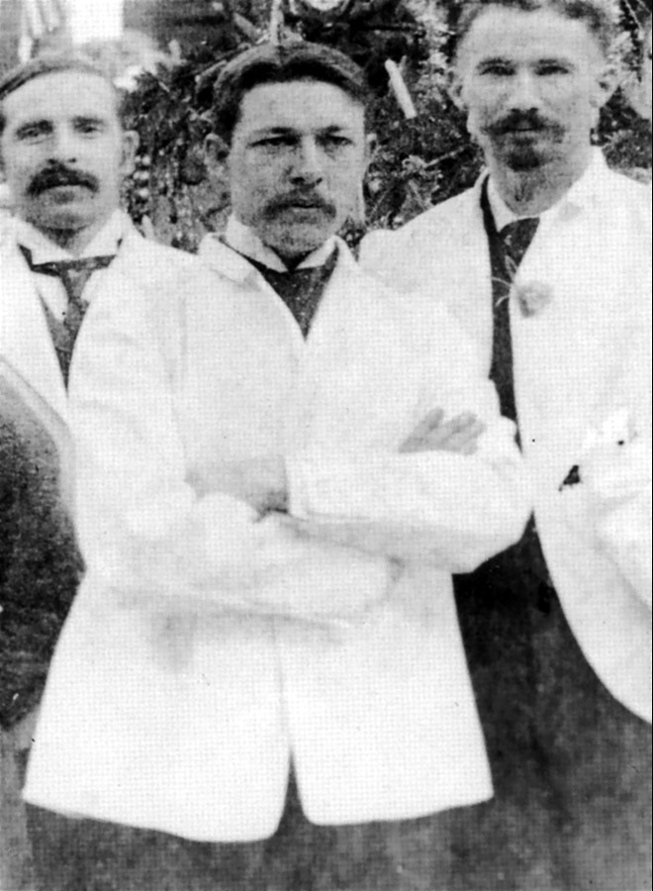
El padre de la IO?
William Coley
Cirujano MSKCC (NY)
1862-1936
“Coley’s toxin”
Notes:
En 1800: reportes anecdoticos de regresion de tumores asociados a sobreinfeccion por S Pyogenes (erisipelas). Genero un cultivo bacteriano atenuado a alta temperatura (Toxina Coley), la cual inoculaba sobre las lesiones tumorales

Slide 11
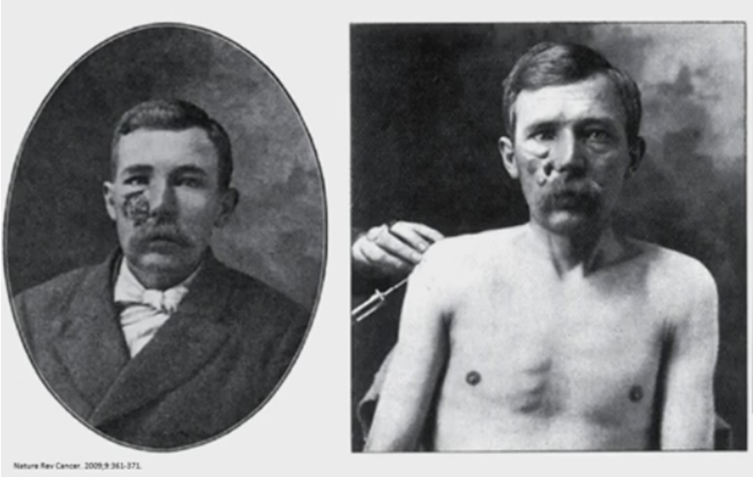
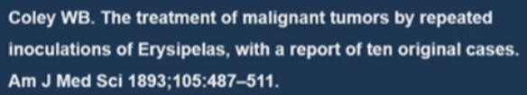

Slide 12
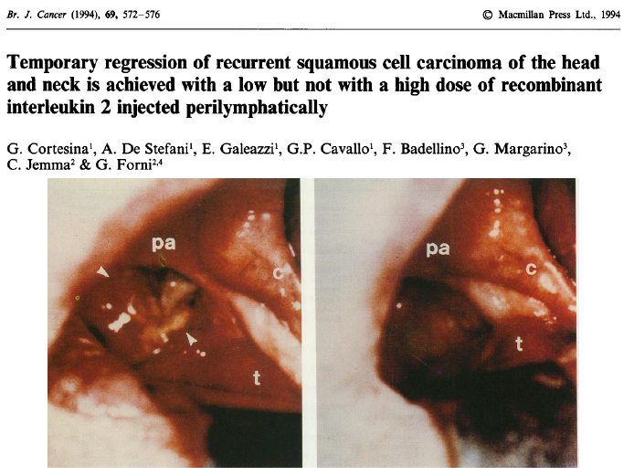
Notes:
The efficacy of ten daily injections of 500 or 500,000 U of recombinant interleukin 2 (IL-2) day-1 given 1.5 cm from the insertion of the sternocleidomastoid muscle on the mastoid was evaluated in 31 patients with recurrent head and neck squamous cell carcinoma. No toxic effects were noted. One complete response (CR) and three partial responses (PRs) were observed in the 16 patients who received 500 U of IL-2, whereas the higher dose was not effective. The CR was recorded in one of the seven patients with a oropharyngeal recurrence

Slide 13
Inmunidad y cáncer
4
TRAFICO
ACTIVACION
Linfos T
3
5
CTLA4
INFILTRACION
DEL TUMOR
2
PRESENTACION
Cel. dendríticas
6
RECONOCIMIENTO
ANTIGENOS
1
7
Destrucción
PD1-PDL1

Slide 14
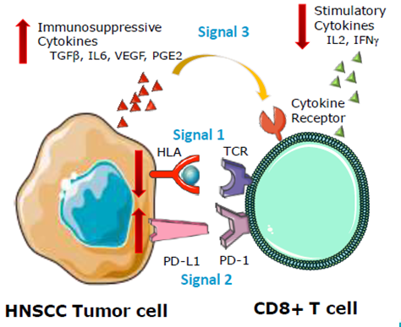
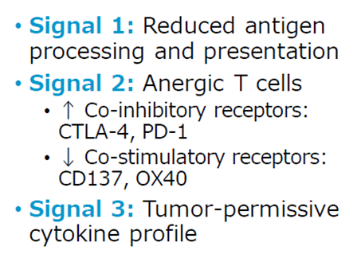
CyC = Microambiente tumoral inmunosupresivo
Adaptado de Ferris R. Inmunology and Inmunotehrapy of Head and Neck Cancer. JCO vol 33 n 29 (2015)

Slide 15
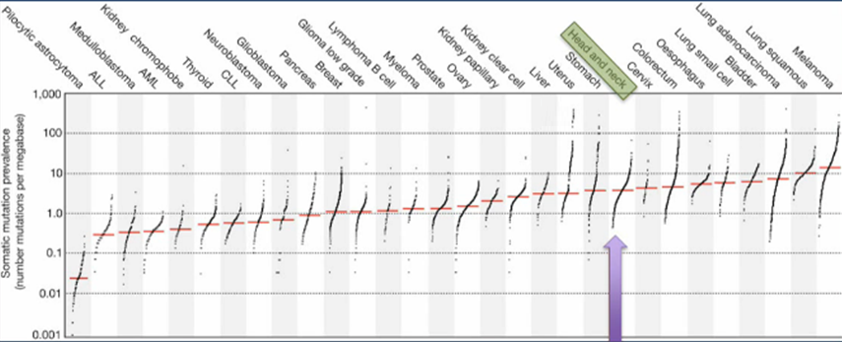
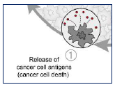

Slide 16
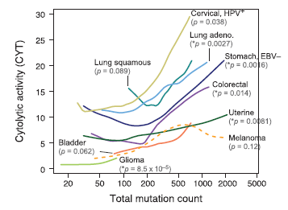
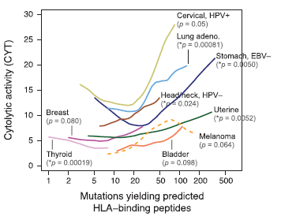
Actividad citolítica (citotóxica) vinculada a la carga mutacional
Rooney MS et al. Cell 160, 48–61, January 15, 2015
Notes:
En estos tumores se observo esta asociación
A) Carga mutacional total B) mutaciones que generan neoepitopes, o sea, peptidos capaces de generar respuesta inmune

Slide 17
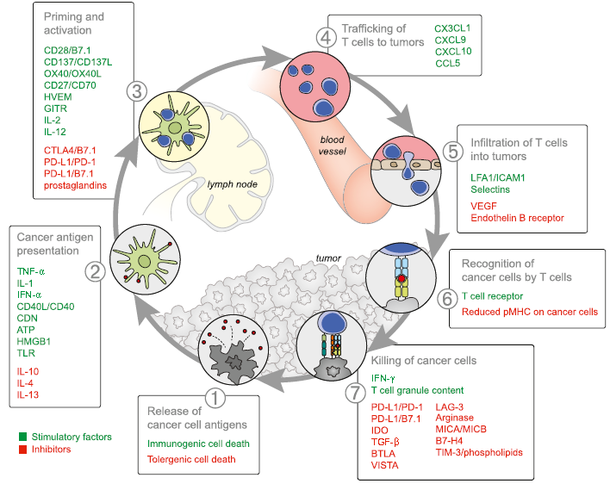
Pembrolizumab
Nivolumab
Durvalumab
Atezolizumab
Avelumab
…..

Slide 18

Historia en H&N avanzado
Nivolumab
Pembrolizumab
PD platino
Bleomicina
Cetuximab + RT
Bonner 2006
1970
1980
1990
2000
2010
2017
MTX alta dosis
Cetuximab avanzado
EXTREME 2008
1985: CDDP + 5Fu

Slide 19

Primera Línea

Slide 20
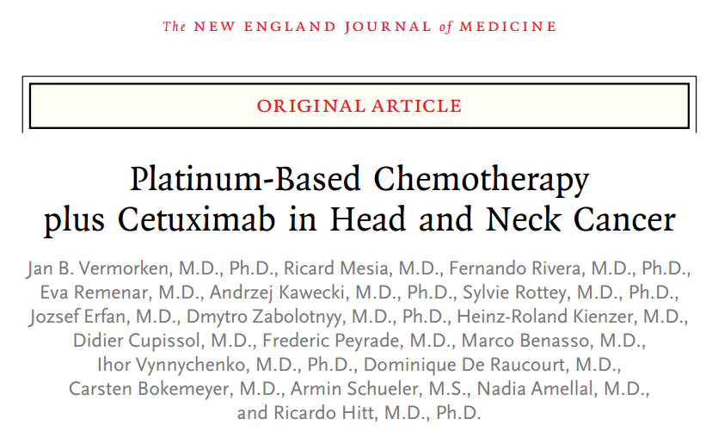
Vermorken et al: NEJM 2008;359:1116-27.

Slide 21
FIII, multicéntrico, 2004-2005, FUP 19m
CDDP 100 mg/m2 o CBDCA AUC 5 + 5FU 1g/m2 IC d1-4 c/21 d
N=442
CDDP o CBDCA+ 5FU + cetuximab semanal
SCC CyC
Mts 45% y Recurr 54%
80% < 65 a y 80% PS 0
30% OroF y 25% laringe
80% EGFR+
 | TR | SVG (m) | SLP (m) | Tox
QT | 19,5 | 7,4 | 3,3
QT + Cet | 35,6 ORR 2,33 p <0,001 | 10,1 HR 0,80 p 0,04 | 5.6 HR 0,54 p <0,001 | CitopeniasSepsis Cutánea
Vermorken et al: NEJM 2008;359:1116-27.

Slide 22
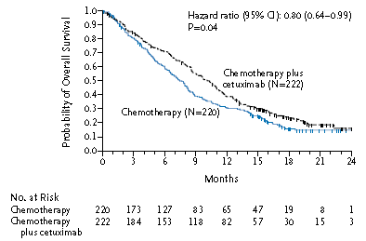

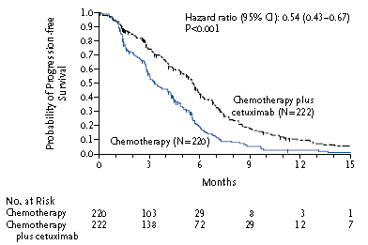
El agregado de cetuximab a la QT mejora SLP Y SVG
Notes:
cisplatin (at a dose of
100 mg per square meter of body-surface area on day 1) or carboplatin (at an area
under the curve of 5 mg per milliliter per minute, as a 1-hour intravenous infusion
on day 1) plus fluorouracil (at a dose of 1000 mg per square meter per day for 4 days)
every 3 weeks for a maximum of 6 cycles and 222 patients to receive the same chemotherapy
plus cetuximab (at a dose of 400 mg per square meter initially, as a 2-hour
intravenous infusion, then 250 mg per square meter, as a 1-hour intravenous infusion
per week) for a maximum of 6 cycles.

Slide 23
ASCO 2019

Slide 24
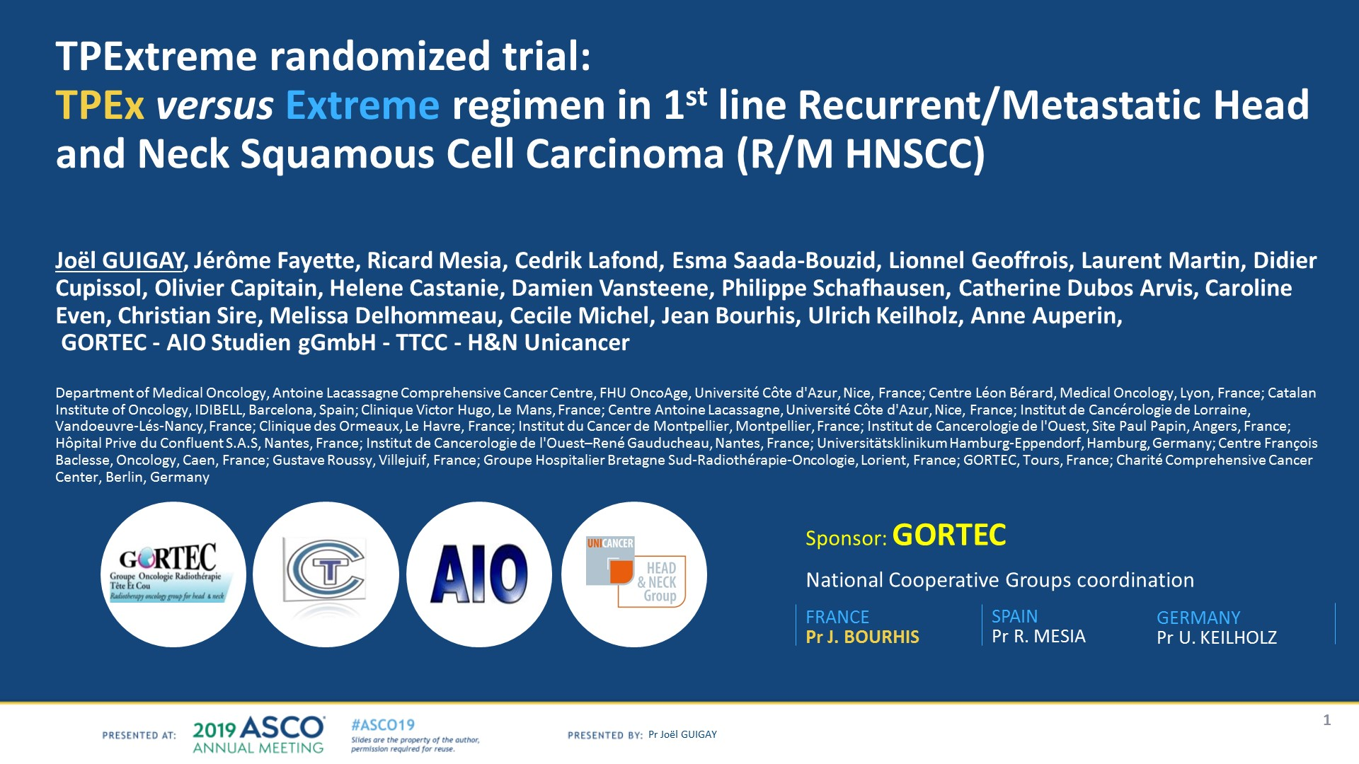
TPExtreme randomized trial:<br />TPEx versus Extreme regimen in 1st line Recurrent/Metastatic Head and Neck Squamous Cell Carcinoma (R/M HNSCC)<br /><br />Joël GUIGAY, Jérôme Fayette, Ricard Mesia, Cedrik Lafond, Esma Saada-Bouzid, Lionnel Geoffrois, Laurent Martin, Didier Cupissol, Olivier Capitain, Helene Castanie, Damien Vansteene, Philippe Schafhausen, Catherine Dubos Arvis, Caroline Even, Christian Sire, Melissa Delhommeau, Cecile Michel, Jean Bourhis, Ulrich Keilholz, Anne Auperin,<br /> GORTEC - AIO Studien gGmbH - TTCC - H&N Unicancer<br /><br />Department of Medical Oncology, Antoine Lacassagne Comprehensive Cancer Centre, FHU OncoAge, Université Côte d'Azur, Nice, France; Centre Léon Bérard, Medical Oncology, Lyon, France; Catalan Institute of Oncology, IDIBELL, Barcelona, Spain; Clinique Victor Hugo, Le Mans, France; Centre Antoine Lacassagne, Université Côte d'Azur, Nice, France; Institut de Cancérologie de Lorraine, Vandoeuvre-Lés-Nancy, France; Clinique des Ormeaux, Le Havre, France; Institut du Cancer de Montpellier, Montpellier, France; Institut de Cancerologie de l'Ouest, Site Paul Papin, Angers, France; Hôpital Prive du Confluent S.A.S, Nantes, France; Institut de Cancerologie de l'Ouest–René Gauducheau, Nantes, France; Universitätsklinikum Hamburg-Eppendorf, Hamburg, Germany; Centre François Baclesse, Oncology, Caen, France; Gustave Roussy, Villejuif, France; Groupe Hospitalier Bretagne Sud-Radiothérapie-Oncologie, Lorient, France; GORTEC, Tours, France; Charité Comprehensive Cancer Center, Berlin, Germany
Indicación sin aprobación regulatoria en Argentina
Presented By Joel Guigay at 2019 ASCO Annual Meeting

Slide 25
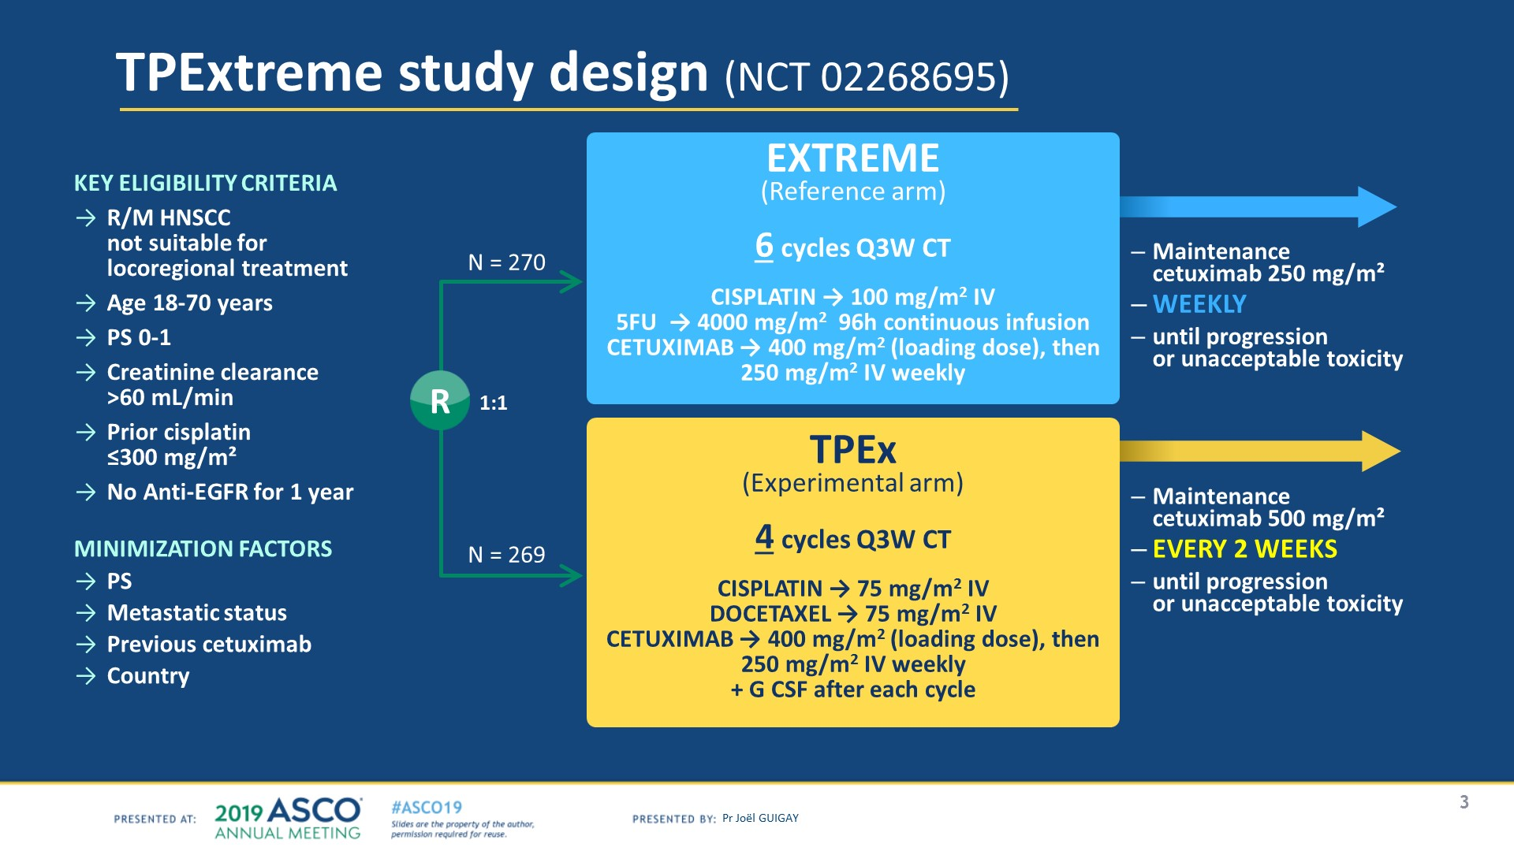
TPExtreme study design (NCT 02268695)
Indicación sin aprobación regulatoria en Argentina
Presented By Joel Guigay at 2019 ASCO Annual Meeting

Slide 26
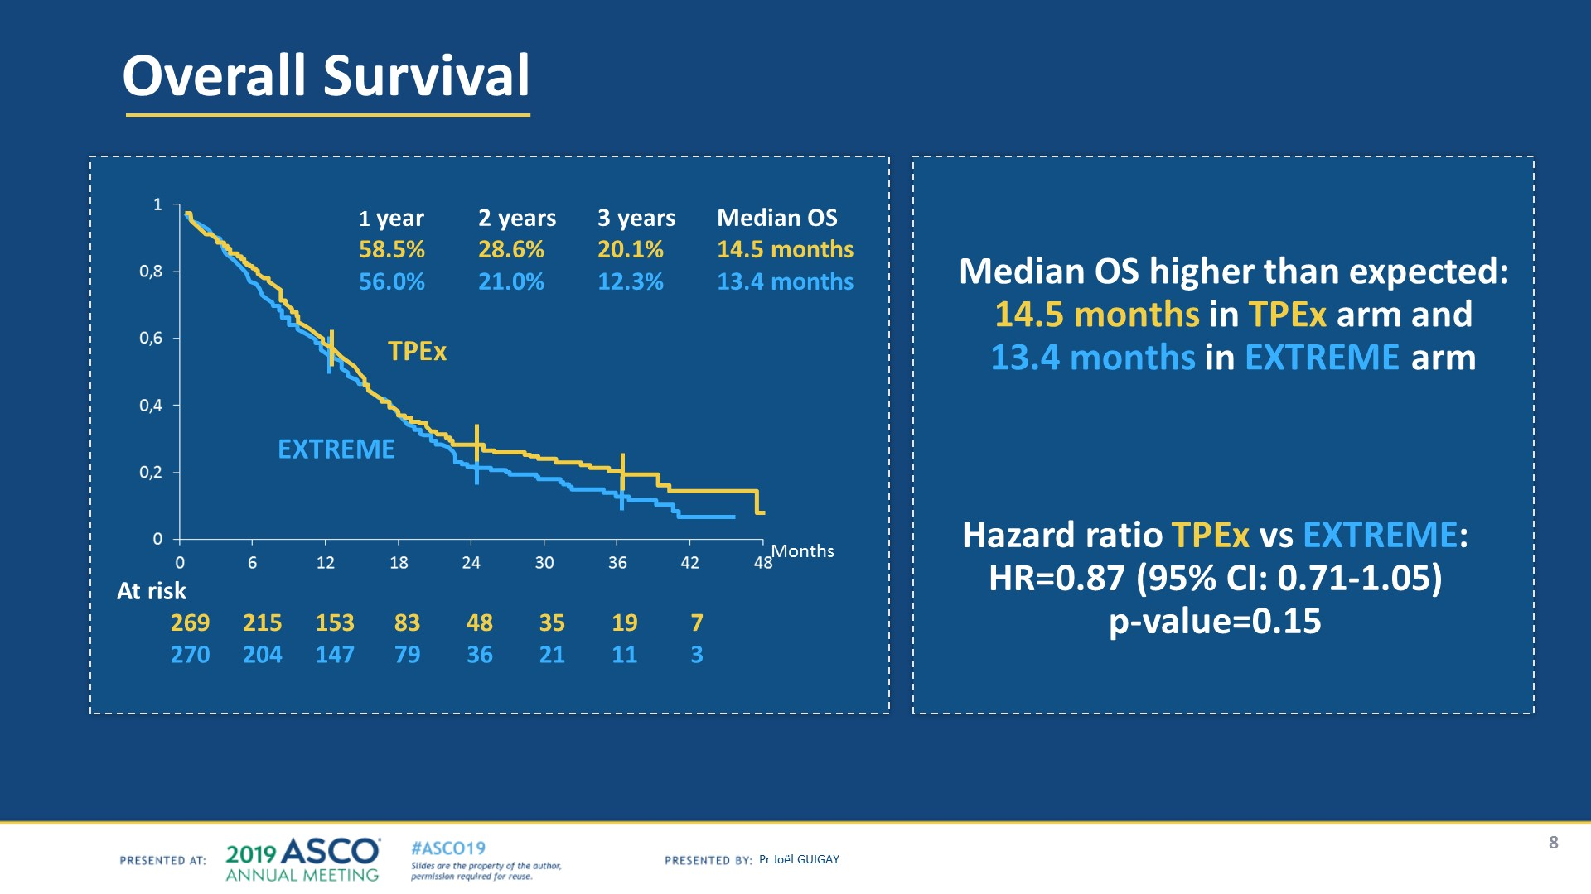
Overall Survival
Indicación sin aprobación regulatoria en Argentina
Presented By Joel Guigay at 2019 ASCO Annual Meeting

Slide 27
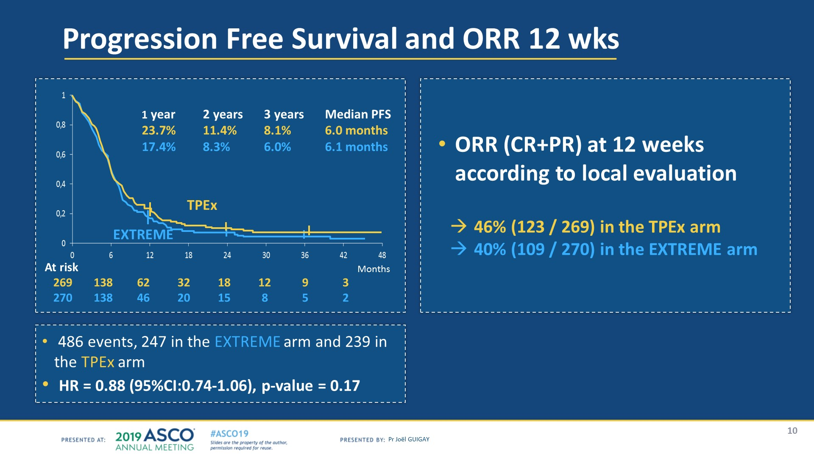
Progression Free Survival and ORR 12 wks
Indicación sin aprobación regulatoria en Argentina
Presented By Joel Guigay at 2019 ASCO Annual Meeting

Slide 28
Segunda Línea

Slide 29
Nivolumab

Slide 30
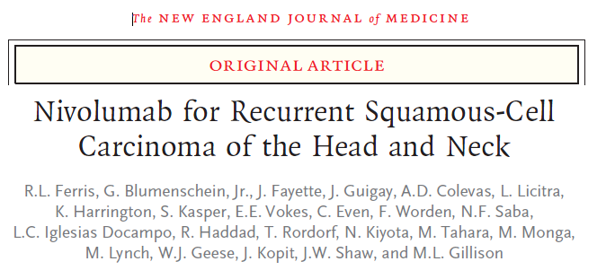

Slide 31
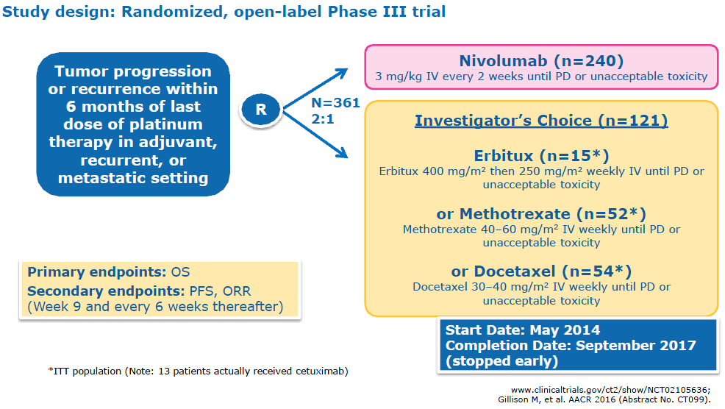
Ferris et al. ASCO Annual Meeting 2016

Slide 32
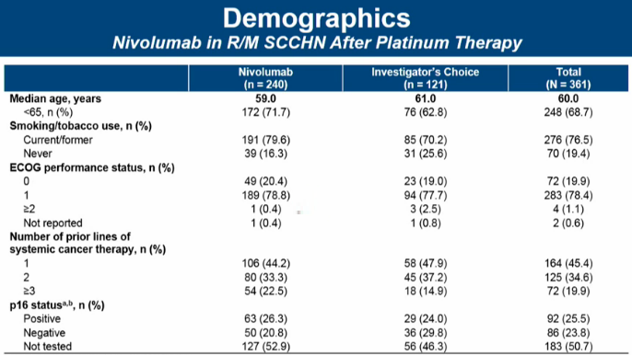
Ferris et al. ASCO Annual Meeting 2016

Slide 33
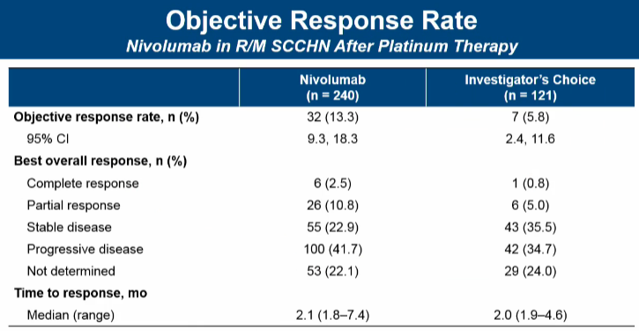
Ferris et al. ASCO Annual Meeting 2016

Slide 34
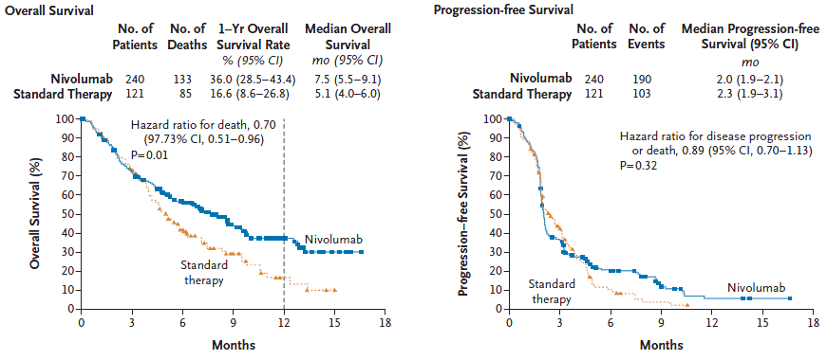

Slide 35
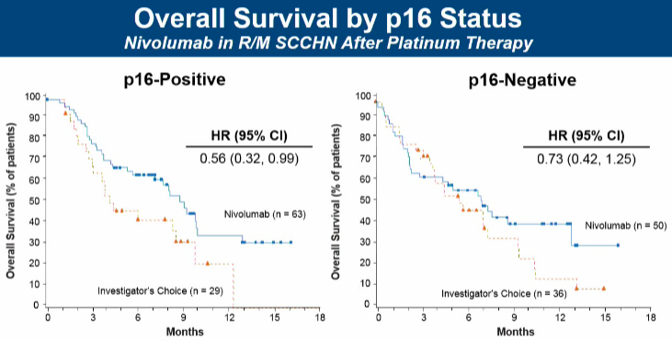
Ferris et al. ASCO Annual Meeting 2016

Slide 36
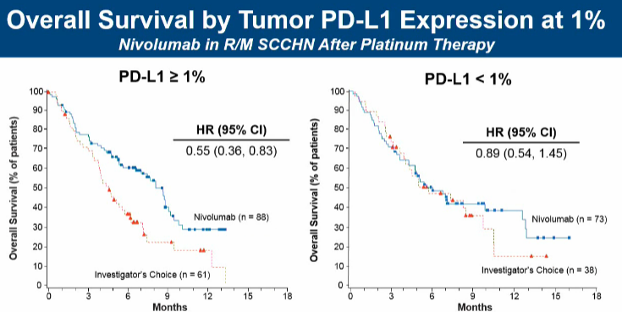
Ferris et al. ASCO Annual Meeting 2016
Notes:
PD-L1 status was determined using the Dako PD-L1 IHC 28-8 pharmDx test

Slide 37
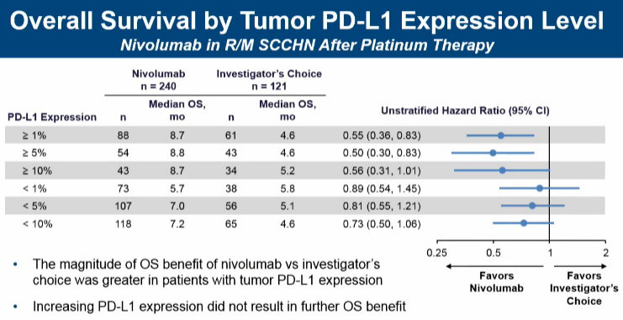
Ferris et al. ASCO Annual Meeting 2016

Slide 38
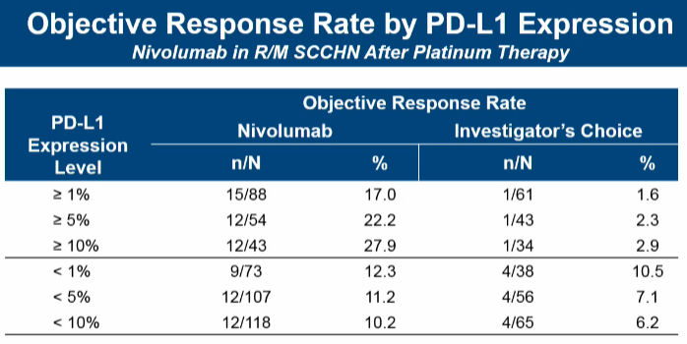
Ferris et al. ASCO Annual Meeting 2016

Slide 39
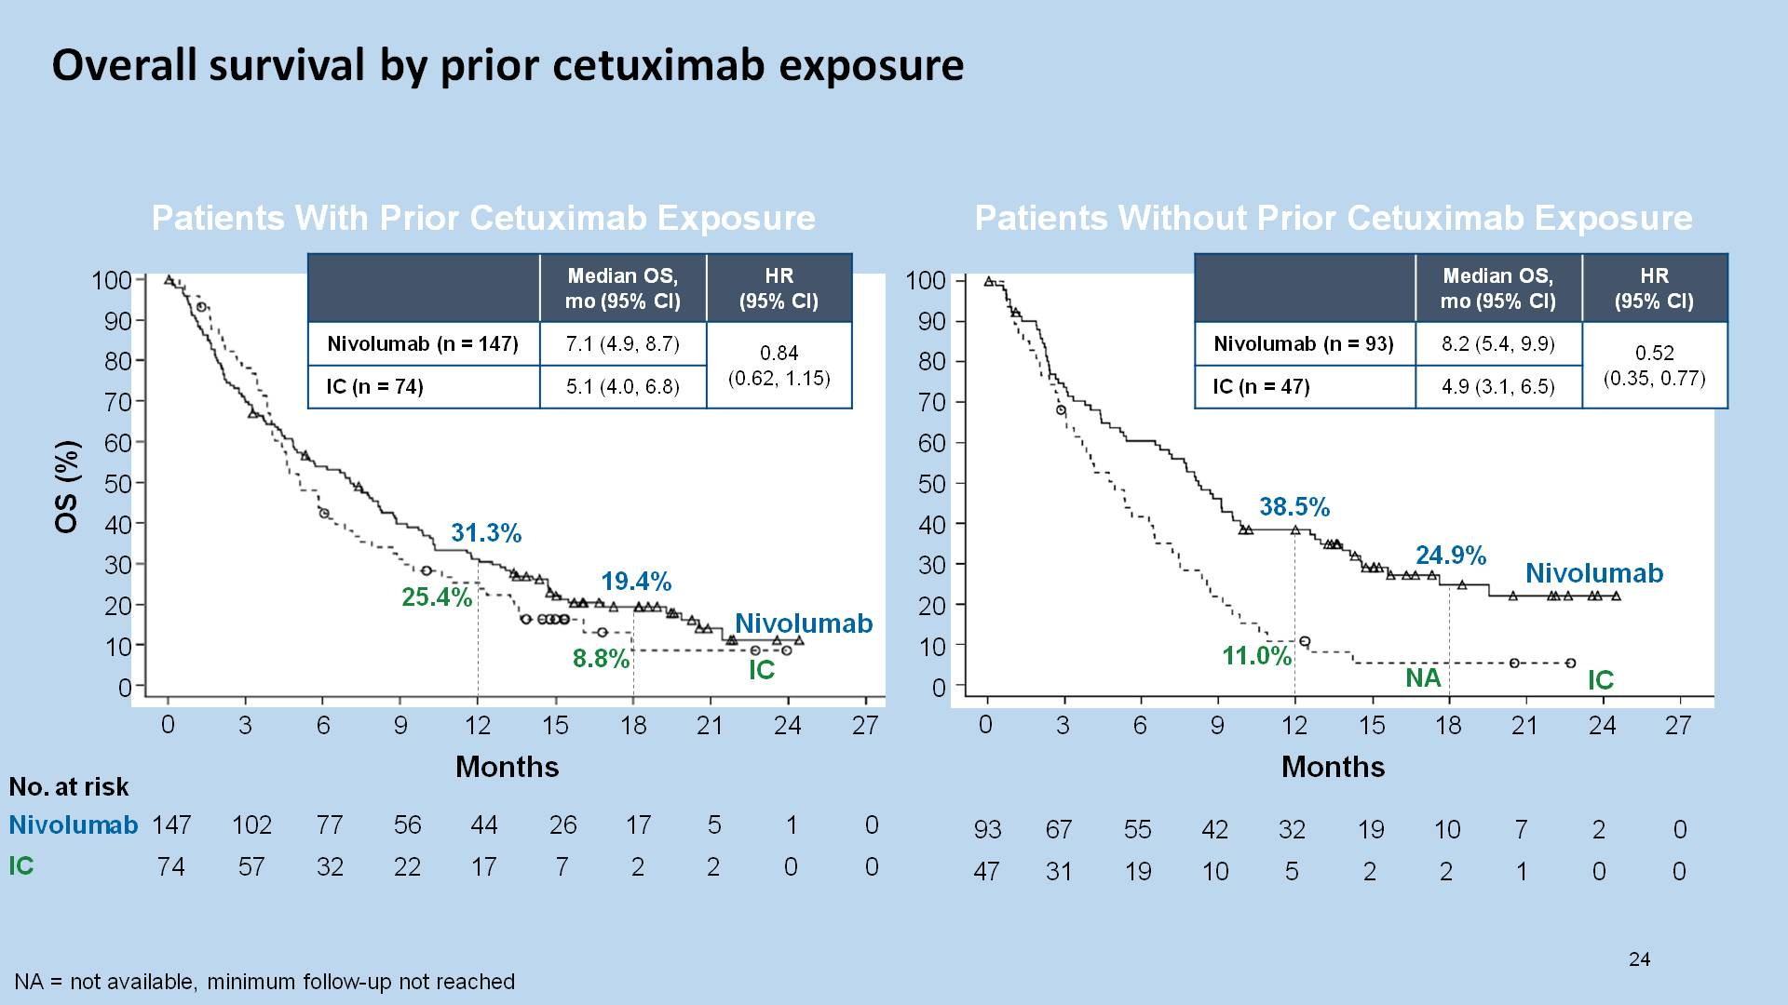

Slide 40
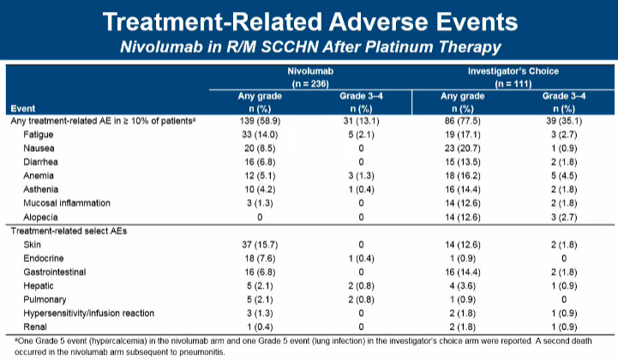
Ferris et al. ASCO Annual Meeting 2016

Slide 41
Nivolumab vs investigator’s choice in recurrent or metastatic squamous cell carcinoma of the head and neck: 2-yr outcomes in the overall population and
PD-L1 subgroups of CheckMate 141
Robert L. Ferris,¹ George Blumenschein Jr,² Jerome Fayette,³ Joel Guigay,⁴ A. Dimitrios Colevas,⁵ Lisa Licitra,⁶ Kevin J. Harrington,⁷ Stefan Kasper,⁸ Everett E. Vokes,⁹ Caroline Even,¹⁰ Francis Worden,¹¹ Nabil F. Saba,¹² Lara Carmen Iglesias Docampo,¹³ Robert Haddad,¹⁴ Tamara Rordorf,¹⁵ Naomi Kiyota,¹⁶ Makoto Tahara,¹⁷ Mark Lynch,¹⁸ Vijayvel Jayaprakash,¹⁸ Li Li,¹⁸ Maura L. Gillison²
¹University of Pittsburgh Medical Center Hillman Cancer Center, Pittsburgh, PA, USA; ²MD Anderson Cancer Center, Houston, TX, USA; ³Centre Leon Berard, Lyon, France; ⁴Centre Antoine Lacassagne, FHU OncoAge, Université Côte d'Azur, Nice, France; ⁵Stanford University, Stanford, CA, USA; ⁶Fondazione IRCCS Istituto Nazionale dei Tumori and University of Milan, Milan, Italy; ⁷Royal Marsden NHS Foundation Trust/The Institute of Cancer Research, London, UK; ⁸West German Cancer Center, University Hospital, Essen, Germany; ⁹University of Chicago Medical Center, Chicago, IL, USA; ¹⁰Gustave Roussy, Villejuif Cedex, France; ¹¹University of Michigan, Ann Arbor, MI, USA; ¹²Winship Cancer Institute of Emory University, Atlanta, GA, USA; ¹³Hospital Universitario 12 de Octubre, Madrid, Spain; ¹⁴Dana-Farber/Harvard Cancer Center, Boston, MA, USA; ¹⁵Universitätsspital Zurich, Zurich, Switzerland; ¹⁶Kobe University Hospital, Kobe, Japan; ¹⁷National Cancer Center Hospital East, Kashiwa, Japan; ¹⁸Bristol-Myers Squibb, Princeton, NJ, USA

Slide 42
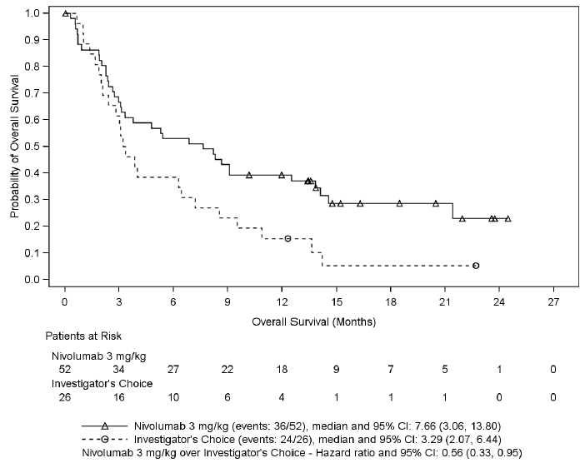
Sustained OS Benefit in the Overall (ITT) Population
Nivolumab reduced the risk of death by 32% vs IC
The 24-month OS rate was nearly tripled with nivolumab compared with IC
100
 | Median OS (95% CI), mo | HR (95% CI)
Nivo | 7.7 (5.7, 8.8) | 0.68 (0.54, 0.86)
IC | 5.1 (4.0, 6.2)
90
80
70
60
OS (%)
50
40
30
22.2%
20
16.9%
11.7%
Nivo
10
2.3%
IC
0
8.6%
6.0%
0
3
6
9
12
15
18
21
24
27
30
33
36
39
No. at risk
Months
Nivo
240
169
132
98
78
57
50
42
37
28
15
10
4
0
IC
121
88
51
32
23
14
10
8
7
4
1
1
0
0
Symbols represent censored observations. ITT = intent-to-treat; Nivo, nivolumab

Slide 43
OS in PD-L1 Non-Expressors (<1%)
In PD-L1 non-expressors, the HR for risk of death with nivolumab vs IC consistently trended lower with longer follow-up
Primary Analysisª
(Dec 2015 data cutoff)
1-Year Follow-up
(Sept 2016 data cutoff)
2-Year Follow-up
(Sept 2017 data cutoff)
100
 | Median OS, mo (95% CI) | HR (95% CI)
Nivo | 5.7 (4.4, 12.7) | 0.89 (0.54, 1.45)
IC | 5.8 (4.0, 9.8)
 | Median OS, mo (95% CI) | HR (95% CI)
Nivo | 6.1 (4.4, 10.3) | 0.83 (0.54, 1.29)
IC | 5.5 (3.7, 8.5)
 | Median OS (95% CI), mo | HR (95% CI)
Nivo | 6.5 (4.4, 11.7) | 0.73 (0.49, 1.09)
IC | 5.5 (3.7, 8.5)
100
100
90
90
90
80
80
80
70
70
70
60
60
60
50
OS (%)
OS (%)
OS (%)
50
50
40
40
40
30
Nivo
30
30
20
20
Nivo
20
IC
10
IC
Nivo
10
10
0
0
0
IC
0
3
6
9
12
15
18
0
3
6
9
12
15
18
21
24
27
0
3
6
9
12
15
18
21
24
27
30
33
36
39
No. at risk
Months
Months
Months
Nivo
73
52
33
17
8
3
0
73
52
37
30
27
13
8
3
1
0
76
54
39
32
29
20
19
17
15
11
5
4
3
0
IC
38
29
14
6
2
0
0
38
29
18
13
10
5
2
2
0
0
40
30
19
14
10
7
5
4
4
1
0
0
0
0
Symbols represent censored observations; ªFrom NEJM, Ferris RL et al., Nivolumab for Recurrent Squamous-Cell Carcinoma of the Head and Neck, 375, 1856-67, Copyright © 2016 Massachusetts Medical Society. Reprinted with permission from Massachusetts Medical Society.

Slide 44
Tumor Response
In the nivolumab arm, complete responses were observed in both PD-L1 expressors and PD-L1 non-expressors
  Seven complete responders (2 PD-L1 expressors, 2 PD-L1 non-expressors, and 3 with no data on tumor PD-L1 expression)
  One patient had a partial response, which later converted to a complete response
 | Nivolumab (n = 240) | IC (n = 121)
ORR, % (95% CI) | 13.3 (9.3, 18.3) | 5.8 (2.4, 11.6)
Time to response, median (range), months | 2.1 (1.8 to 7.4) | 2.0 (1.9 to 4.6)
Duration of response, median (range), months | 9.7 (2.8 to 32.8+) | 4.0 (1.5+ to 11.3)

Slide 45
Treatment-Related Adverse Events
The safety profile of nivolumab remained consistent with previous analyses,^{1,2} and manageable
  Fewer grade 3–4 events in the nivolumab arm vs the IC arm
  No new safety signals were reported
The incidence of serious TRAEs was lower in the nivolumab arm (7.2%) vs the IC arm (15.3%)
Rates of death due to drug toxicity remained unchanged from the primary analysis¹
 | Nivolumab (n = 236) |  | IC (n = 111)
 | Any grade | Grade 3–4 | Any grade | Grade 3–4
Any TRAE, n (%) | 146 (61.9) | 36 (15.3) | 88 (79.3) | 41 (36.9)
TRAEs in ≥15% of patients, n (%) Fatigue Nausea Anemia Asthenia | 37 (15.7) 22 (9.3) 12 (5.1) 10 (4.2) | 5 (2.1) 0 3 (1.3) 1 (0.4) | 20 (18.0) 23 (20.7) 19 (17.1) 17 (15.3) | 3 (2.7) 1 (0.9) 6 (5.4) 2 (1.8)
Ferris RL, et al. N Engl J Med 2016;375:1856–1867. 2. Gillison ML, et al. The Oncologist 2018; In Press.
TRAE = treatment-related adverse event

Slide 46
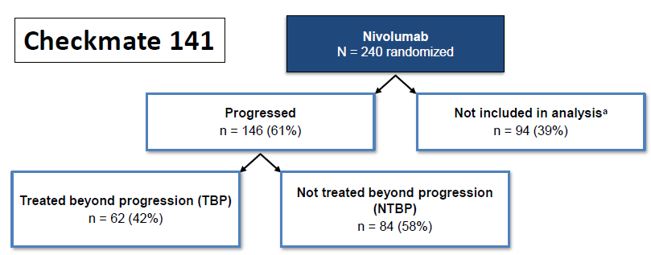

Tratamiento luego de progresión
Haddad et al. ESMO 2017 Poster #10430

Slide 47
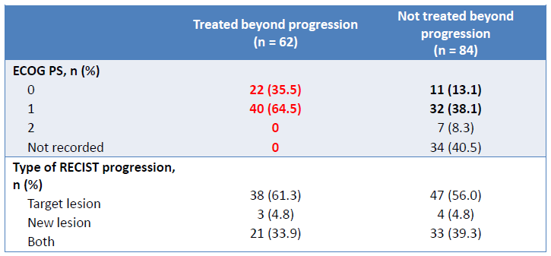
Haddad et al. ESMO 2017 Poster #10430

Slide 48
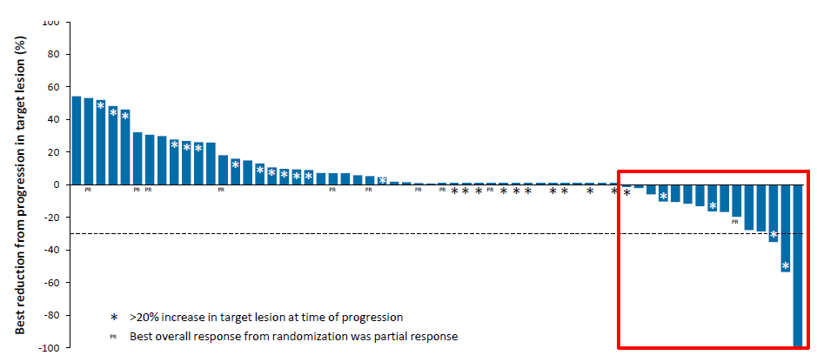

Haddad et al. ESMO 2017 Poster #10430

Slide 49
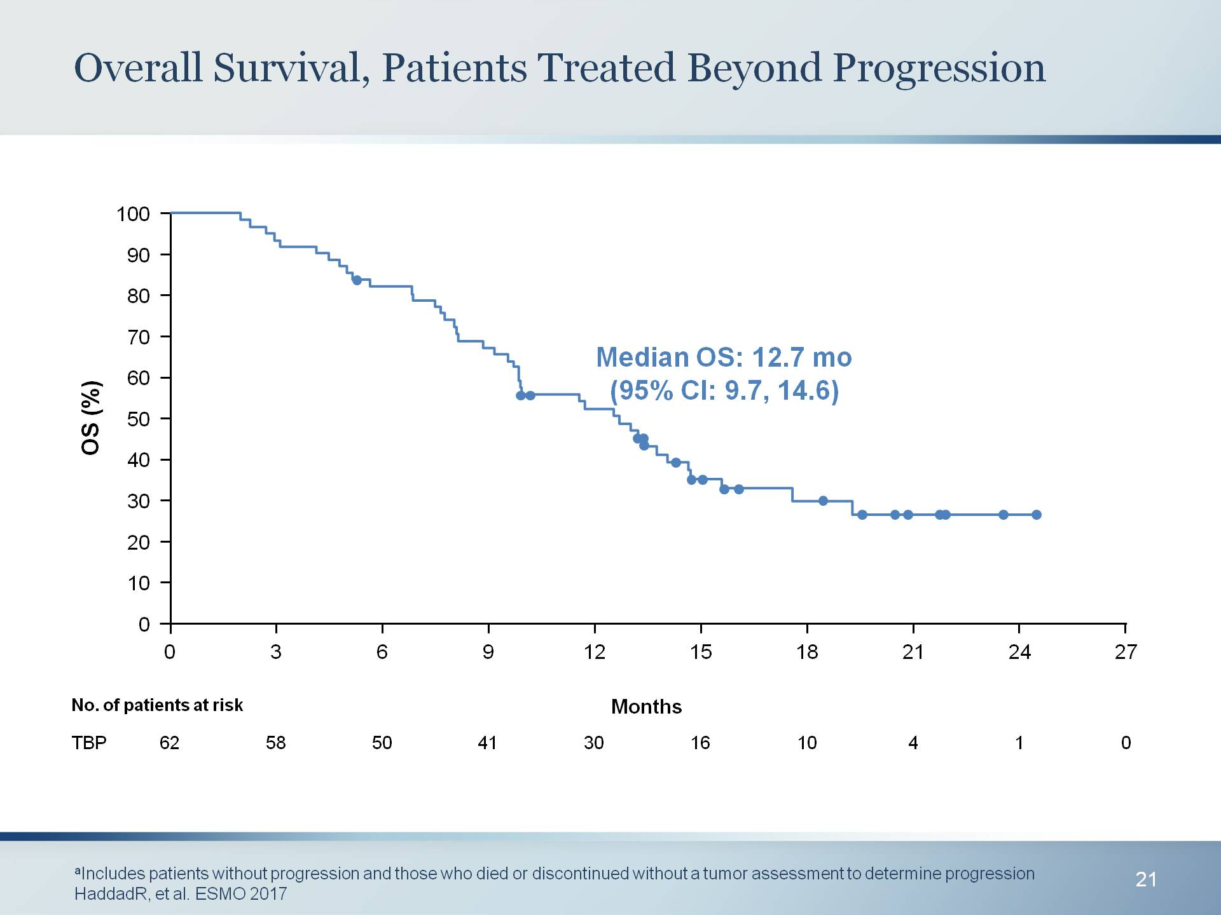
Overall Survival, Patients Treated Beyond Progression
Presented By Robert Ferris at 2018 ASCO Annual Meeting

Slide 50
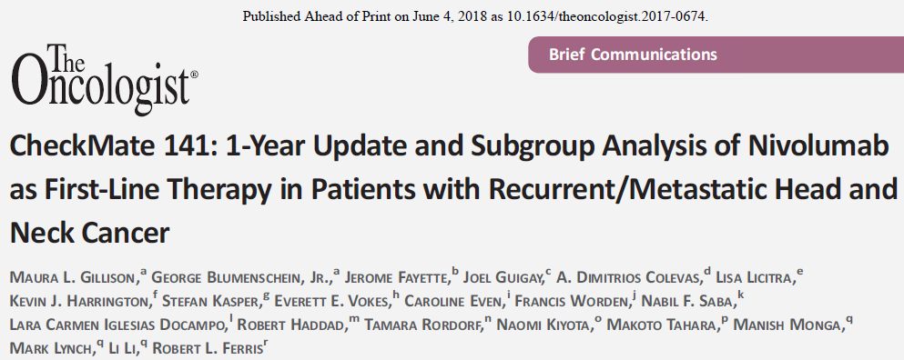
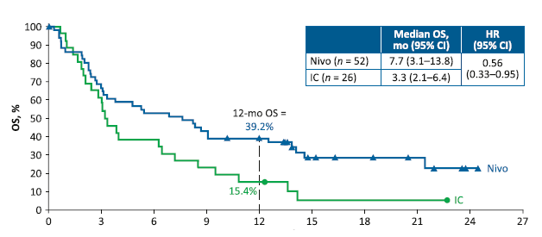
N 76 Platino refractarios
Fup md 11 meses

Slide 51
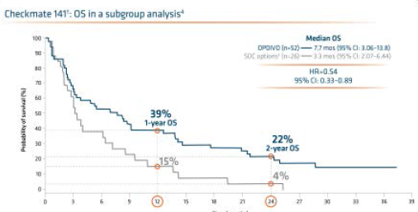
2-Year update – Subgroup analysis of OPDIVO of Nivolumab as First Line Therapy
2. Ferris RL, Blumenschein G Jr, Fayette J et al. Nivolumab vs investigator's choice in recurrent or metastatic squamous cell carcinoma of the head and neck: 2-year long-term survival update of CheckMate 141 with analyses by tumor PD-L1 expression. Oral Oncol. 2018;81:45-51.

Slide 52
Pembrolizumab

Slide 53
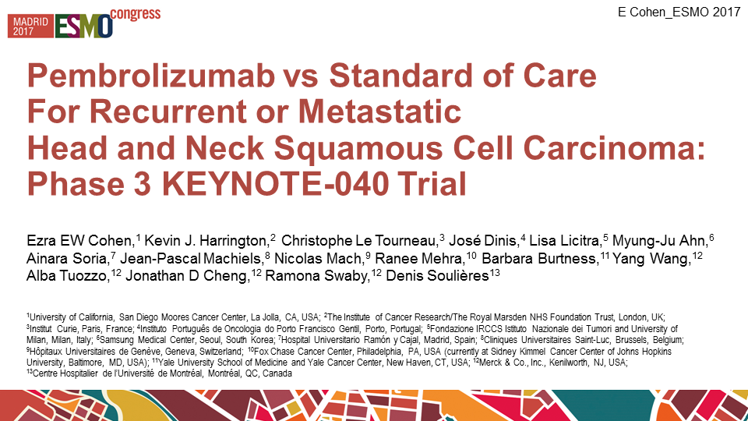

Slide 54
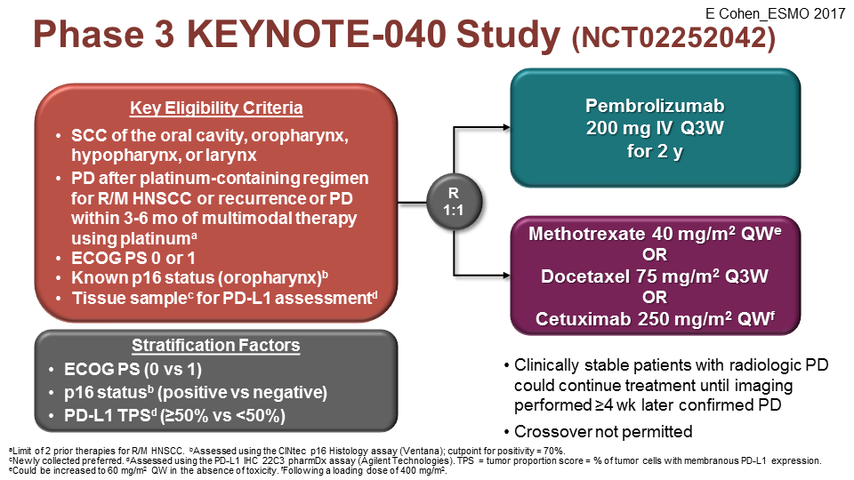

Slide 55
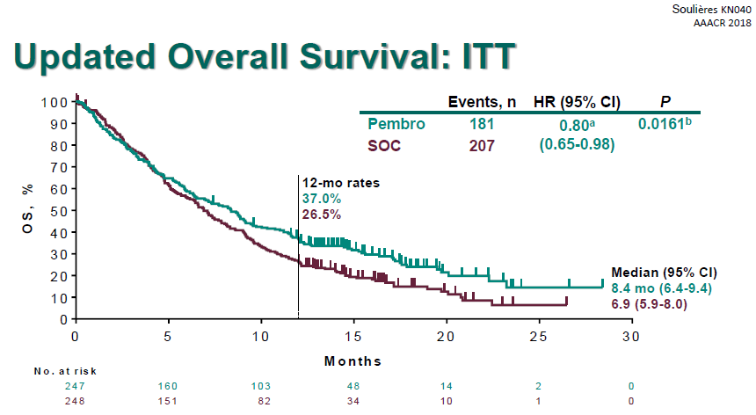

Slide 56
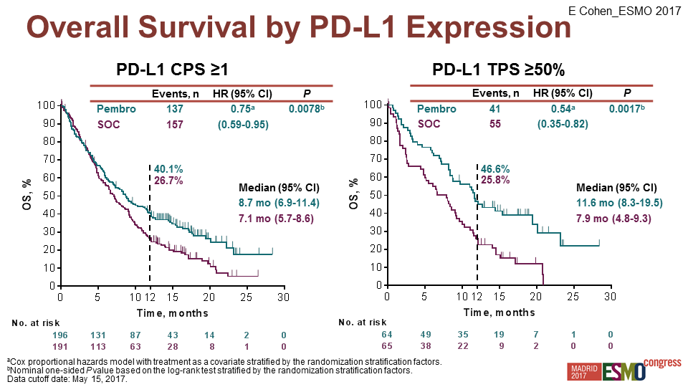

Slide 57
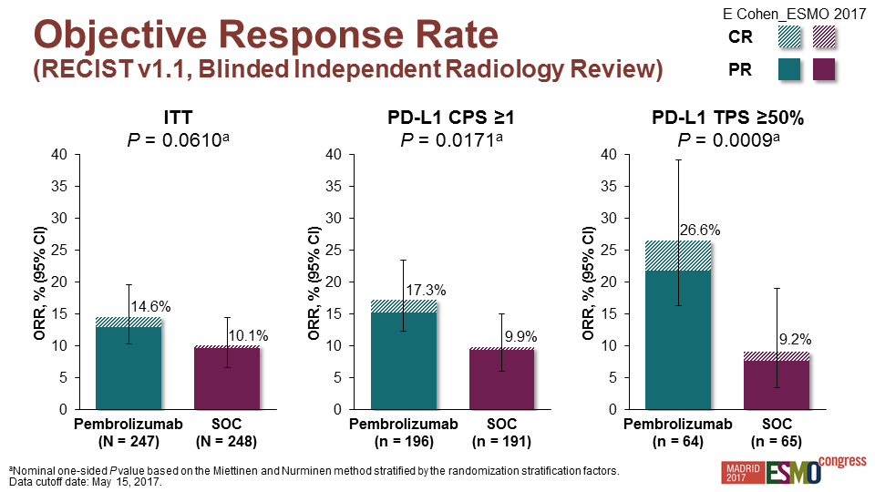

Slide 58


Slide 59
Experiencia Local

Slide 60



N 40 fup 12 meses
32%

Slide 61



BJSTR DOI: 10.26717/BJSTR.2019.17.002983

Slide 62
Como mejorar los resultados?
Nuevas combinaciones.

Slide 63

Melanoma Model: Overall Survival with I-O
Presented By Marc Ernstoff at 2017 ASCO Annual Meeting

Slide 64




Es la IO monoterapia la mejor opción?

Slide 65




Frío
Caliente

Slide 66

Básica: Beneficio de concurrencia…

Slide 67

Gillison et al. Presented at the Multidisciplinary Head and Neck Cancers Symposium. Scottsdale. Arizona. February 15-18, 2018.

Slide 68

n 10
n 10
Gillison et al. Presented at the Multidisciplinary Head and Neck Cancers Symposium. Scottsdale. Arizona. February 15-18, 2018.

Slide 69


Gillison et al. Presented at the Multidisciplinary Head and Neck Cancers Symposium. Scottsdale. Arizona. February 15-18, 2018.

Slide 70

Conclusiones
IO (anti PD1):
Actividad en H&N: HPV(+); HPV(-)
Aumento SVG
TRG 15-20% Población pretratada/monoterapia 1raL
TRG 36% Población seleccionada/combinada QT
PDL1 rol biomarcador 1ra línea
Excelente tolerancia
Futuro: Combinar!: RT, QT, IO+IO, IO+ITK….
Respuestas prolongadas!

Slide 71
Conclusiones H&N
2da línea: 1 Inmunoterapia (SoC)
Nivolumab/Pembrolizumab
2 Ensayo clínico
3 Taxanos
Inmunoterapia:
2da línea
PD dentro de los 6 meses QT/RT

Slide 72
Muchas gracias!
agustinhfalco@yahoo.com.ar

